Slide 1

Memento mori: Why talking about death is good for business
Nick Bird
Triple Point

Slide 2
Memento Mori -
What we can learn from the Romans when Estate Planning
November 2025

Slide 3


Slide 4

This presentation is for professional advisers only and not to be shared with retail clients.
Important information
Presenter
The investments discussed in the presentation are considered to be a high-risk investment by the Financial Conduct Authority and may not be suitable for all investors.
Triple Point does not provide investment or tax advice and information in this presentation should not be construed as such. Potential investors should speak to a financial adviser.
As with all investments, our products place capital at risk. Investors may not get back the full amount invested and interest is not guaranteed. Past performance is not a guide to future performance. Investments in unquoted shares carry a higher risk than investments in quoted shares and are illiquid. Tax treatment will depend on a client’s individual circumstances and may be subject to change in the future.
Prospective investors should carefully read the terms and risk factors set out in the corresponding Information Memorandum and Investor Agreements.
This financial promotion has been issued by Triple Point Administration LLP, which is authorised and regulated by the Financial Conduct Authority under firm reference number 618187.
Nick Bird
Regional Director, London

Slide 5
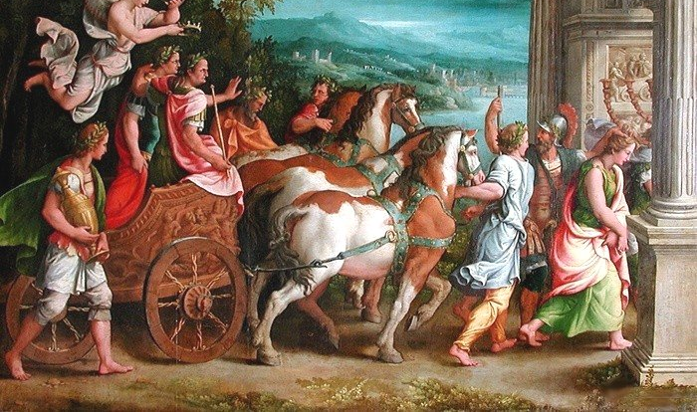

Slide 6
Learning Objectives
How to find more clients to help with estate planning
How to engage those clients and make money meaningful
How to plan with those clients
How to use Business Relief to meet clients planning goals

Slide 7
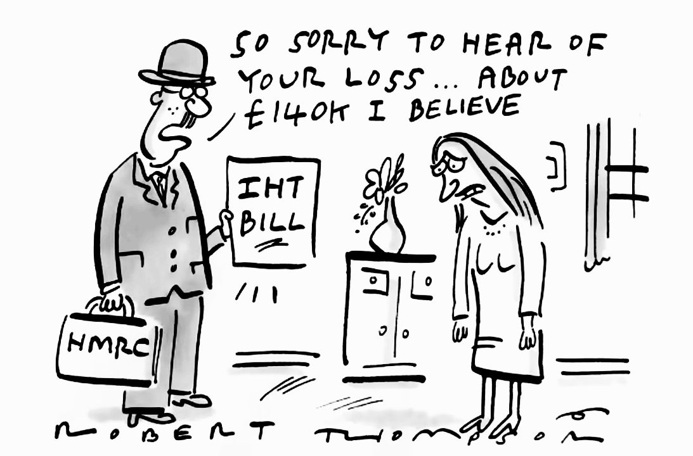

Slide 8

In the next 20 years over £5.5 trillion is set to pass down the generations.
Notes:
You will have heard of this concept.
Eye watering amounts of money being given up by the baby boomers.
You’d like to think that those inheriting this wealth will be benefiting from financial advice but let’s not take that for granted…
…in the next 20 years, over 5.5 trillion pounds is set to pass down the generations. That’s a massive figure!
To put it into perspective, 1 trillion seconds is over 31 thousand years
Meaning 5.5 trillion seconds is just shy of 175 thousand years

Slide 9



Tax planning
The raise from income tax, capital gains tax and inheritance tax is expected to increase¹
Nearly 153,000 estates could face new or increased inheritance tax liability by 2030²
Tax at the highest rate since 1949
Can you spot a trend?
2009
2014
2021
2023
2025/2026 forecast³
£2.3 bn
£3.7 bn
£5.9 bn
£7.1 bn
£9.1 bn
Notes:
Has your client’s situation changed.
Last time the NRB threshold increased was in 2009
2009 2.3bn
If it had increased with inflation it would be about £700k. But it didn’t
19% of estates with a tax liability are from estates valued at less than a million – interesting as some people feel there is a £1m allowance. which emphasizes that you do not have to have super wealthy clients for them to have an issue
https://www.gov.uk/government/statistics/inheritance-tax-statistics-commentary/inheritance-tax-statistics-commentary
These figures are already out of date - £4.1bn in the last 6 months of 2023.

Slide 10
Reasons why investors don’t start IHT Planning
According to the Kings Court Trust, £5.5 trillion will move hands in the United Kingdom between now and 2055
Notes:
Given all this wealth changing hands, we took a deeper look into why investors don’t start IHT planning – and ultimately what you as advisers are up against.
The number one reason for why clients don’t start IHT planning was around concerns about losing access and control of capital.
Secondly, is inertia. Which I am sure, all of you have encountered with clients at one time or another – the inability to make a decision of any kind.
Thirdly and Fourth is the fact clients don’t really appreciate the size of their estate and they think they do not have a problem – but given the tax freeze, more and more people are being caught.
The fifth is a strange one - it is the belief someone else will pay for things…
And Lastly, which is slightly comical - its just generally disliking their family or beneficiaries, so are not bothered about whats left.
Anyway, lets look at the bulk of the set and the first two and see what may be the solution

Slide 11

What does it mean for financial advisers
Percentage of intergenerational wealth lost
Lost greater than 50% of AUM
>25%
No client
relationship
Lost less than 20% of AUM
Lost greater than 20% of AUM
Notes:
Because a lot of the advisers who have been providing on this wealth cease to do so when it is inherited.
15% of advisers losing over half their assets on death of their clients – because of a lack of engagement with the beneficiaries – with the clients’ children. Nearl half losing over 20% of assets. You don’t need me to tell you how this affects your business, revenue, profit, value of the business. Is this something you care about? I’m guessing it is.
Este planning allows you to engage with the family and demonstrate the value of financial planning.
Kings Court Trust found that IFAs are losing a significant share of assets under management after a client dies.
15% of practices lost more than 50%
34% reported losing 20% or more.
Over 25% felt a lack of client relationship was the biggest reason they did not retain assets.
If you don’t build a relationship with the next generation, you may risk losing out in the long run

Slide 12

Grow your business one tree at a time
The Family Tree
Mum
Dad
Mother-in-Law
Father-in-Law
YOU
Spouse
Daughter
Son
HMRC
Notes:
Although your clients might not have an issue, what about their parents? Are they likely to inherit money?
Best practice – get to know the family to fully understand the planning needs of your client.
LPA/Attorney.
Good Financial Planning is about the bigger picture.
Recall the KCT figures – 5.5mn of wealth due to change hands and yet much of that money will be lost by the existing advisor. You have a chance to become te adviser for the generation up and to secure your future AUM in doing so.
Think outside the box.
Which leads me nicely onto the next myth…

Slide 13

Make money meaningful
Notes:
Show the Guiness video
After say what does this video tell you about estate planning? It is all about the people? Wanting to pass something in that creates memories, not painful memories.
By not undertaking planning, you are leaving a painful legacy for beneficiaries to navigate unless they are wealthy in their own right.
Then outline the process of the tax and highlight how that is so far from what we want when we really consider estate planning.
Which do you want to leave as a legacy?
Show process for payment of tax and distribution of estate
You must pay Inheritance Tax by the end of the sixth month after the person died. For example, if the person died in January, you must pay Inheritance Tax by 31 July.
Mrs Jones dies on 1/12/23
Inheritance tax is due on 30/6/24
Grant of probate is received after IHT paid
The grant of probate allows for assets to be liquidated and distributed so without it the assets of the esatet cannot be used to satisfy the Iht bill
Bereavement increases the risk of mortality and poor health
Bereavement support charity, Cruse, estimates that for each death six people experience intense grief - bereavement causes nearly two million working people to suffer from intense grief each year, alongside those still grieving from a bereavement in previous years. (https://www.sueryder.org/sites/default/files/2021-01/Sue_Ryder_Grief_in_the_workplace_report_0.pdf) The grief that comes following a bereavement may include difficult and unexpected emotions, from shock or anger to disbelief, guilt, and profound sadness. It can lead to a loss of sleep, a loss of appetite and an inability to think properly and can even trigger mental health conditions, such as depression, eating disorders, anxiety and Post Traumatic Stress Disorder (PTSD)4 . Bereavement has also been linked to an increased likelihood of heart attacks5 , diabetes6 and increased mortality
When someone experiencing intense grief is at work, in the first six months their productivity is assumed to be 70% of normal capacity on average and 95% in the second six months. Is this the right mental frame of mind for someone to be trying to take out financial loans to pay the tax bill?

Slide 15


Slide 16







Make planning simple
Trust planning
Gifting
Spending
Life insurance
Business Relief
Charities

Slide 17






Planning scenarios: inheritance tax planning
For clients with
Power of Attorney
For clients who want to retain access and control
For clients with
limited life expectancy
For clients wanting to
ensure full IHT exemption after the death of the surviving spouse
For couple wanting to use the Business Relief allowance more efficiently
For clients wanting to use the tax-free lump sum to reduce future pension exposure to IHT

Slide 18

WHAT WE DO IN LIFE
ECHOES IN ETERNITY

Slide 19
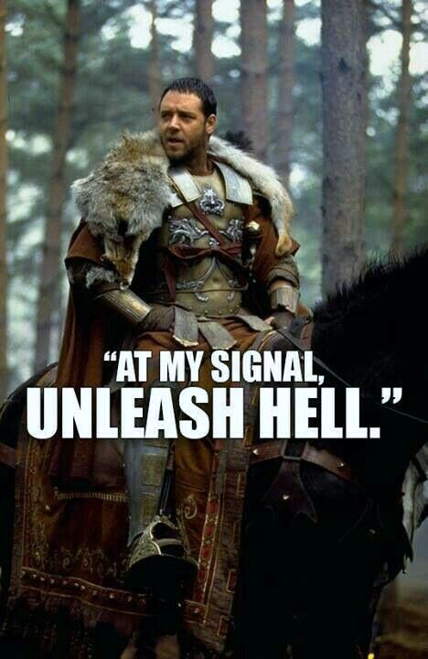
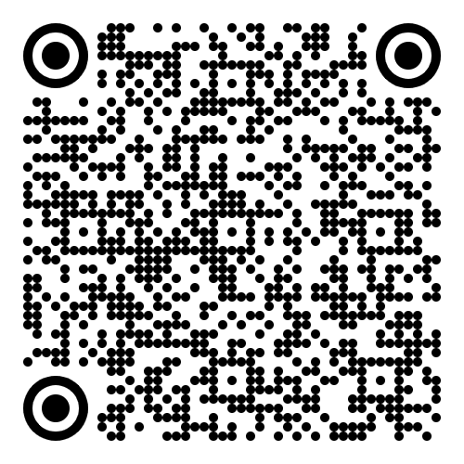



Talk estate planning with Triple Point
Meet with our BDM Team
Help clients together
HELP

