Slide 1
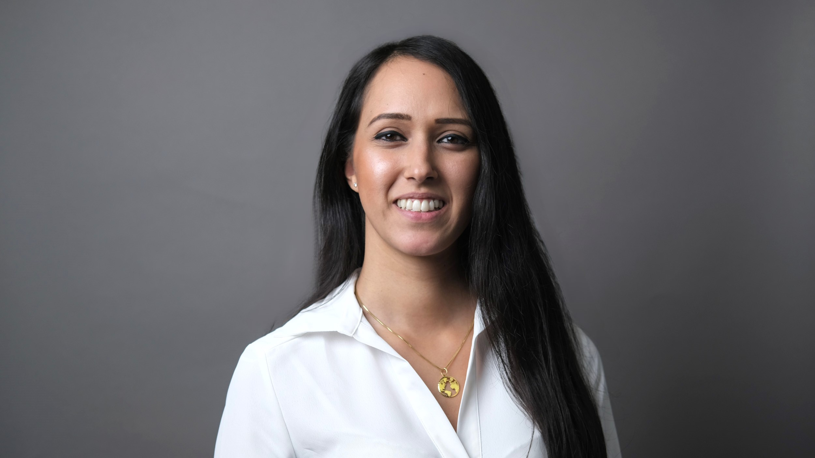
Niche to win - How I found my niche & steps to finding yours
Jay Dhaliwal
Chase de Vere
Jay Dhaliwal
Chase de Vere

Slide 2

Niche to Win…
How I Found My Niche & Steps To Find Yours!
JAY DHALIWAL – CHARTERED INDEPENDENT FINANCIAL PLANNER

Slide 3
LEARNING OBJECTIVES
By the end of this session, attendees will be able to:
Understand the strategic benefits of niching in financial advice.
Explore real-world examples and lessons.
Discover how niching can enhance client trust, referrals, and long-term business value.
Identify key steps to define and develop a niche.

Slide 4


Agenda
What is Niching?
My Journey to Advising
How to Find Your Niche
Key Elements of Niching
Challenges
Breakthroughs

Slide 5



WHAT IS NICHING?
Niching is the strategic process of focusing your financial advice practice on serving a specific group of clients who share common characteristics…
Such as profession, life stage, financial goals, or values.
It allows you to build deeper trust, deliver more relevant advice, and differentiate yourself in a very competitive market.

Slide 6
My journey to advising
July 2015
Wesleyan Pensions Administrator
- Defined Contribution Schemes
- Pension Flexibilities: 6 April 2015
August 2017
Achieved Diploma in Financial Planning
after 14 months of self-funded study
Advised to wait 1 year for the Wesleyan Trainee Scheme to launch
September 2017
Rejected by Chase de Vere
- Trainee Adviser Role
- Feedback: ‘get more experience’
- Kept in contact with hiring managers
January 2018
August 2018
Promoted to Paraplanner
within Wesleyan
Rejected by Wesleyan
- Trainee Adviser Scheme
Joined Chase de Vere as an Independent Financial Adviser
January 2019

Slide 7
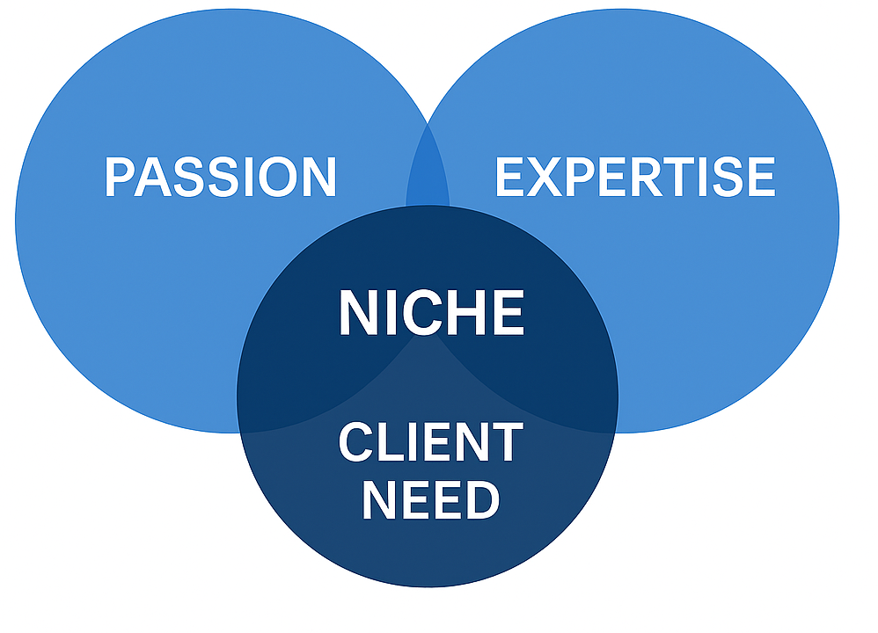
HOW TO FIND YOUR NICHE
My niche is medical professionals. To find yours…
Ask yourself:
Who do you enjoy working with, or what problems do you love to solve?
Where do I have deep knowledge or experience where I can add value?
Are there any ‘pain points’ or client needs that I can help with?

Slide 8
The Key Elements of establishing a Niche
Target Audience
A clearly defined group, such as:
Profession: medical, business owners, legal, tech entrepreneurs, teachers, armed forces, emergency staff.
Life stages: young professionals, pre-retirees (aged 50-67), recent divorcees, high earners / HENRY.
Financial goals based: Early Retirement / FIRE, Estate planning, Business owners, passive income.
Values based: Ethical / ESG investing, faith based (Islamic Finance).

Slide 9
The Key Elements of establishing a Niche
Specialist Knowledge
Understanding the specific financial challenges faced by these defined groups and identifying the advice opportunities within them.

Slide 10
Specialist knowledge: profession examples
Medical Professionals
Legal Professionals
NHS Pension Scheme (including McCloud Remedy, Annual / Lifetime Allowance (TTFC))
Locum / self-employed income structures
Extracting profits from a limited company
Protection planning (income protection, critical illness cover, life insurances – FIB / WOL )
Tax planning for high earners (e.g. tapering, tax-free childcare)
Understanding of medical career pathways and pressures
Partnership structures and profit shares
SRA rules and compliance
Protection planning (income protection, critical illness cover, life insurances – FIB / WOL )
Tax planning for high earners (e.g. tapering, tax-free childcare)
Retirement planning for self-employed solicitors
Bonuses

Slide 11
Specialist knowledge: life stages examples
Young Professionals
Pre-retirees
Budgeting and cashflow planning
Student loan repayment strategies
First-time home buying and mortgage advice
Protection (income protection, critical illness cover, life insurances – FIB / WOL )
Building financial literacy and good habits
Pension consolidation and drawdown strategies
Cashflow modelling for retirement
Tax-efficient decumulation
Inheritance and estate planning

Slide 12
Specialist knowledge: financial goals examples
Early Retirement (FIRE)
Business Exit Planning
Financial Independence, Retire Early
Aggressive saving strategies (50 – 70% of income)
Tax wrappers (ISAs, Pensions)
Passive income planning
Withdrawal rate modelling (4% rule)
To retire early, usually 30’s – 40’s
Business valuation and succession planning
Tax-efficient extraction of profits
Use of trusts and IHT planning
Coordination with legal and accountancy professionals

Slide 13
The Key Elements of establishing a Niche
Tailored Solutions
Offer advice and services that directly address your target audience needs.
This opens up the conversation to further advice areas.
For example: Pensions > Protection > Investments / Savings > Inheritance Tax

Slide 14
The Key Elements of establishing a Niche
Target Audience
A clearly defined group such as profession, life stage, financial goals, or values.
Specialist Knowledge
Understanding the specific financial challenges faced – identifying these opportunities.
Tailored Solutions
Offer advice and services that directly address their needs.
This opens up the conversation to further advice areas.

Slide 15

challenges

Slide 16
Fear of exclusion
You might be worried about turning away potential clients and limiting growth…
Or be concerned that narrowing focus might reduce opportunities
But, in reality…
You are positioning yourself as a subject matter expert.
You are able to pitch presentations to colleagues in a similar position
Or conducting joint client meetings with both spouses present will open new doors.
Niching doesn’t mean saying “no” to everyone else - it means saying “yes” more confidently to the clients you serve best. Over time, this clarity attracts more of the right clients and builds a stronger, more sustainable practice.

Slide 17
Understanding the niche deeply
Know Their World
  Learn the career paths, pressures, and lifestyle of your niche group.
  For example, medical professionals often face long hours, irregular income, and complex pension schemes.
Master Their Financial Challenges
  Identify the recurring financial pain points they face.
  This could include NHS pension complexities, tax planning for high earners, or protection gaps.
Stay Current
  Keep up with industry-specific changes, legislation, and trends.
  For example, understanding the McCloud Remedy or changes to Annual/Lifetime Allowance is crucial for advising doctors.
Use Their Language
  Speak in terms they understand and relate to.
  Avoid jargon unless it’s familiar to them - this builds trust and clarity.

Slide 18
Understanding the niche deeply
It takes time to build the technical knowledge and confidence to advise.
At first, I was disadvantaged by my age and imposter syndrome…
But I’m very lucky as I’ve received internal training on the NHS Pension Scheme, Annual Allowance, Lifetime Allowance, Transitional Tax-Free Cash Certificates, the McCloud Remedy Period etc.
However, a lot of learning has also been done on the job…
Clients will often face very similar issues, and as your experience grows, so does your knowledge.

Slide 19
Building credibility
Immerse Yourself in the Community
  Attend industry-specific events, webinars, and conferences.
  For example, if your niche is medical professionals, show up at events or hospital seminars. This builds visibility and trust.
Create targeted content
  Write blogs, record videos, or host webinars that address niche-specific issues. This positions you as a thought leader and builds authority.
Collaborate with Trusted Professionals as Introducers
  Partner with accountants or solicitors who already serve your niche.
  Their endorsement can accelerate your credibility.
Leverage Testimonials and Case Studies
  Share anonymised success stories that demonstrate your expertise and impact.
  Social proof is powerful in building trust.

Slide 20
Challenges overview
Fear of exclusion
The perceived risk of turning away potential clients, limiting growth or missing opportunities.
Understanding the niche deeply
It takes time to build the technical knowledge and confidence to advise.
Building credibility
Consistent effort – attending events, networking, seminars, webinars, tailored advice.

Slide 21

breakthroughs

Slide 22
Deeper client relationships
Clients feel genuinely understood when you speak their language and know their world…
Advice becomes more proactive and relevant.
You can anticipate common concerns and offer tailored solutions with confidence.
Trust builds faster, leading to more open conversations and long-term engagement.
Stronger relationships result in higher client retention and satisfaction.

Slide 23
Personal brand recognition
You become known as the go-to expert for your niche
  Whether it's professionals, life stages, financial goals or value based.
Your messaging becomes clearer and more consistent
  Making it easier for clients and peers to understand what you do and who you help.
Opportunities for visibility increase
  Including speaking engagements, media features, and professional panels.
Marketing becomes more effective, as your brand speaks directly to the needs and values of your ideal client.
You build trust faster, because your brand reflects deep understanding and alignment with your audience.

Slide 24
Increased referrals
Specialisation builds trust - clients feel confident recommending you to others in their community.
Niche communities are tightly connected, making word-of-mouth more powerful.
Your expertise becomes known within the group, leading to organic growth.
Referrals are more targeted and qualified, as they come from people who understand your value.
You spend less time chasing leads, and more time deepening relationships with ideal clients.
Your reputation compounds, as each successful client experience reinforces your credibility.

Slide 25
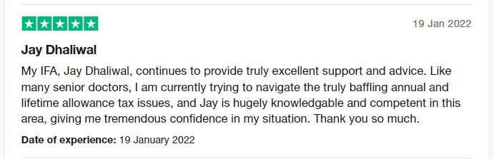
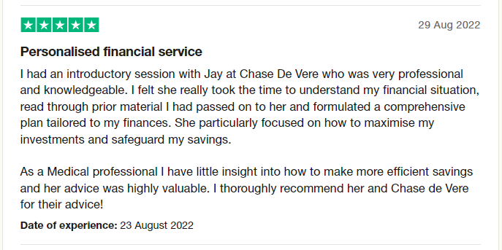
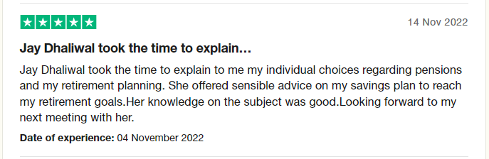
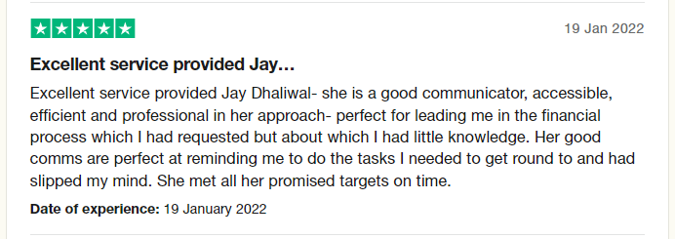
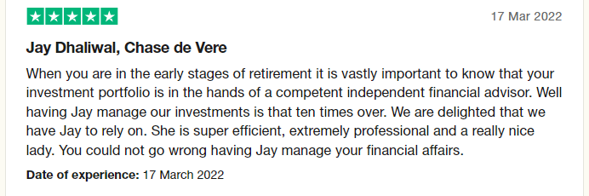
Trustpilot reviews

Slide 26
Breakthroughs overview
Deeper client relationships
Clients feel understood. Efficiency: similar concerns and solutions based on previous client experiences.
Personal brand recognition
This helps with marketing, speaking opportunities and reputation.
Increased referrals
When positioned as a specialist, referrals grow organically as they are a result of experience and credibility.

Slide 27



This session explored how niching can transform a financial planning practice. I shared my personal journey focusing on medical professionals, and the challenges and breakthroughs I experienced along the way.
We looked at how to define a niche through profession, life stage, financial goals, and values, and the specialist knowledge and tailored solutions needed to serve each effectively with real world examples.
Niching allows advisers to build deeper client relationships with enhanced trust, streamline their advice process, and stand out in a competitive market. It’s not about limiting opportunity - it’s about creating clarity, connection and confidence. Hopefully, you can now identify key steps to define and develop your own niche!

Slide 28

Thank you…
Any questions?
Jay Dhaliwal
Chartered Independent Financial Adviser
10 years financial services experience, with the last 6 years advising
Young Professional of the Year 2025
One of the 2024 PAM NextGen Leaders
Professional Adviser’s Young Achiever of the Year Award Winner 2023
Personal Finance Society (PFS) POWER Panel Practitioner, June 2023
PFS Education Champion, volunteering to teach finance in schools, 2020+
School Governor for King Edward VI Handsworth Girls Grammar School (the secondary school that I attended in Birmingham), March 2025

