Slide 1

How do you want to go out? Build a business worth leaving
Brett Davidson
FP Advance

Slide 2


How Do You Want To Go Out?
Build A Business Worth Leaving
Brett Davidson
Founder

Slide 3


Learning Objectives:
1
Learn what really drives business value (and it’s not a bunch of short-term hacks)
2
Discover how to unlock value in your business, at whatever stage of development you find yourself
3
Understand how to position yourself for maximum choice at the end of your business career

Slide 4


Growth, Sale, or Succession: Which has to come first?

Slide 5
Growth

Slide 6

Growth Must Come First - Why?
1
Opportunities for your team
(To attract and retain talent)

Slide 7
Growth Must Come First - Why?
1
Opportunities for your team
(To attract and retain talent)
2
The key to growth is not chasing growth
(It’s laying foundations - the inputs)
You can’t ‘will’ growth - you lay foundations
Growth is not usually linear
Amazing growth is sustainable, repeatable growth - the compound effect

Slide 8
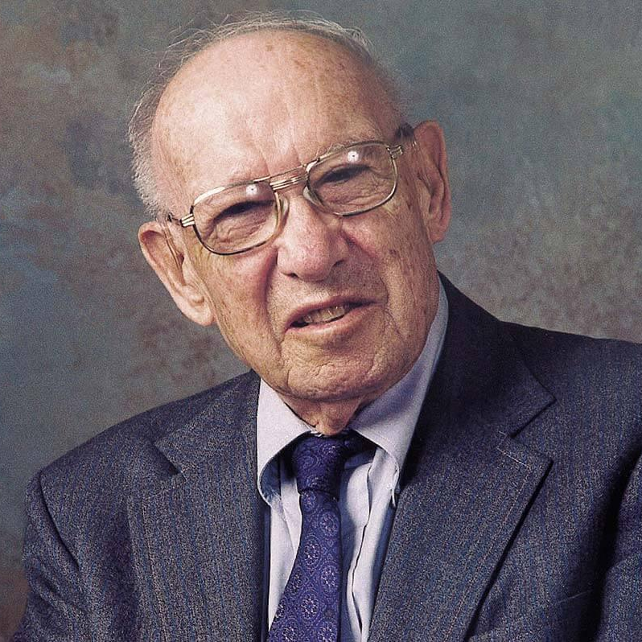
“To say that the purpose of business is to make a profit is like saying that the purpose of life is to breathe.”
Paraphrasing Peter Drucker

Slide 9
Growth Must Come First - Why?
1
Opportunities for your team
(To attract and retain talent)
2
The key to growth is not chasing growth
(It’s laying foundations - the inputs)
3
What is growth?
(Strip out market movements, or acquisitions)

Slide 10
Growth Must Come First - Why?
1
Opportunities for your team
(To attract and retain talent)
2
The key to growth is not chasing growth
(It’s laying foundations - the inputs)
3
What is growth?
(Strip out market movements, or acquisitions)
4
Getting your structure right is vital for growth

Slide 11

Recommended Reading - HBR Article
How Fast Should Your Company Really Grow
Why leaders should take a strategic perspective
by Gary P. Pisano

Slide 12
Recommended Reading - HBR Article
When inflation is taken into account, most companies barely grow.
Analysis of 10,897 publicly held U.S. companies from 1976 to 2019:
  Firms in the top quartile grew at an inflation-adjusted average of 11.8% per year
  Those in the lower three quartiles experienced little or no growth (0.3%, 0.03%, and -0.5%, respectively).
And the majority of firms in the top quartile were unable to sustain superior growth performance for more than a few years.
Source: How Fast Should Your Company Really Grow by Gary P. Pisano

Slide 13
Recommended Reading - HBR Article
“I have found that while the usual explanations for slow or minimal growth - market forces and technological changes such as disruptive innovation - play a role, many companies’ growth problems are self-inflicted.”
Source: How Fast Should Your Company Really Grow by Gary P. Pisano

Slide 14
Structural Barriers
To Growth

Slide 15
Businesses generating <£1M revenue

Slide 16
DO NOT try to grow by hiring more advisers

Slide 17
Up and Coming Firm - Example*
*Annual revenue approximately £500,000
Owner-Adviser
Adviser 1
Para admin planner (wanna-be adviser) 2
Para admin planner (wanna-be adviser) 3
Technical Administrator Support

Slide 18



What’s the real issue?

Slide 19

This Is What I See…
The owner has hired future advisers before getting themselves truly productive.
That decision has created a bunch of management problems that put the owner under even more pressure:
With so many aspiring advisers they need a Practice Manager
The aspiring advisers are demanding (more pay and opportunity)
But there’s not enough revenue to pay for these things…yet

Slide 20
Here’s how to get to £1M of revenue in great shape

Slide 21

1
Who’s your biggest asset?
You are the best adviser and rainmaker - that’s why you started your own firm
The people working for you haven’t started their own firm because they can’t do what you do
Priority #1 - build your own productivity to £600,000

Slide 22

Please DO hire anyone who can help you be more productive

Slide 23
Up and Coming Firm - Example
Owner-Adviser
Paraplanner
Technical Administrator Support

Slide 24

When you get to…
about £300,000 of revenue, look for a shadow adviser to support you

Slide 25

The Shadow Adviser
What do they actually do?
Shadow you in every client meeting
Take all the notes and get them documented afterwards
Hand off work to the other members of your support team
Manage ALL of the follow through with the team
Keep you informed
Do the technical research and create the strategy (with your input)

Slide 26
The Shadow Adviser
What do they look like?
Technically qualified (CFP, Chartered)
Can do almost everything you do (cashflows, tax, pensions, investment strategy)
Great paraplanner
Struggling adviser

Slide 27
Up and Coming Firm - Example
Owner-Adviser
Shadow Adviser
Paraplanner
Technical Administrator Support
Technical Administrator Support

Slide 28
Up and Coming Firm - Example
Stay focused on your productivity
Owner-Adviser
Shadow Adviser
Paraplanner
Technical Administrator Support
Technical Administrator Support

Slide 29

Your Next Adviser
Is your current shadow adviser
When you get to £600k+ of revenue
Split off bottom ⅔ or ¾ of your client base - say £400k to your shadow (quality clients)
You will have the top ⅓ or ¼ of client relationships - say £200k (that need your level of expertise)
Hire a new shadow - and build again

Slide 30


How does your new servicing adviser get paid?

Slide 31
On £400k of revenue your shadow gets paid a salary
(e.g. £60k, £80k, 100k)

Slide 32

But eventually this model slows growth and doesn’t scale well

Slide 33
Businesses generating >£1M revenue

Slide 34


You can download my white paper here:
How To Solve The Scale Problem
(in financial planning businesses)

Slide 35
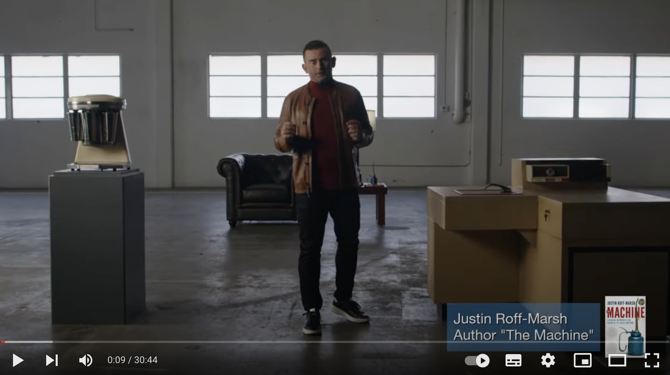
Double-Digit Growth (and why you're stuck on single digits)
Use link: https://fpadvance.com/ddg

Slide 36

Revenue is the responsibility of Operations,
not Sales

Slide 37

Operations - A New Focus
Responsibilities:
Incremental growth of revenue
Helping clients do more business with you (by providing a frictionless ongoing service, engaging deeply and spotting opportunities)

Slide 38
Sales - A New Focus
Responsibilities:
New business (and that’s it)
And we value a new sale as an annuity (which might be worth 5x, 10 x, or 15x the initial sale value)

Slide 39
One adviser-owner I was speaking with about this idea, put it this way:
“If all I did was hold meetings to secure new clients, which might mean I have two meeting slots set aside on Tuesday, Wednesday and Thursday, a morning and an afternoon slot, and if securing a new client takes say four meetings, and I work for 46 weeks per year, then as a single adviser I have room to secure 69 new clients per year.
We’ve probably not secured 69 new clients in the last 5 years with two of us supposedly focused on sales.”

Slide 40
New Structure
Marketing
Sales
Operations
Communication
(Existing clients)
Adviser 1 -
New Business
Adviser 2 -
New Business
Servicing Advisers (£600k revenue)
Promotion
(New clients)
Shadow Adviser 1
Shadow Adviser 2
Paraplanning Support
Technical Administrator Support
Paraplanning Support
CRM’s

Slide 41

These changes lead to…
A meaningful improvement in customer service quality
A dramatic increase in (true) sales activity
No significant change in operating expenses

Slide 42
The Business With
Four Advisers
(Treated the same)

Slide 43

A structure that works
The servicing advisers could look after £800,000 - £1M of annual revenue
Is this a difficult conversation?

Slide 44
A structure that works
The servicing advisers could look after £800,000 - £1M of annual revenue
Is this a difficult conversation?
How do the ‘selling’ advisers get paid?

Slide 45
Bringing On 50 - 70 New Clients pa
Average planning fee: £2,500
Average implementation fee: £5,000
Average ongoing fee: £8,000
Yr 1: 50 x £7,500 = £375,000
Yr 2: 50 x £8,000 = £400,000

Slide 46
Bringing On 50 - 70 New Clients pa
Average planning fee: £2,500
Average implementation fee: £5,000
Average ongoing fee: £8,000
Yr 1: 50 x £7,500 = £375,000
Yr 2: 50 x £8,000 = £400,000
Salary Package: £200,000 - £250,000

Slide 47

Now we have a high growth business with a bunch of excited people working in it

Slide 48
If you are trying to position yourself for sale, does any of this help you?

Slide 49

But what is the key foundation to lay?

Slide 50
But what is the key foundation to lay?
Building future leaders

Slide 51
But what is the key foundation to lay?
Building future leaders
  With the leadership skills…
  and the selling skills…
  to take the business onward

Slide 52
If you are trying to position yourself for internal succession, does any of this help you?

Slide 53
But what is the key foundation to lay?

Slide 54
But what is the key foundation to lay?
Building future leaders

Slide 55
But what is the key foundation to lay?
Building future leaders
  With the leadership skills…
  and the selling skills…
  to take the business onward

Slide 56

Growth, sale or succession?
The issues are identical
(not similar, identical)

Slide 57

When you understand these issues the conversation shifts to creating more valuable firms

Slide 58

Creating More Valuable Firms
Measure ‘real’ organic growth and invest in it

Slide 59
The Truth About Growth
US Data - SEI
70% of growth in the last decade came from the market
30% came from true organic growth
But only 6% of firms generated 76% of the 30%
So 94% of firms experienced minimal organic growth
Strip our market movements and measure the net inflow of
new AUM (after withdrawals)

Slide 60
Creating More Valuable Firms
Measure ‘real’ organic growth and invest in it
Get equity into the hands of more motivated team members

Slide 61
Creating More Valuable Firms
Measure ‘real’ organic growth and invest in it
Get equity into the hands of more motivated team members
Transferring ownership and leadership is really difficult for founders*
  Everything that made you successful now works against you:
    Obsessing over the business and the clients
    Controlling every detail
    Taking on every challenge as your own
    Rushing to be first to do things that need to be done
    Wanting to be the clients most trusted adviser
  All of these things helped you build a great business…and all of them will sabotage you as you try to create successors
*Source: Philip Palaveev: The Ensemble Practice

Slide 62

Training G2 to lead
the next phase of our profession is the biggest challenge

Slide 63
Growth, sale or succession?
The issues are identical
(not similar, identical)

Slide 64
Learning Outcomes:
1
Learn what really drives business value (and it’s not a bunch of short-term hacks)
2
Discover how to unlock value in your business, at whatever stage of development you find yourself
3
Understand how to position yourself for maximum choice at the end of your business career

Slide 65

www.fpadvance.com

