Slide 1

Bridging the generation gap: Winning the trust of tomorrow’s clients
Andrew McBride
Achieve UK Consulting Ltd

Slide 2


Bridging the generation gap
Presented by andy Mcbride

Slide 3

How Netflix changed tv?

Slide 4

Identify the key value differences between Boomers, Gen X, Millennials, and Gen Z — and explain how these differences impact trust-building in financial advice.
Apply the New Trust Equation to their own practice to create stronger connections with younger clients.
Select at least one digital communication, transparency, and education tool to trial within 30 days.
Adapt traditional financial language into modern, values-driven messaging that resonates with younger generations.
Implement a 30-60-90 day action plan to begin engaging and retaining future wealth-holders.

Slide 5

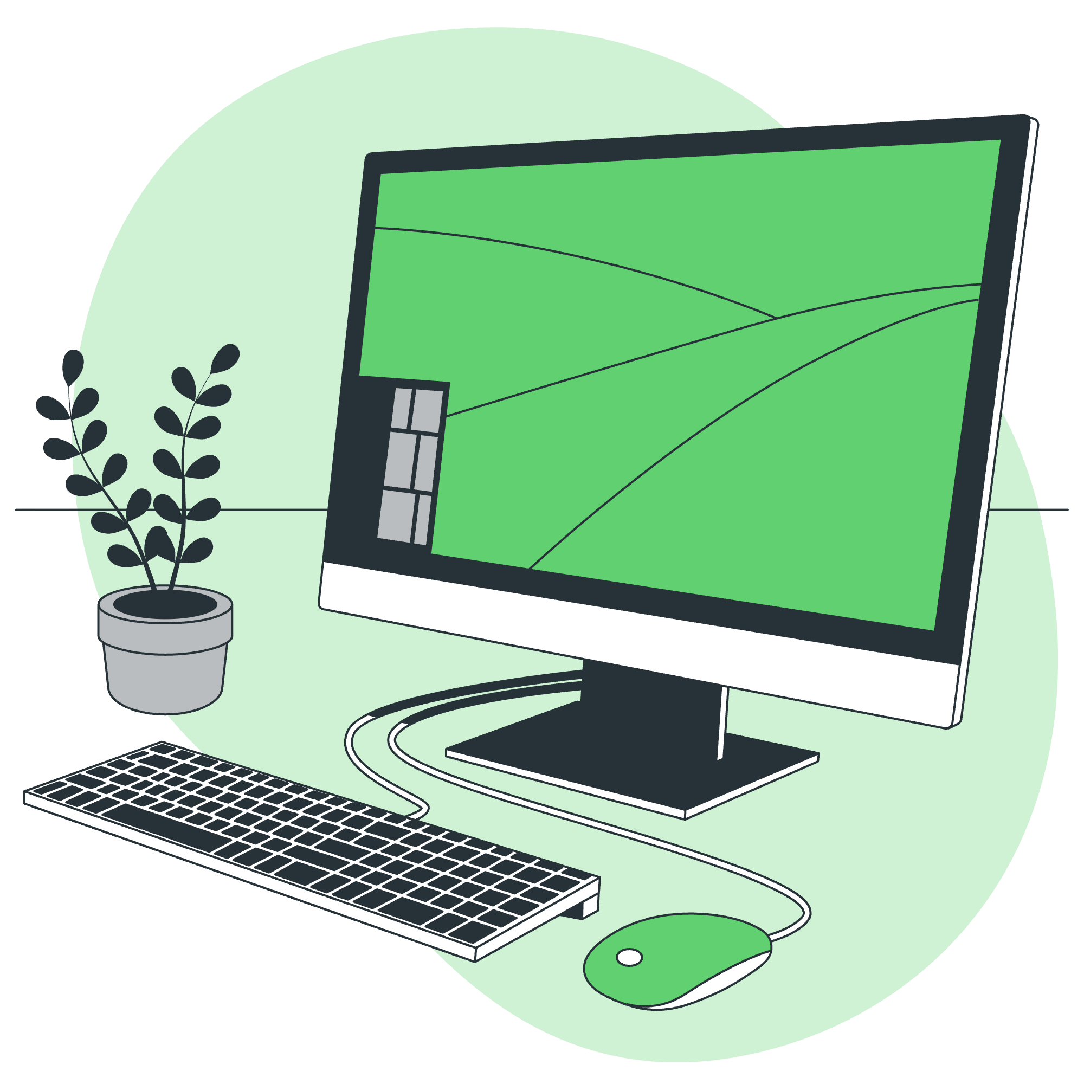

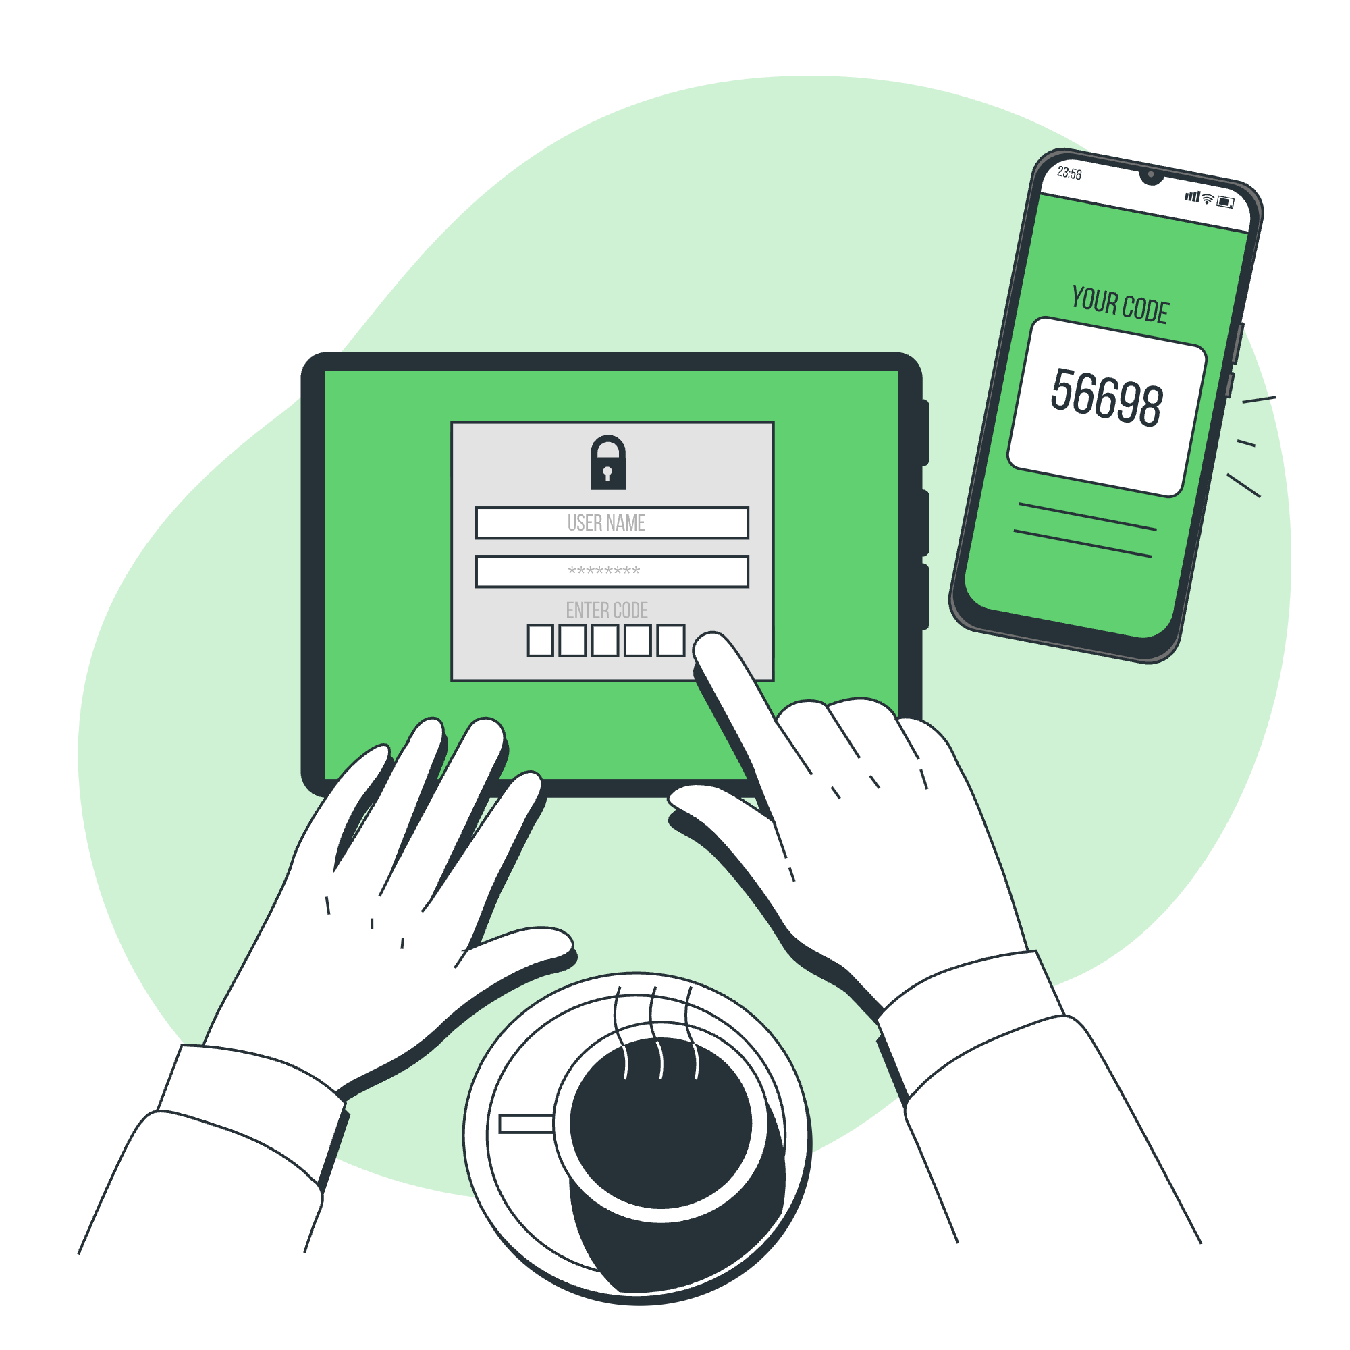





The Timeline
1946
1965
1981
1997
2012
Baby Boomers
Generation X
Millennials
Generation Z

Slide 6
The £5 Trillion question
Money is going to move, but will it move to you…

Slide 7



Do not edit
How to change the design
What percentage of wealthy famiies lose their wealth by the second generation?
The Slido app must be installed on every computer you’re presenting from

Slide 8

70%
Stat #1
Of wealthy families lose their wealth by the second generation, 90% lost by the third (The Williams Group).

Slide 9
Do not edit
How to change the design
What percentage of heirs plan to use the same financial adviser as their parents?
The Slido app must be installed on every computer you’re presenting from

Slide 10

20%
Stat #2
Only 1 in 5 of heirs plan use the same financial adviser as their parents (Scottish Widows)

Slide 11
The generational shift
It’s not just about age – it’s about values

Slide 12
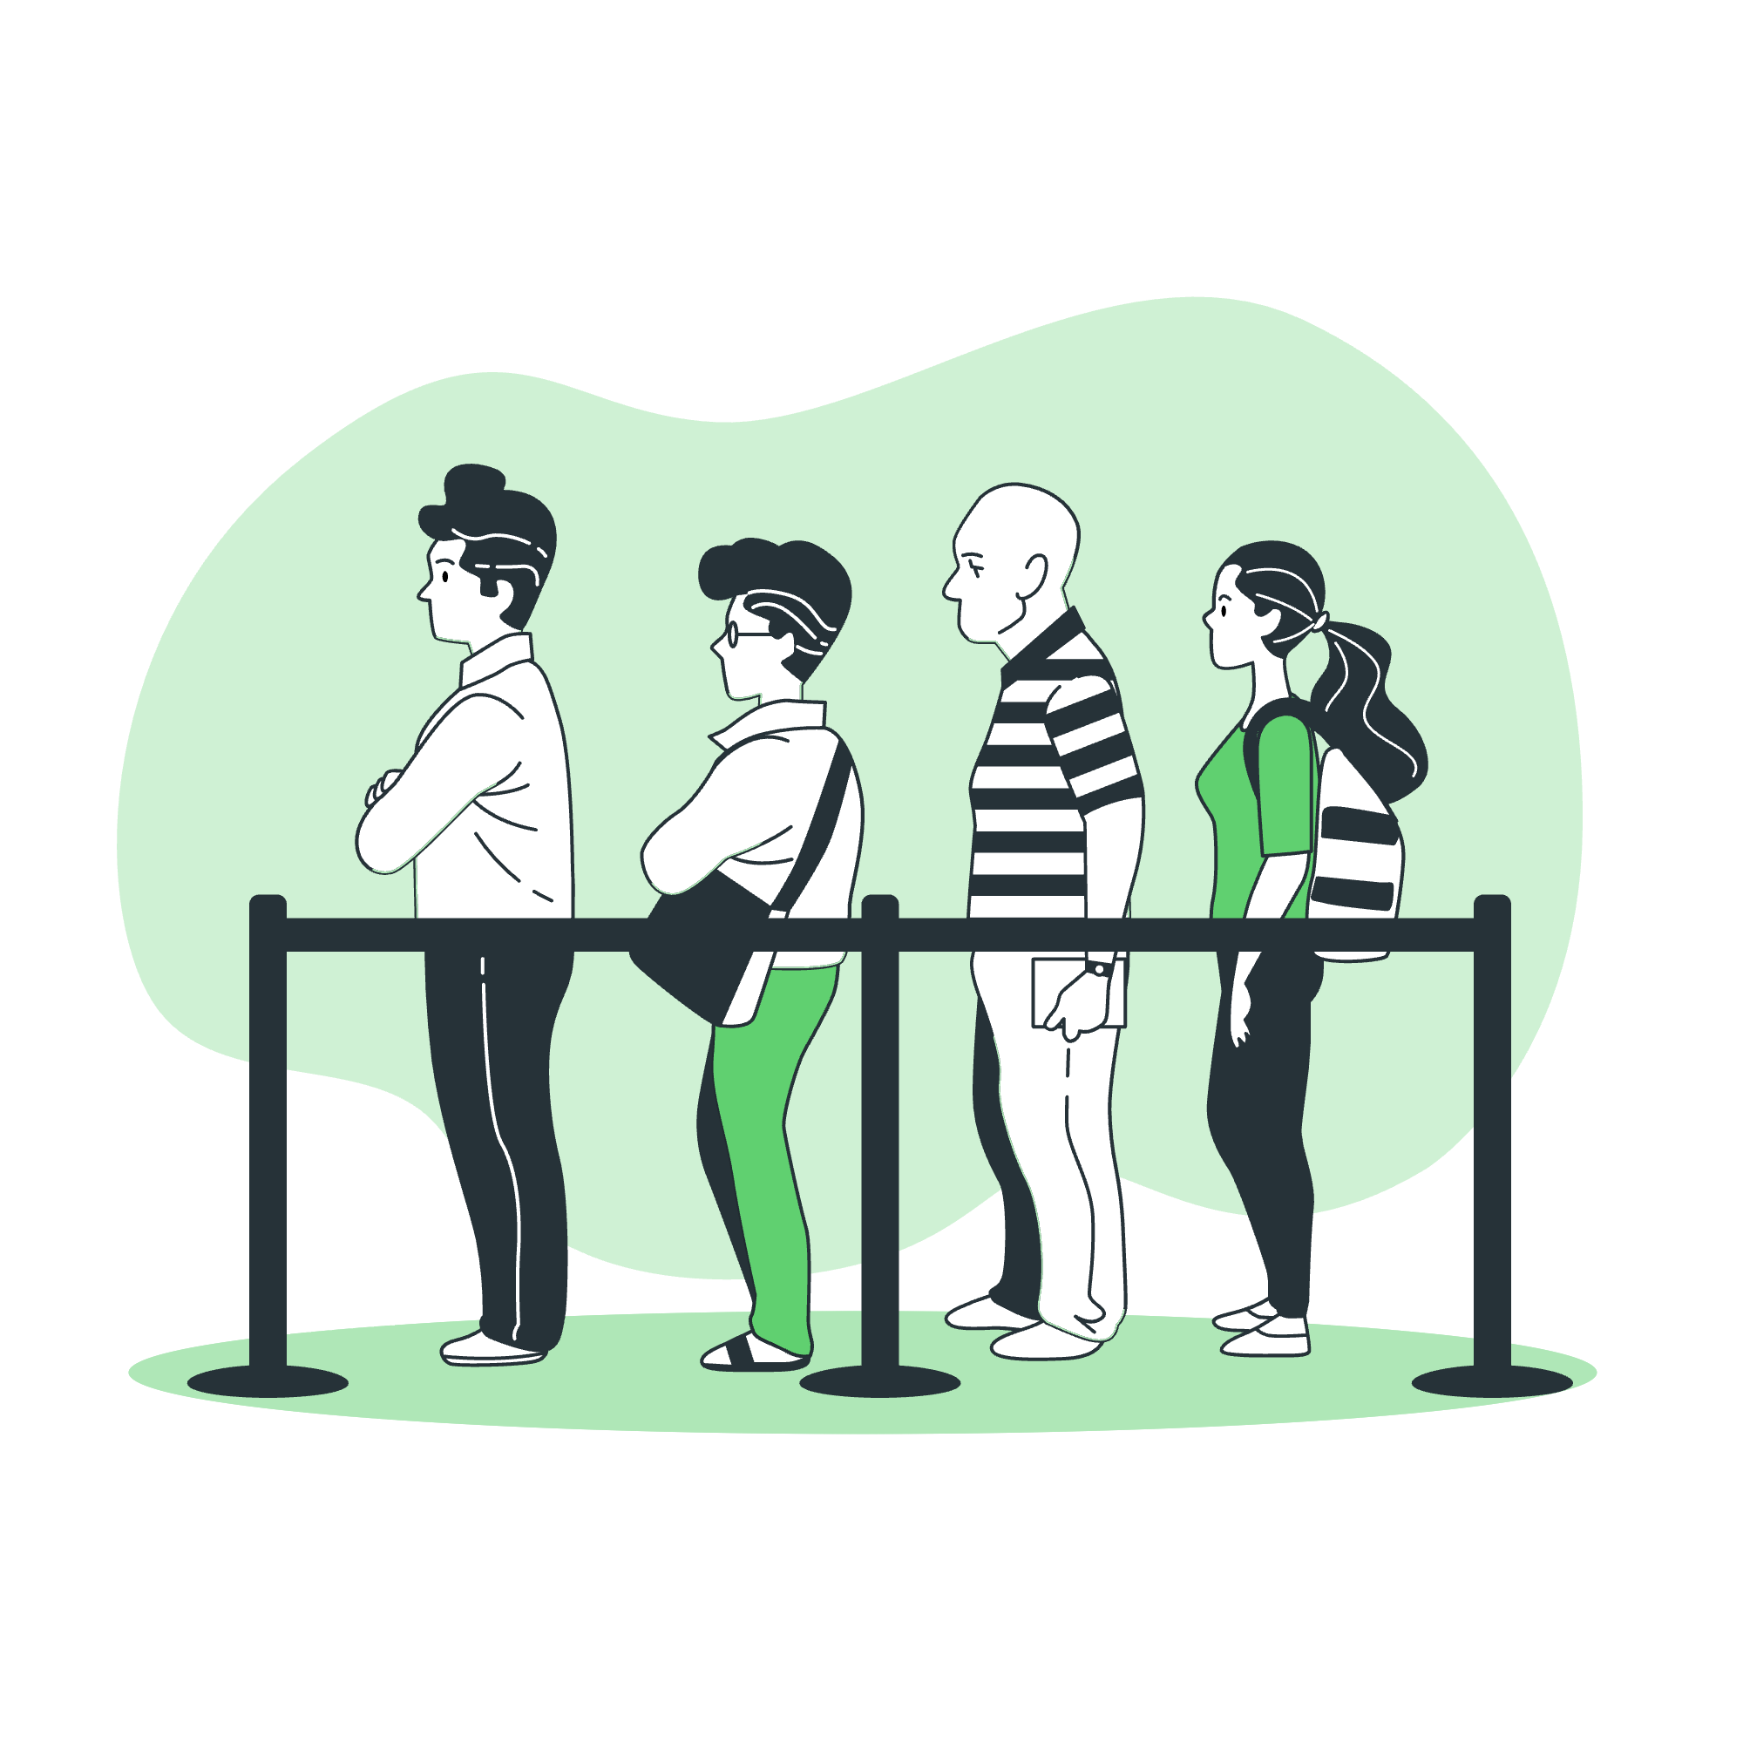


Baby boomers & Gen x
Security and stability
Traditional relationship building
Phone calls and face-to-face meetings
Trust through credentials and track record

Slide 13



Millennials & GEN z
Purpose and impact
Transparency and authenticity
Digital-first communication
Trust through shared values and social proof

Slide 14

Expertise
+
Track Record
The Trust Equation

Slide 15
Expertise
+ shared values
+ transparency
+
Accessibility
The Trust Equation

Slide 16
The digital-human balance
Technology should AMPLIFY relationships, not replace them.

Slide 17



Three pillars of modern client engagement

Slide 18
Transparent processes
Show your decision-making process, not just outcomes
Regular "Behind the Scenes" content
Clear fee structures explained visually
Real-time portfolio performance tracking

Slide 19
accessible communication
Regular micro-check-ins via preferred channels
Video updates on market conditions
Interactive dashboards they can access 24/7
Text/WhatsApp for quick questions

Slide 20
Educational empowerment
Shift from: "Trust me, I'm the expert"
Shift to: "Let me show you how to think about this"

Slide 21
Practical digital tools that work

Slide 22
For Transparency
Client portals with real-time data

Slide 23
For communication
Loom videos for personalised updates or reports

Slide 24
For Education
Scenario models they can explore

Slide 25
Shifting Gears
‘It ain’t what you do, it’s the way that you do it*…’

Slide 26

Language shift
Traditional Term
Wealth Preservation
Asset Allocation
Risk Management
Estate Planning
Diversification
Retirement Planning
Financial Products
Annual Review
Investment Returns
Volatility
Translation
Keeping the Bag Safe
Where the Bag Goes
Level the Chaos
Endgame Plan
Don’t YOLO the Bag
Work-Optional Mode
Money Tools
Money Check-in
Gains / Scoreboard
Market Vibes

Slide 27

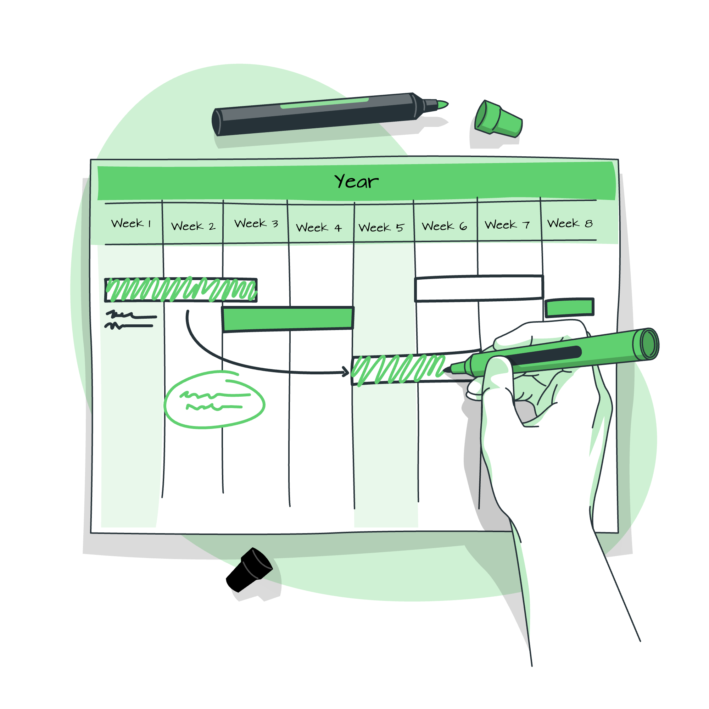

Mindset shift
The Goal
The System

Slide 28

impact shift
I |  | Involve them in the process
M |  | Make it relevant to their life goals
P |  | Provide education, not just advice
A |  | Acknowledge their values and concerns
C |  | Connect to bigger picture outcomes
T |  | Track progress in meaningful ways

Slide 29
30, 60 & 90 day plan
“The question isn’t ‘what are we going to do’, the question is ‘what aren’t we going to do?…”

Slide 30

30 Days
Plans
Audit current client communication preferences & tools
Set up basic digital communication tools
Create one piece of educational content each week
Identify your youngest clients for feedback sessions

Slide 31
60 Days
Plans
Spec/Build client Portal or Dashboard requirements
Begin using video for routine updates
Implement the IMPACT communication framework
Start gathering and sharing client success stories

Slide 32
90 Days
Plans
Measure engagement and satisfaction changes
Refine processes based on feedback
Expand digital tool use
Begin targeted marketing to younger demographics

Slide 33
Take action
After the insight

Slide 34

Identify the key value differences between Boomers, Gen X, Millennials, and Gen Z — and explain how these differences impact trust-building in financial advice.
Apply the New Trust Equation to their own practice to create stronger connections with younger clients.
Select at least one digital communication, transparency, and education tool to trial within 30 days.
Adapt traditional financial language into modern, values-driven messaging that resonates with younger generations.
Implement a 30-60-90 day action plan to begin engaging and retaining future wealth-holders.

Slide 35
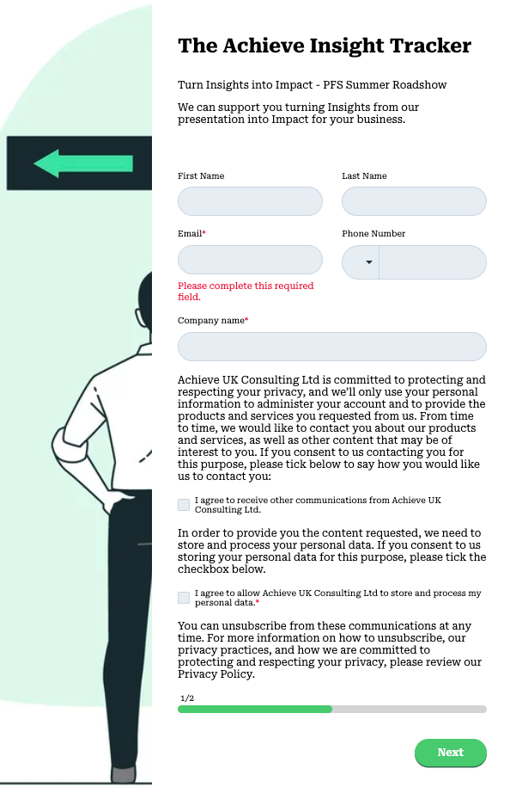
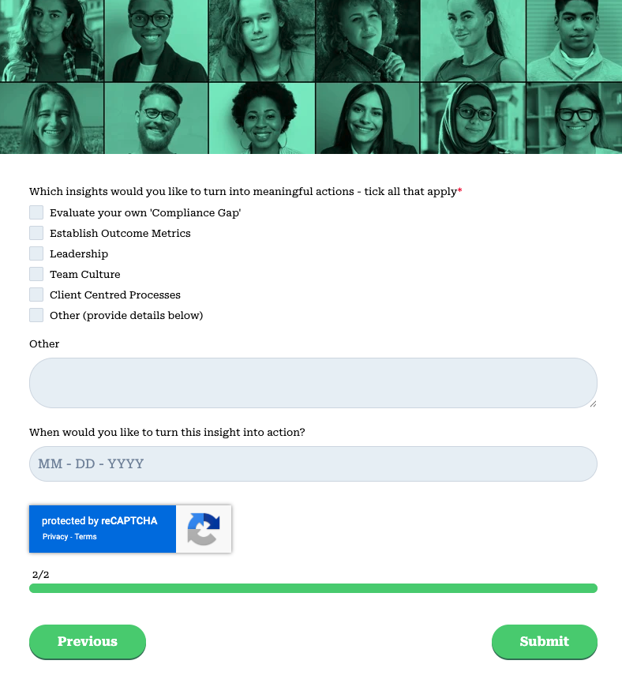
Your Actions from today
Step 1 – Decide on your Action:
Evaluate your own ‘Communication’
Schedule some feedback with your youngest clients
Create your first educational video or content
Step 2 – Hold yourself to account
Now you know what your will work on, set it as a task
Be specific on objectives and timescales
Step 3 - Phone a Friend
Use support from a colleague or mentor or Achieve

Slide 36
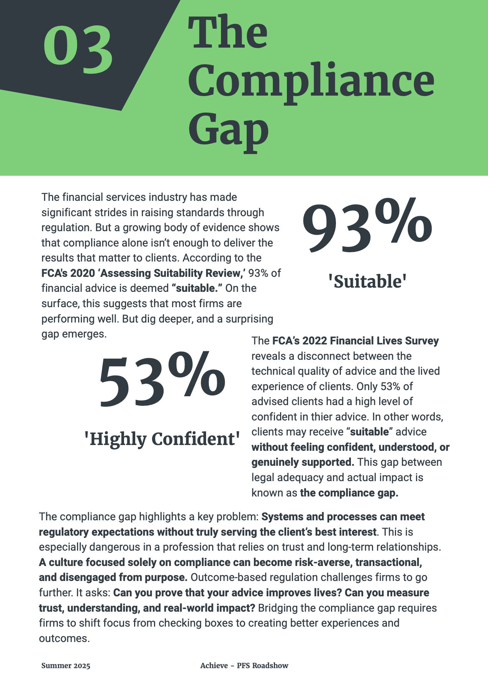
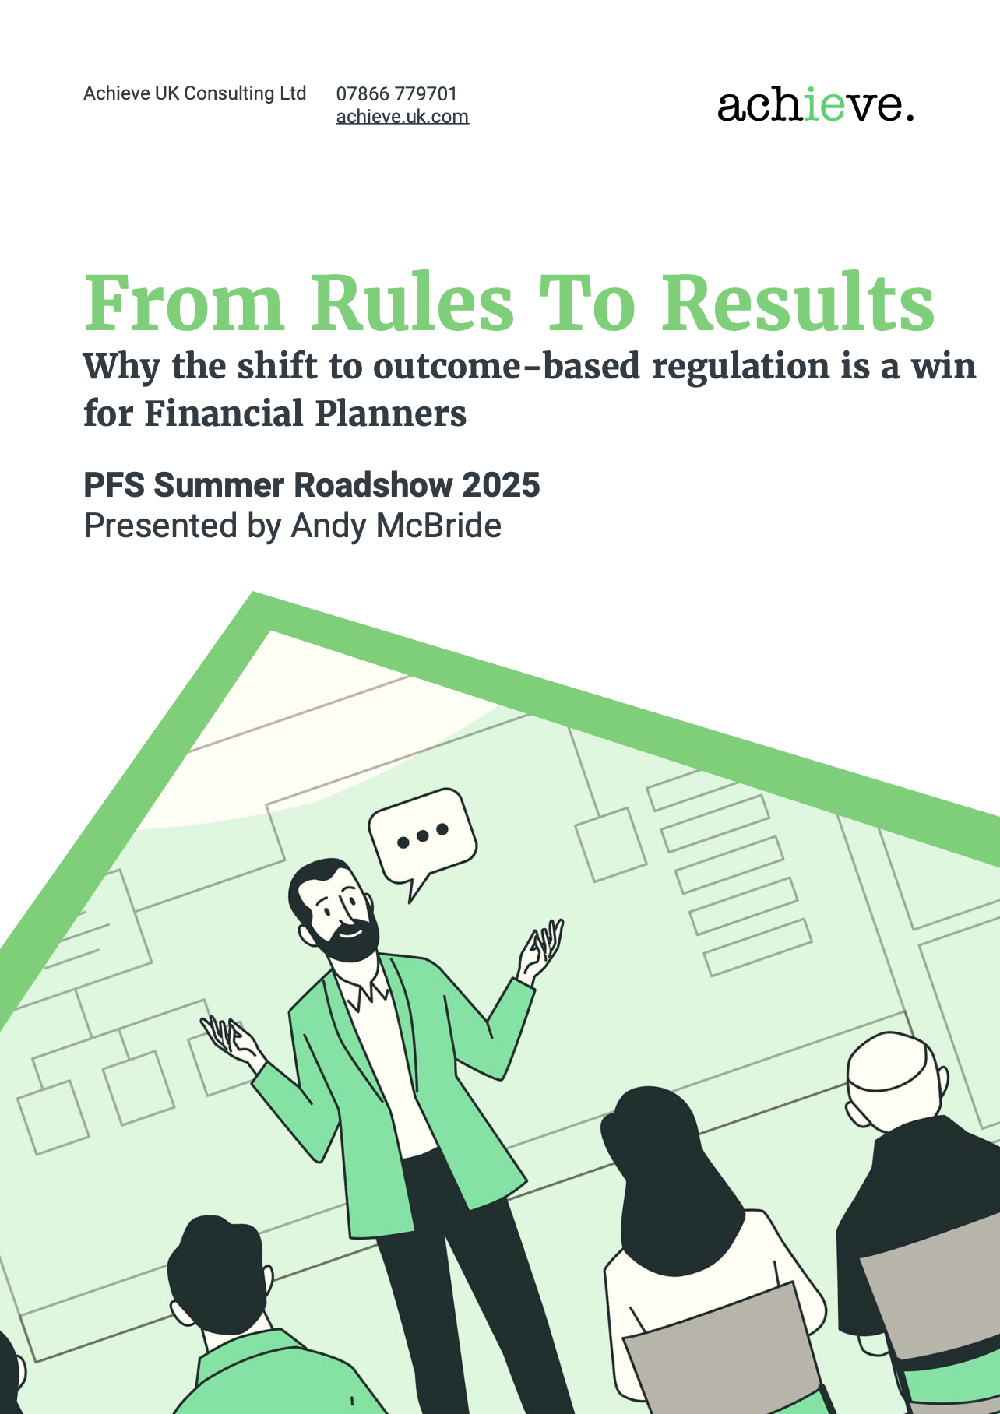
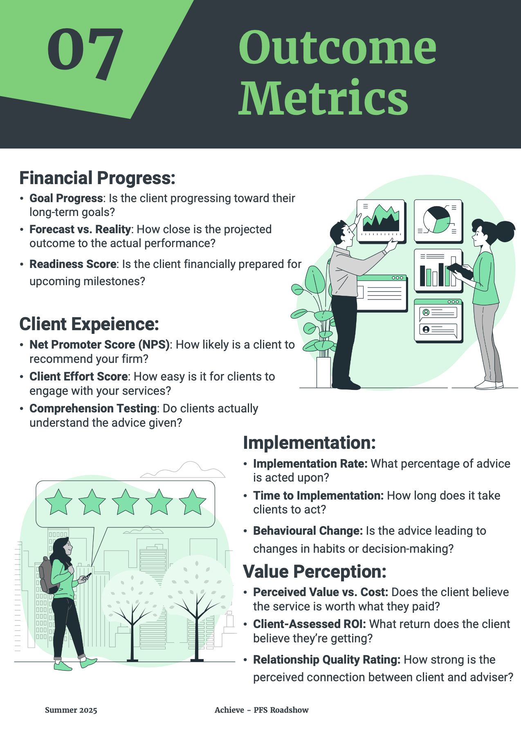
Your Presentation Summary

Slide 37
“And these children that you spit on as they try to change their worlds are immune to your consultations. They’re quite aware of what they’re going through.”
David Bowie - Changes

Slide 38
Thank You

