Slide 2
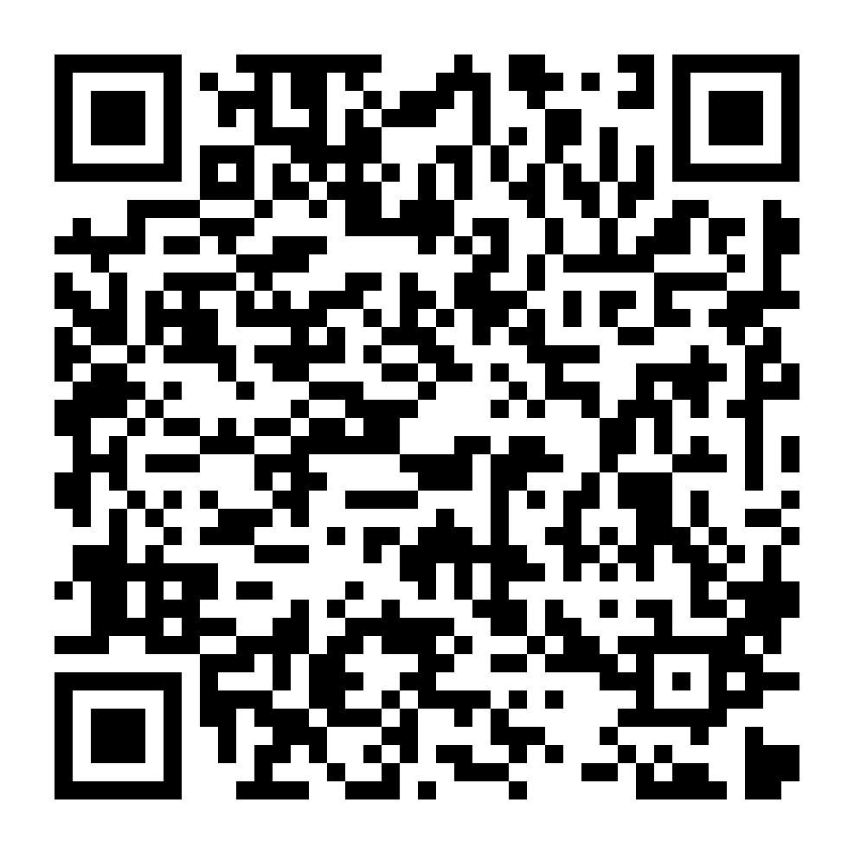
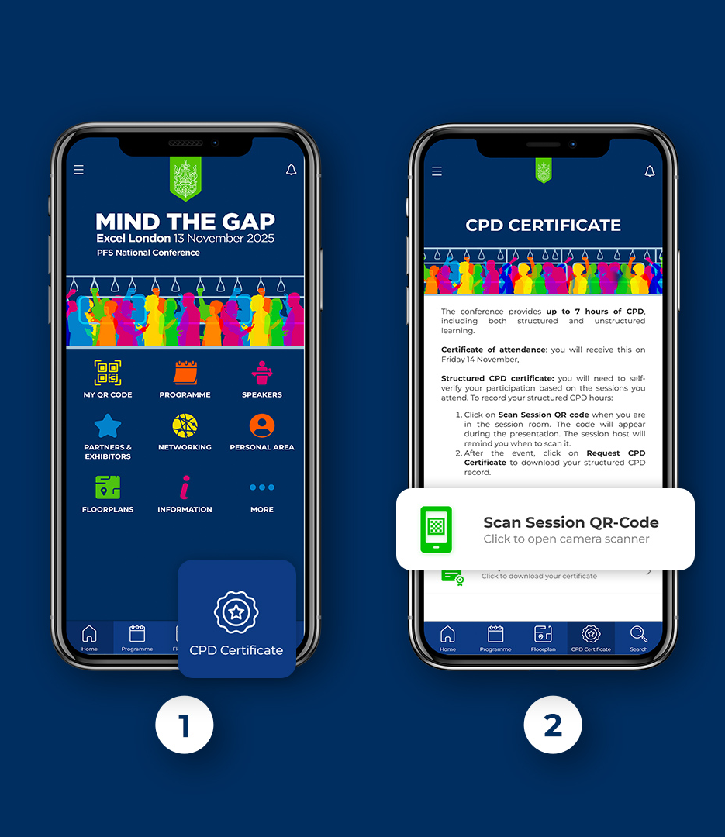
Bridging the gap between study and success: turning potential into passes
CHECK IN FOR STRUCTURED CPD!
✅ Open the Conference App
📄 Tap on CPD Certificate in the bottom menu
📷 Scan this session’s QR Code

Slide 3
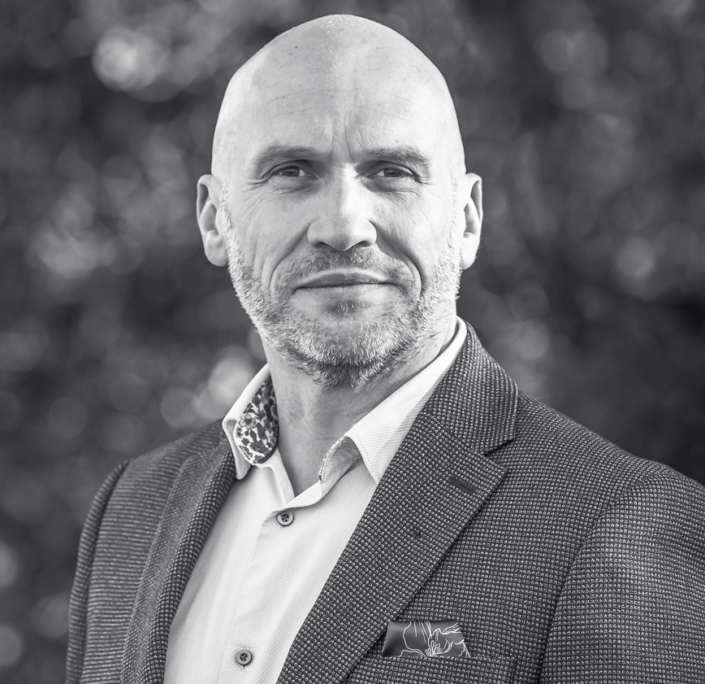
Bridging the gap between study and success: turning potential into passes
Jon Dunckley
Plannex

Slide 4
Bridging the gap between study and success: from potential to passes
Jon Dunckley BSc(Hons) MSc MAPP FCII FPFS FCSI FLIBF FIoL FLPI FAC CFP

Slide 5
Learning Objectives
Through this session, you should:
  Better understand the way the brain stores information
  Understand and be able to implement best practice techniques to remember more whilst studying less
  Be able to develop your own roadmap for exam success

Slide 6
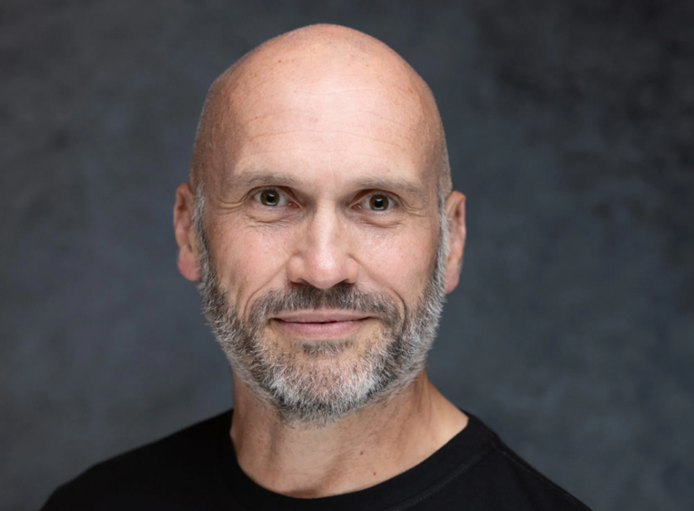
Who am I?
Part financial planner
Part psychologist
100% geek!

Slide 7
Where’s the gap?

Slide 8
The issue
Poor approach to study
Cramming
Rushing
Passing but not learning
Consumer detriment?

Slide 9
The solution?
Learn
Use the brain properly
Store it and use it!

Slide 10
The Brain

Slide 11
How the brain learns
Staggering complexity
Incredible simplicity
Multi-phase nature
Biological mechanisms

Slide 12
The role of forgetting
Adaptive value
Emotion and pain
Cognitive load
Lack of relevance
Forgetting curve

Slide 13
Improving retention
Meaning
Engagement
Environment
Sleep

Slide 14
Studying less –remembering more

Slide 15
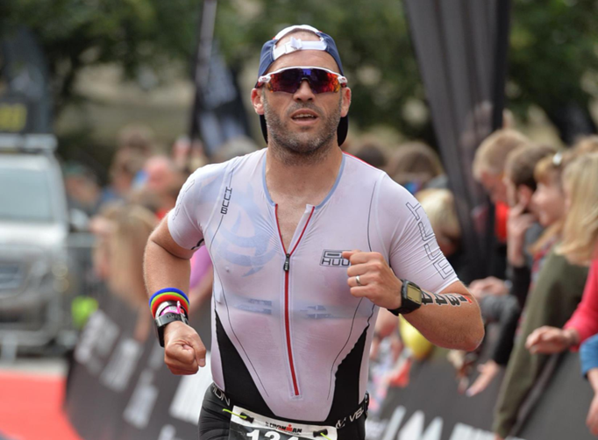
Overcoming the wiring
Learning styles?
Run less, run faster
Create the scaffold
Build from there
No ‘junk miles’

Slide 16
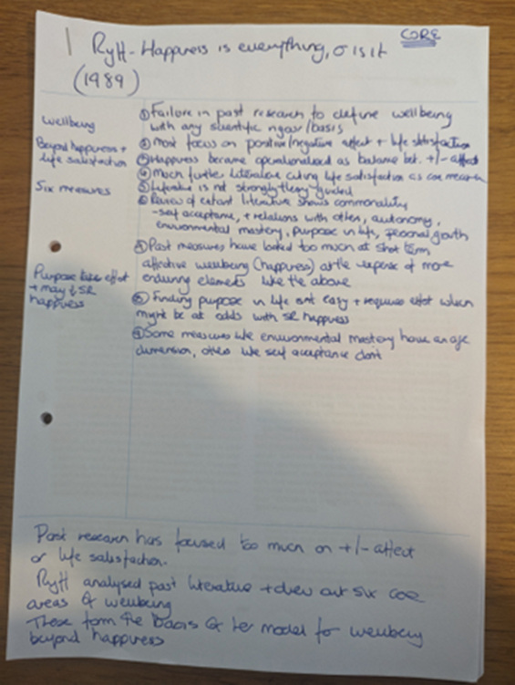
Winning techniques
Reading properly
Taking good notes

Slide 17

Revision
Spaced repetition
Active engagement
Interleaving
Dual coding
Feynman notebook
The ridiculous

Slide 18
Developing your plan

Slide 19
Your own plan
Know the exam
Work backwards
Implement good techniques
Simulate the exam
Metacognitive review

Slide 20
Exam day
Make sure you’ve slept
Eat and drink
Don’t talk to others
Fire up the brain

Slide 21
Learning Outcomes
Through this session, you should:
  Better understand the way the brain stores information
  Understand and be able to implement best practice techniques to remember more whilst studying less
  Be able to develop your own roadmap for exam success

