Slide 1
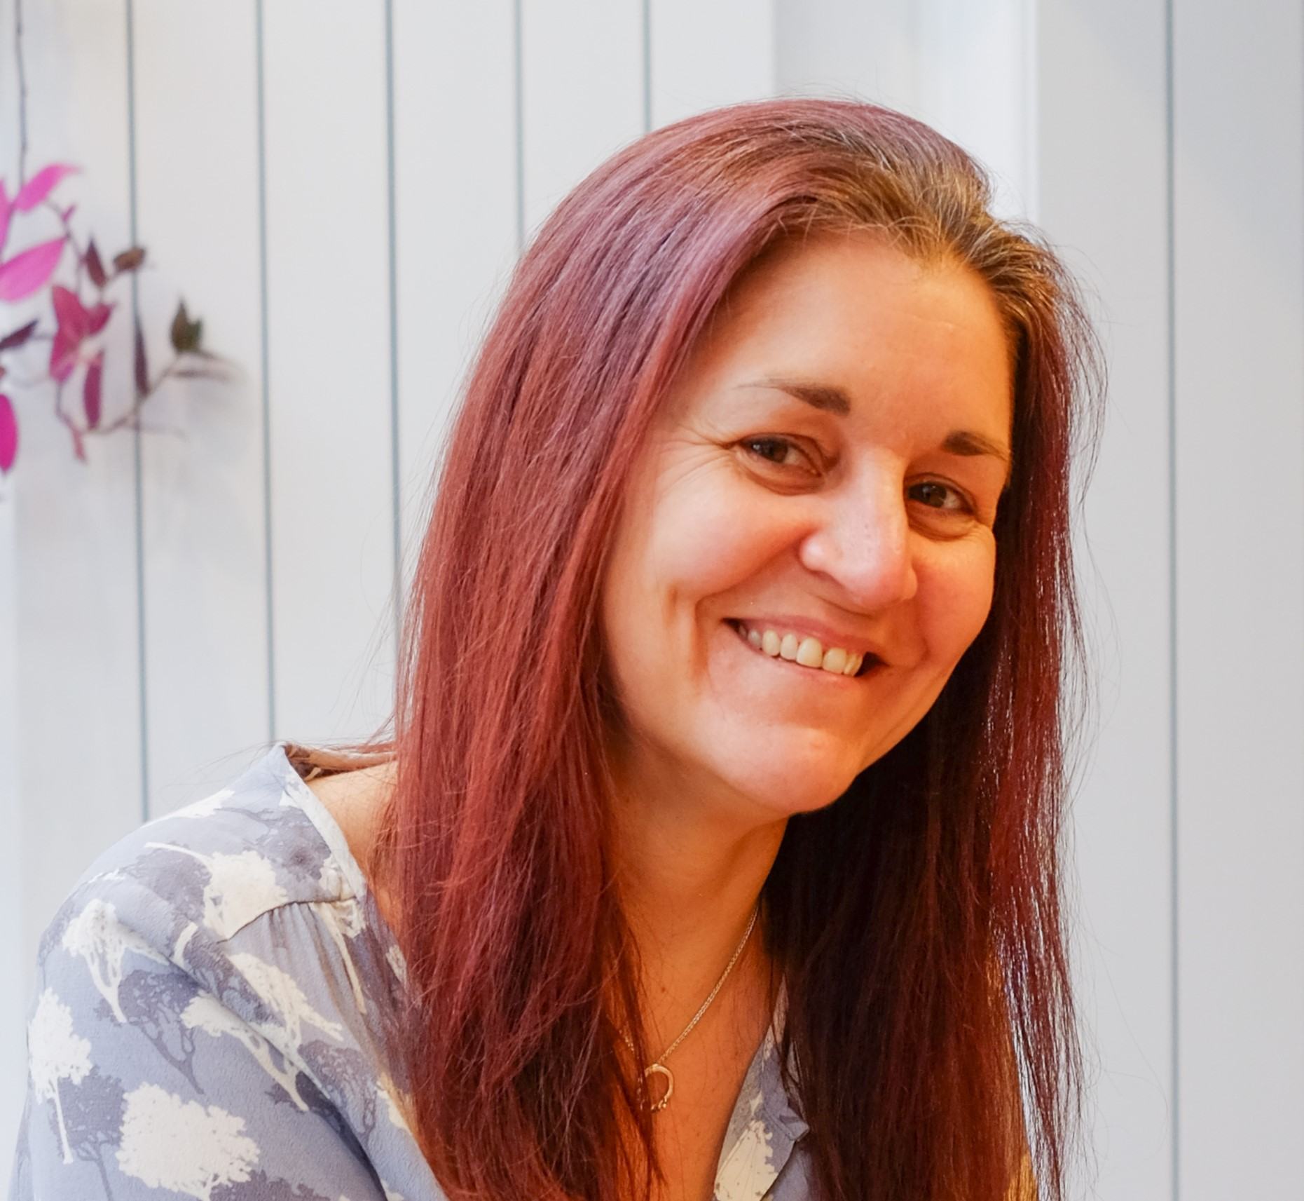
Vote for your future self: Intentional evolution in your career as a financial planner
Becca Timmins
When We Think

Slide 2


Vote for your future self:
Intentional evolution in your career as a Financial Planner

Slide 3

Learning objectives
Consider the needs and expectations of tomorrow’s clients
Assess the skills you will need to serve them
Identify obstacles that might hinder your development
Understand the anatomy of “lightbulb moments”
Develop a tangible next step for your career development

Slide 4
Who do you need to become to serve your clients in 2035 and how will you get there?

Slide 5
Who might your clients be in 2035?
Notes:
What is the average age of your clients?
Should have a pretty good idea of this now following recent FCA survey...
Lots of different suggestions of when people seek advice, but somewhere between 50-55 seems like a reasonable mid-point.

Slide 6
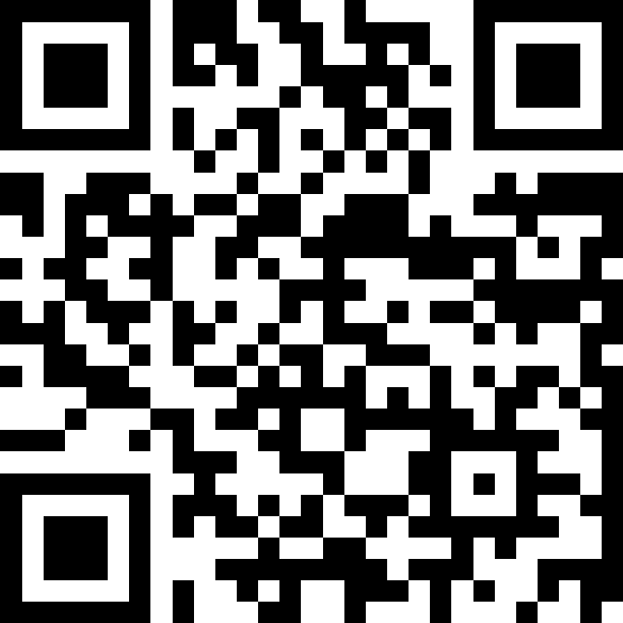
SLIDO - what’s the average age of your clients?
Under 35-45
45-55
55-65
Over 65
Notes:
Introduce:
Nick and Heather (60 - roughly average age of current clients)
Sam and Hayley - 40 - potentially those seeking your advice in the next 10 years
Cultural, financial and geopolitical experiences of both and how these might have shaped expectations

Slide 7


Nick & Heather
Sam & Hayley
Notes:
Introduce:
Nick and Heather (60 - roughly average age of current clients)
Sam and Hayley - 40 - potentially those seeking your advice in the next 10 years
Cultural, financial and geopolitical experiences of both and how these might have shaped expectations

Slide 8
Analog childhood, adapted to digital as adults
Free university education; many got grants
House price-to-income ratio ~3:1
Experienced extremes 15%+ interest rates
Hybrid - analogue childhood but digital by teens
University £3,000-£9,000/year fees
House price-to-income ratio ~7-8:1
Only knew ultra-low rates until recently

Slide 9
50-60% had access to final salary pensions
Single income could support a family
Climate change not a major issue until mid-life
Support climate action but prioritise economic stability
5-10% have final salary pensions
Dual-income essential
Grew up with established climate science
Climate consciousness part of identity and values

Slide 10
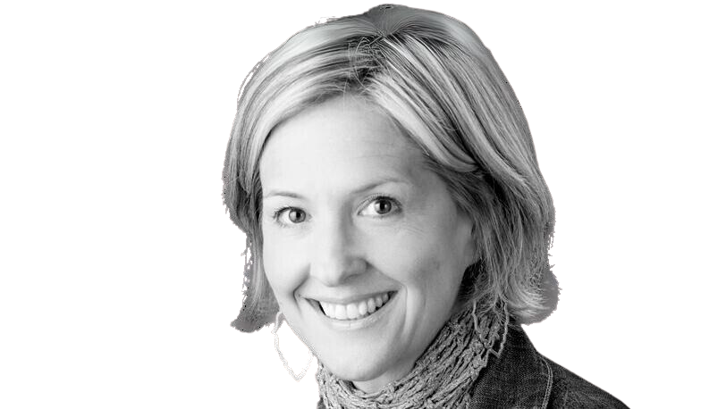
In terms of AI, I hear a lot of experts trying to soothe people’s anxiety about the pace of technological change by offering platitudes like
“What makes us human will ensure our relevance.”
This is dangerous simply because, right now, we’re not especially good at what makes us human.
Brene Brown - Strong Ground
Notes:
Tech has driven disconnection, loneliness - crave community and real life connection
Fear drives self protective behaviours rather than openness
Polarisation instead of understanding
EG - Gen X vs Gen Z (we raised them!) and they just need the why. Hear more commonly frustrations and irritations between the two
Talking and interrupting more, listening less...

Slide 11

The tech is striding ahead to meet these changing expectations, are you?

Slide 12
SLIDO:
What skills do you think you might need to develop over the coming years to meet changing client expectations?
WORD CLOUD

Slide 13
What's the gap between the Financial Planner you are today and the one you need to become?

Slide 14

Every action is a vote for the person you want to become
James Clear (Atomic Habits)

Slide 15
What's the gap between the Financial Planner you are today and the one you need to become?

Slide 16

Define an outcome
Uncover the main assumption getting in the way
Assess it
Replace it
Play with a new story
What challenging step do you want to take to close that gap?
What might you be assuming that will stop you?
What are you assuming that will most stop you?
Is that assumption true? What are your reasons?
You want to take that step. So, what could you credibly assume instead, in order to do so?
If you knew *** how would you ***?

Slide 17
Define an outcome
Uncover the main assumption getting in the way
Assess it
Replace it
Play with a new story
If you knew *** how would you ***?

Slide 18
Who do you need to be to serve your clients?

Slide 19
Who do you need to become to serve your future clients?

Slide 20

Next steps:
Be intentional - create time to think
Find and challenge your own limiting assumptions
Actively seek opportunities to develop your skills

Slide 21
Learning outcomes
Considered the needs and expectations of tomorrow’s clients
Assessed the skills you will need to serve them
Identified obstacles that might hinder your development
Understood the anatomy of “lightbulb moments”
Developed a tangible next step for your career development

Slide 22





Thank you
Steps to move forward when you (or your clients!) feel stuck
www.whenwethink.me
becca@whenwethink.me
Becca Timmins

