Slide 1

Client psychology: The competitive edge for modern advisers
Dr Philip Courtenay
Humans and Money

Slide 2

Client psychology
The competitive edge for modern advisers
Dr Philip Courtenay

Slide 3
Learning objectives
1
Spot the psychological factors that cause clients to procrastinate, avoid, or undervalue advice.
2
Pinpoint the friction points in the advice journey that silently cost conversion, retention, and referrals.
3
Use behavioural science techniques to make advice easier to act on - and show your value more clearly.

Slide 4
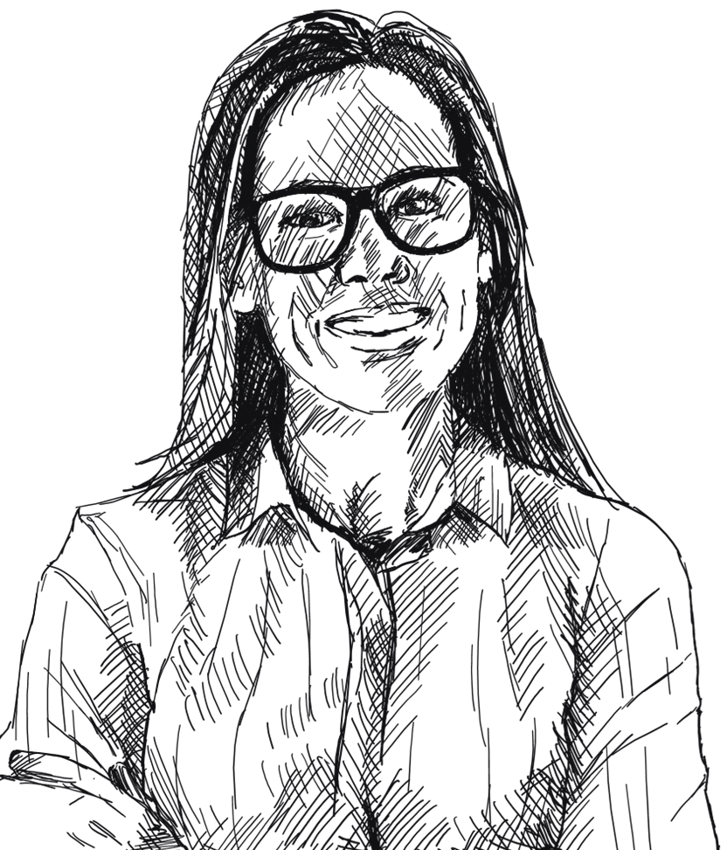
Avoid advice
Procrastinate
Don’t see your true value

Slide 5
Motivation is rarely the issue.
Notes:
Motivation is rarely the issue.
…So what is?

Slide 6
The 3Es
Motivation
Costs
Emotions
Economics
Effort

Slide 7
Pre-contemplation
Not thinking about advice
Notes:
Getting fit example

Slide 8
Problems ≠ Symptoms
Notes:
Identity as a good parent is felt now.

Slide 9
Pre-contemplation
Not thinking about advice
Contemplation
Weighing up whether to engage you

Slide 10


Slide 11
Doing more doesn’t create value, salience does.
Notes:
Insurance example of specificity.
People can picture having to give up their house in retirement. Or their family struggling if they passed away.

Slide 12

Notes:
Overwhelm of too much info
Focus on THE most important thing first.

Slide 13
Pre-contemplation
Not thinking about advice
Contemplation
Weighing up whether to engage you
Preparation
Planning to become a client

Slide 14
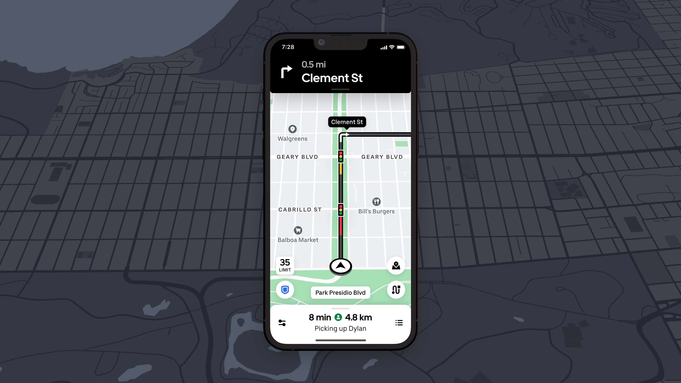
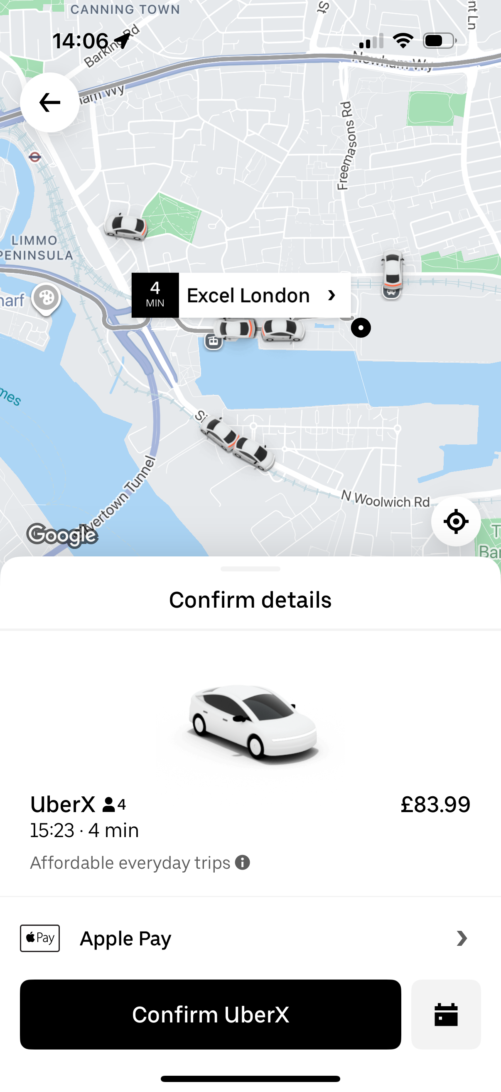
You can’t always control how difficult things are.
But you can control how difficult they feel.
Notes:
Uncertainty feels long.
Ambiguity feels long.
Reduce uncertainty:
Deliveroo/Uber example of reducing perceived time (or McDonalds in-house where you see your order number and progress)
Or make it more enjoyable. (e.g. Netlify game whilst deploying)

Slide 15
Pre-contemplation
Not thinking about advice
Contemplation
Weighing up whether to engage you
Action
Preparation
Taking advice
Planning to become a client

Slide 16

Notes:
Toilet paper being folded example knowing cleaning has taken place
A lot of the work you do is behind the scenes.

Slide 17
Don’t think of a big red bus.
Notes:
Here’s a task for you….
I said DON’T think of one!
If we put an investment performance chart in front of someone,
we’re telling them… investment performance is important!

Slide 18
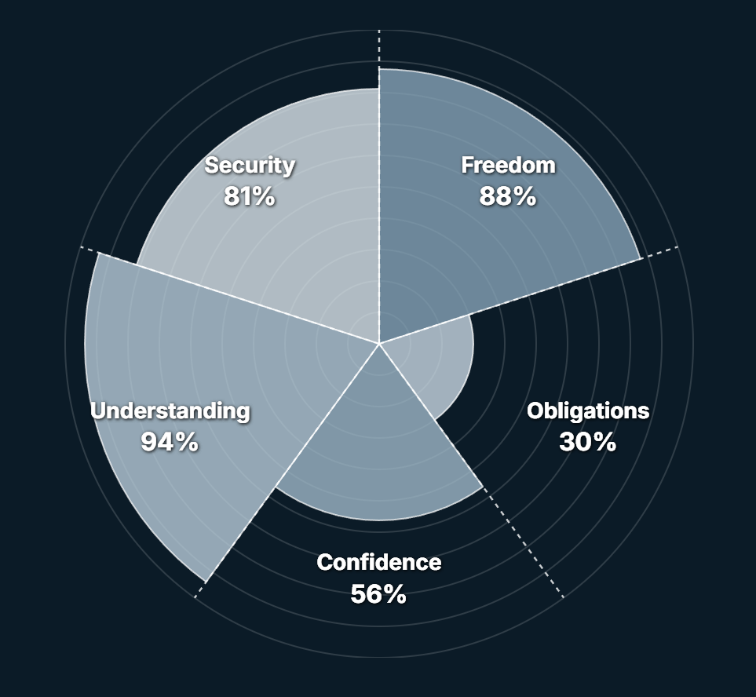
What do you want clients to pay attention to?

Slide 19
Pre-contemplation
Not thinking about advice
Maintenance
Contemplation
Feeling like they’ve made a good decision
Weighing up whether to engage you
Action
Preparation
Taking advice
Planning to become a client

Slide 20

Notes:
Reinforce progress and good decision they’ve made.

Slide 21
Learning outcomes
1
Spot the psychological factors that cause clients to procrastinate, avoid, or undervalue advice.
2
Pinpoint the friction points in the advice journey that silently cost conversion, retention, and referrals.
3
Use behavioural science techniques to make advice easier to act on - and show your value more clearly.

Slide 22


Thank you
Dr Philip Courtenay
www.HumansAndMoney.com

