Slide 1


Slide 2
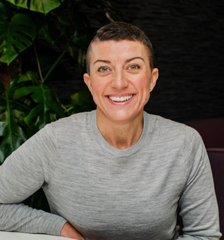
Elevating excellence! Turning the ordinary into extraordinary
Michelle Hoskin
Standards International

Slide 3



Elevating Excellence™
Turning the ordinary into the extraordinary!
Michelle Hoskin

Slide 4

Learning Outcomes
  Identify and eliminate operational complexities to create simpler, more effective ways of working.
  Understand how beliefs, trust, and authenticity shape team culture, performance, and leadership impact.
  Apply the 6 Human Needs framework to build stronger, more connected, and motivated teams.
  Adopt the concept of ‘Teamship’ as the foundation for sustainable collaboration and success.
  Explore and implement The 5 Key Elements of Excellence™ as a focused framework for operational growth.
  Gain insight into what’s really going on in your business and feel inspired to take confident, next-step actions.
© Standards International Ltd 2025. All rights reserved. Standards International, WOWW! and The Paraplanner Standard are all trademarks.

Slide 5
Help you to...
Understand
the real gaps!

Slide 6
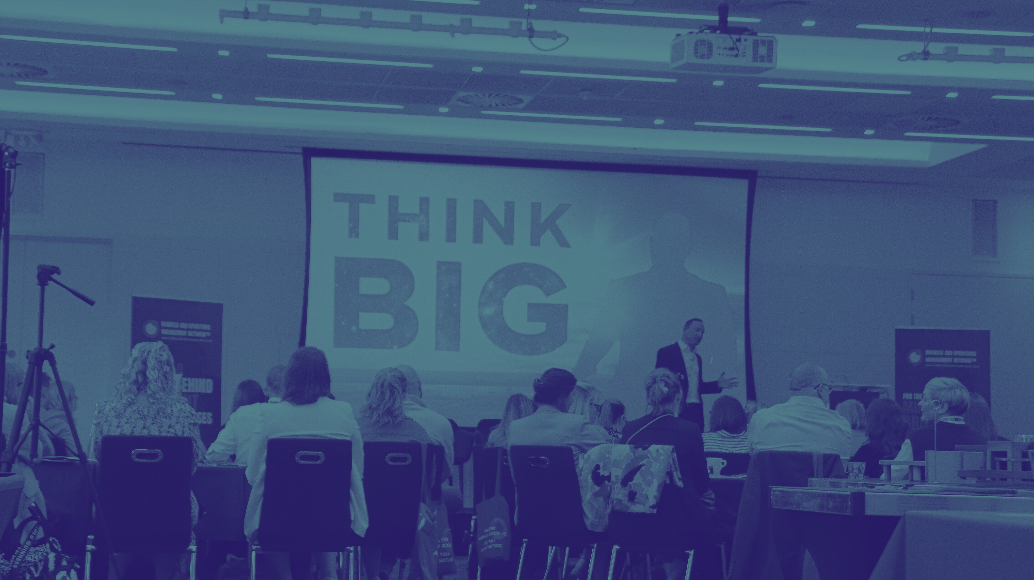
Change is never a matter of ability; it's always a matter of motivation!
Tony Robbins

Slide 7


The Great 're' Evaluation

Slide 8

the real gap!
Who’s showing up?
Authenticity doesn't automatically guarantee success,
but inauthenticity guarantees failure.
Every time. Always
Jamie Kern Lima

Slide 9

the real gap!
WHAT DO
YOU BELIEVE?
... how’s that
working out for you?
© Standards International Ltd 2024.

Slide 10

‘Who’ and ‘what’ is running your business?
... and how’s that working out for you?
© Standards International Ltd 2024.

Slide 11

STANDARDS
V's
EXPECTATIONS
the real gap!

Slide 12


Business planning & communications
The 5 Elements of
EXCELLENCE™
Team engagement & productivity
Operational & technology frameworks
Service innovation & client proposition
Brand strategy & marketing
www.leadersinbusinessoperations.com

Slide 13

‘You’ is no longer an option!
Your move!

Slide 14


the real gap!
Do you have the right team?

Slide 15

Company Strapline
21

Slide 16
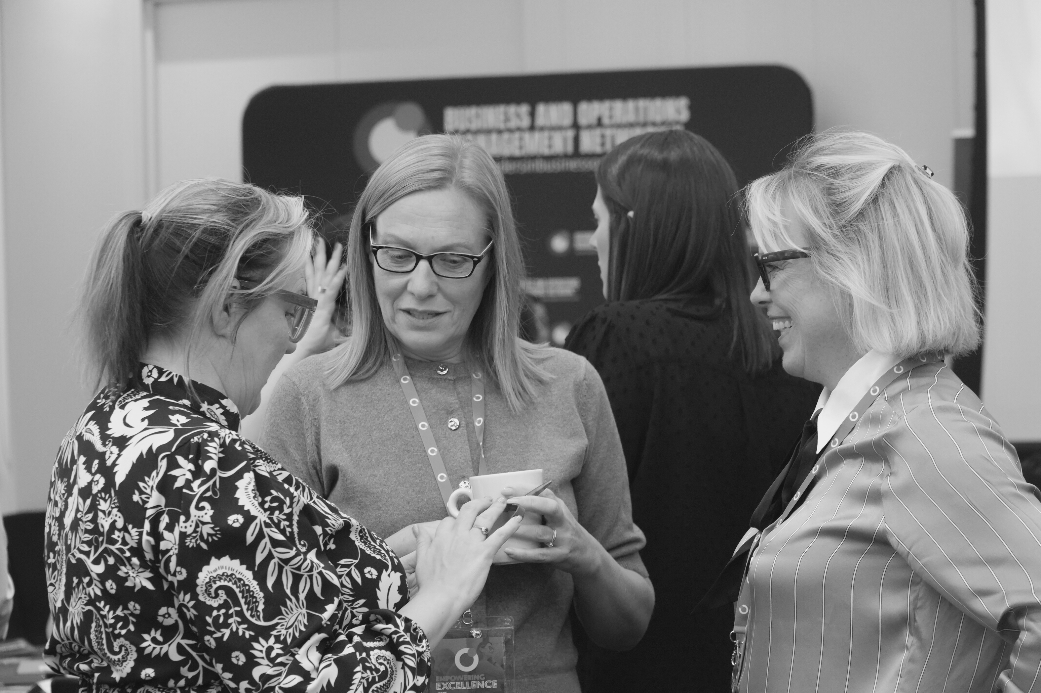

the real gap!
Do they trust you?

Slide 17
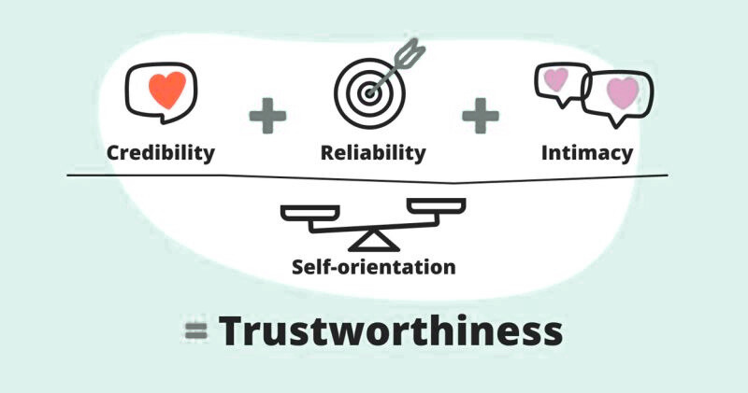
Here is a graphic and a blog post I really liked. - https://blog.jostle.me/blog/trust-equation

Slide 18
the real gap!
“
You aren’t learning anything when you’re talking.”
Lyndon Johnson
Notes:
1.7.2013
6
‹#›

Slide 19






Robbins Research International -https://www.tonyrobbins.com/mind-meaning/do-you-need-to-feel-significant/
The 6 Human Needs
Certainty
Significance
Growth
assurance you can avoid pain and gain pleasure
feeling unique, important, special or needed
an expansion of capacity, capability or understanding
U
C
C
C
S
G
Uncertainty
Connection
Contribution
the need for the unknown, change, new stimuli
a strong feeling of closeness or union with someone or something.
a sense of service and focus on helping, giving to and supporting others

Slide 20






Which needs are in YOUR driving seat?
... and how are they calling the shots!
Notes:
1.7.2013
16
‹#›

Slide 21

Your move!

Slide 22
Business planning & communications
The 5 Elements of
EXCELLENCE™
Team engagement & productivity
Operational & technology frameworks
Service innovation & client proposition
Brand strategy & marketing
www.leadersinbusinessoperations.com

Slide 23

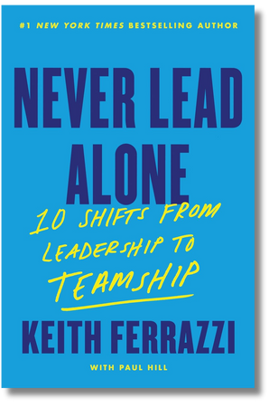
TEAMSHIP = A SHIFT TO COLLABORATION OVER
COMPETITION AND MUTUALLY ACCOUNTABLE UNITS.
1. The Four Key Behaviours of Teamship:
  Co-Elevation: Team members lift each other to achieve common goals, prioritising collective success over individual ambitions.
  Candour: Open, honest communication is encouraged, fostering trust and enabling constructive feedback.
  Accountability: Members hold themselves and each other responsible for their contributions and commitments.
  Generosity: A willingness to support and invest in each other’s success without hesitation.
2. Creating an environment where everyone feels safe (Psychological Safety).
3. We are all Leaders, facilitators and role models, creating the conditions for team’ship to flourish. NO MORE I
4. Building a Culture of "Continuous Transformation".
5. Be clear on our Purpose.
6. Healthy conflict is essential for growth and innovation.
7. Measure and celebrate success.

Slide 24








The Evolution of
Excellence™
Educate
awareness and understanding
Endless
Establish
your ways of working
your practices & principles
Excellence
Elevate
Embed
Just start...
continual improvement
to the next level
© Standards International Ltd 2025. All rights reserved. Standards International, WOWW! and The Paraplanner Standard are all trademarks.

Slide 25

Operations is the unseen force behind every business. It's the bridge between strategy and delivery...
Michelle Hoskin

Slide 26
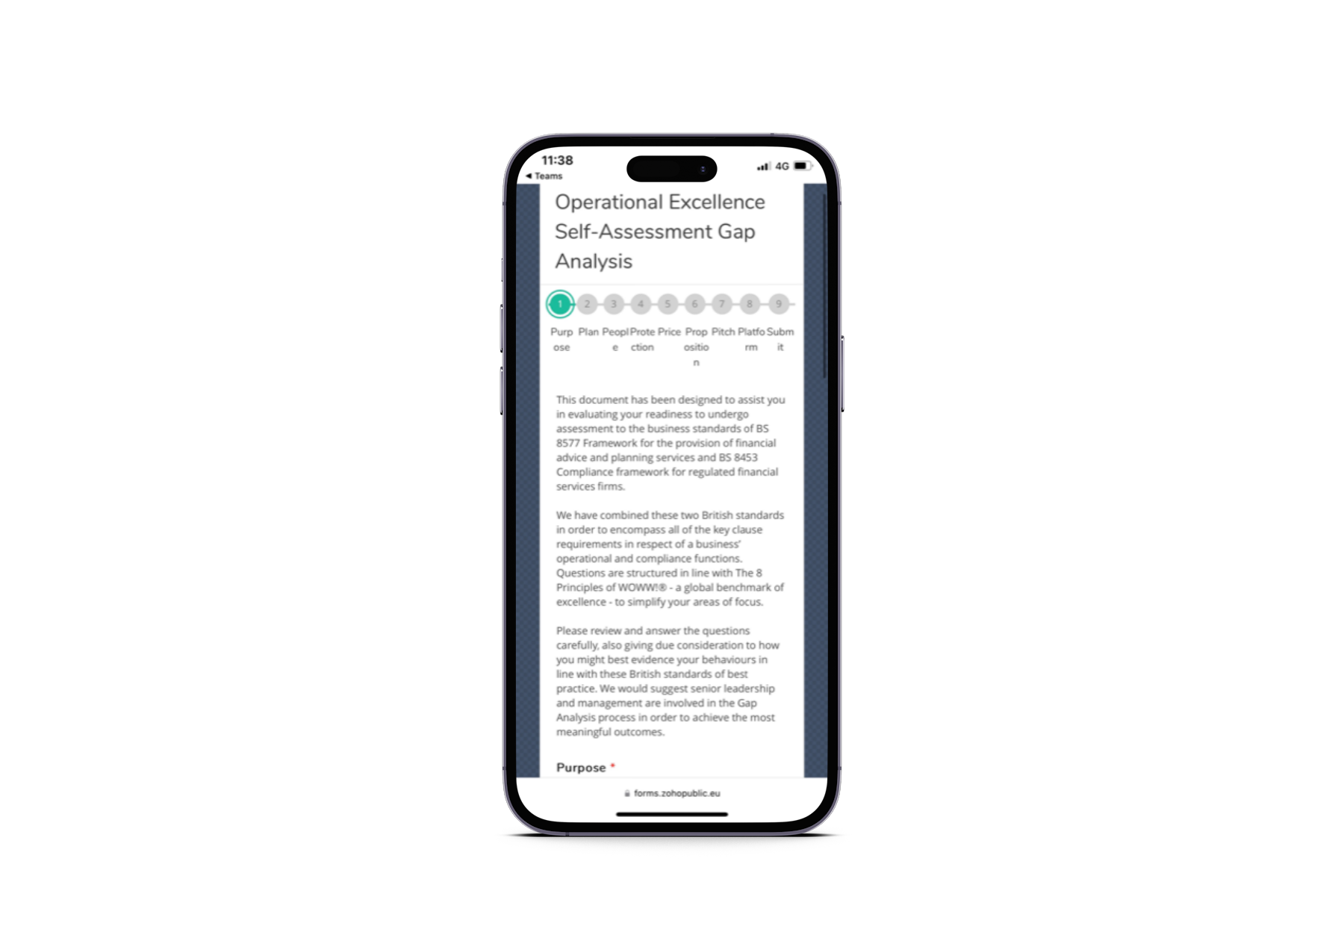



An insight like no other...
Find your ‘real’ gaps!

Slide 27

We are building
a global community!
Community . Connection . Collaboration

Slide 28

We’ve been busy...
Strategy
Full business plan and strategy signed off!
Community
Training programme(s)
We’ve hit over 450 members in our LinkedIn group and over 160 inside of The Vault
12 Week Programme - Feb 2026 intake live!
Ambassadors
Approved, Certified and Advanced Certified Business Management
11 global ambassadors in place and committed to supporting/growing the membership - Ambassador enrolment opens January 2026
Partnership with Skills Edge in motion!
Conference
Business Unbound Podcast
Empowering Excellence Conference and Awards - a resounding SUCCESS! 2026 bookings open!
Scheduled for launch Q1 2026
Knowledge Works
The Leadership Unbound Retreat
Videos launched!
The Leadership Unbound retreat - planning underway!
Member Check -ins!
Bi - weekly ‘The Vault Check - ins’ well and truely underway with Masterclass sessions schedule too!
... and so much more!

Slide 29
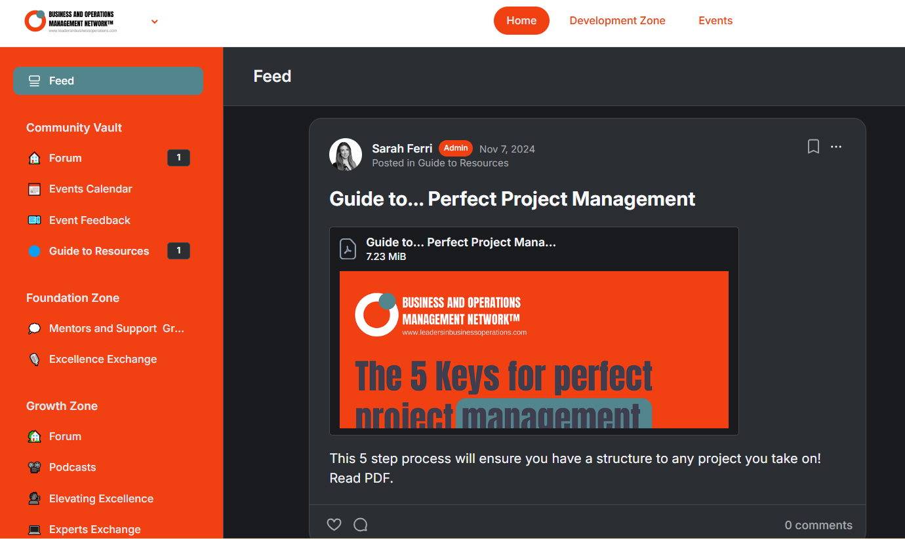
The Members Vault
Membership
EXCLUSIVE!
Unlock your true potential.
Community . Connection . Collaboration
Notes:
7

Slide 30
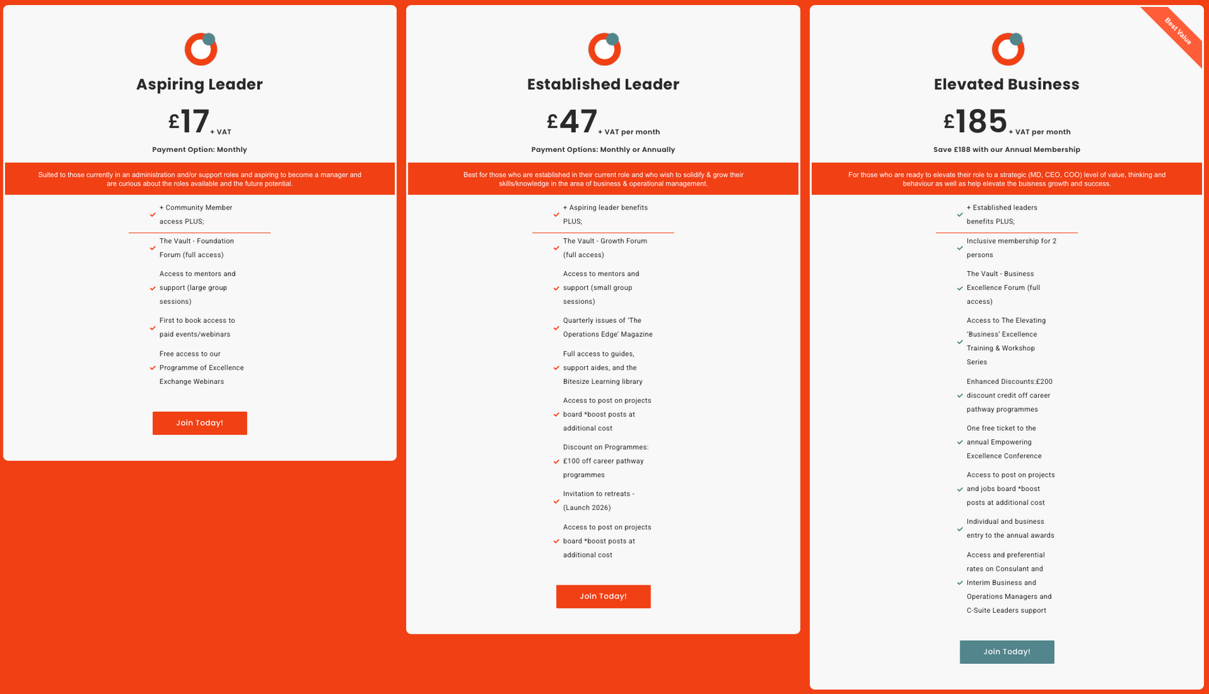
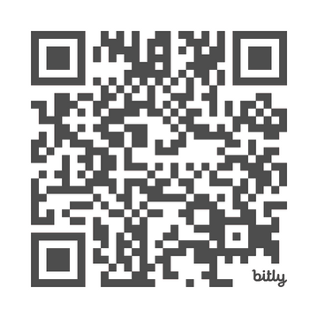
SUPPORT YOUR TEAM!
DEVELOP YOUR LEADERS!
ELEVATE YOUR BUSINESS!
Join your community!
Community . Connection . Collaboration

Slide 31
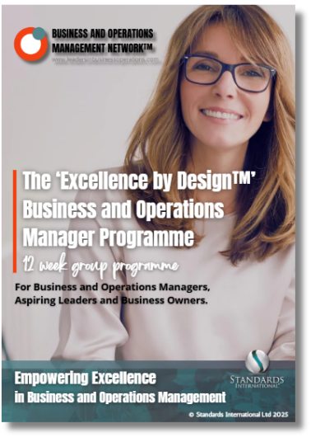
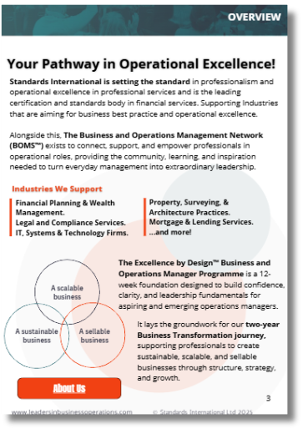
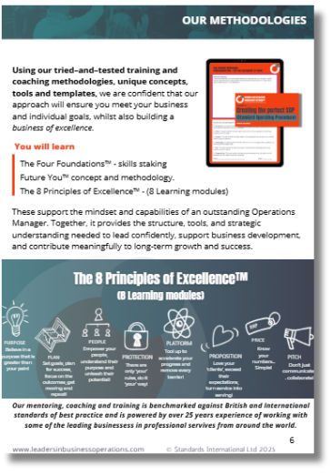

Approved Business and Operations Managers Programme
Community . Connection . Collaboration

Slide 32
Learning Outcomes
  Identify and eliminate operational complexities to create simpler, more effective ways of working.
  Understand how beliefs, trust, and authenticity shape team culture, performance, and leadership impact.
  Apply the 6 Human Needs framework to build stronger, more connected, and motivated teams.
  Adopt the concept of ‘Teamship’ as the foundation for sustainable collaboration and success.
  Explore and implement The 5 Key Elements of Excellence™ as a focused framework for operational growth.
  Gain insight into what’s really going on in your business and feel inspired to take confident, next-step actions.
© Standards International Ltd 2025. All rights reserved. Standards International, WOWW! and The Paraplanner Standard are all trademarks.

Slide 33
THANK YOU

