Slide 1

What do investors think about Gen AI in financial advisers’ workflow?
James Street
Morningstar

Slide 2

What Do Investors Think About Gen AI In Financial Advisers’ Workflow?
James Street, Senior Wealth Solutions Manager, Client Strategy
November 2025
Notes:
Today, we have the pleasure of hearing from two experts from Morningstar’s Behavioral Finance team: Dr. Danielle Labotka, a Behavioral Scientist, and Samantha Lamas, a Senior Behavioral Researcher. They will share insights from their recent research on how generative AI is impacting the workflow of financial advisers and, importantly, what investors think about these changes. Without further ado, I'll hand it over to Danielle and Samantha.
When it comes to financial advising, there’s this idea that Gen AI can help advisors manage their ever-increasing workload.
Clients demand more than ever from you, so Gen AI seems like the perfect solution to scale your practice.
When it gets to the nitty gritty, incorporating Gen AI is harder to navigate.
Even in our internal research, we see that advisors are interested but they need more education/support
Now, on one side it’s the how-to, it’s the prompt, it’s the multitude of options, etc.
On the other it’s the actual implementation with clients.
In a world where the human touch that advisors provide is one of their main differentiator from tech, what will investors think of Gen AI?
You don’t want another form of tech that could alienate clients.
In our research, we investigated how advisors can implement Gen AI in way that add to the client-advisor relationship, in a way that doesn’t backfire.
To set the stage:
Give you our high-level findings
Walk through our research and explain how we came to those conclusions
Then we will give you a breakdown on how you apply these insights to your practice. A Takeaway Checklist.
Go through an example to hammer the points in.
S

Slide 3
Learning Objectives
Understand the most common challenges and misconceptions around AI adoption in smaller advice businesses, especially around client trust and privacy.
Explore the practical Gen AI use cases that can be implemented without specialist support.
Learn how to organise and use client data responsibly to maximise the benefits of AI while maintaining trust and compliance.

Slide 4
Todays agenda
Background– What is AI and why is it so popular?
Our Research – What we looked at and why
Our Findings – What we found
Using AI in your practice – Let’s get practical

Slide 5

Leverage learnings from advisers around the world
An organisation that brings together local experience and global resources to empower investor success
  $368.6 billion
  Assets Under Management and Advisement Worldwide
  400+
  Research & Investment Professionals
  255,000
  Financial Advisers Serviced
  10 million+
  Investors
  12,000+
  Morningstar employees
Morningstar, as at 30 September 2025
Notes:
BY WAY OF A BACKGROUND TO TODAY'S SPEAKERS AND TOPICS AND BECAUSE THERE ARE SO MANY NEW FACES HERE THIS MORNING
I THOUGHT IT WOULD BE USEFUL TO GIVE EVERYONE A QUICK OVERVIEW ON M* AND HOW IT HAS BEEN HELPING ADVISERS ACROSS THE WORLD
M* HAS BEEN SUPPORTING, TALKING TO, LISTENING AND LEARNING FROM ADVISERS GLOBALLY SINCE 1984
OVER THAT TIME THE BUSINESS HAS GROWN FROM JOE MANSUETO'S CHICAGO APARTMENT TO A WORLD RESPECTED ORGANISATION
ALONGSIDE THE BLACK AND WHITE RESEARCH WE DELIVER, WE HAVE ALSO DEVELOPED THE MORE NUANCED BEHAVIOURAL SCIENCE TEAM, ALONGSIDE OUR FINTECH EXPERTS AND CLIENT SERVICE SPECIALISTS – WE WORK TOGETHER
HOW DOES THAT LOOK?
When you work with Morningstar Wealth you leverage learnings from advisers around the world. And you do this in two ways
1) Our products and services incorporate everything we’ve learnt from over 255,000 advisers around the world
2) you get access to that community of advisers – through events and our content.
We really understand advisers and their clients – demonstrated by our AUM and number of advisers who partner with us around the world. ​
Clients are individuals, ​
Advisers and their clients are served by local and global teams including :
A 400+ Research and investment team means we have unapparelled access to research, data and those insights are what you and your clients access through our Investment management capability. Global expertise and local knowledge. Insert – number of analysts in which countries​
Safe pair or hands – trusted​
Behavioural scientists
Technology experts
Adviser client service specialists
​
.

Slide 6
The background of AI

Slide 7
Artificial Intelligence (AI): refers to computer systems capable of performing tasks that typically require human intelligence, such as reasoning, learning, perception and language understanding.
Source: International Organization for Standardization

Slide 8

How do you feel about using AI in your advice workflow?
1-3 - Still not very confident about using Gen AI in my workflow
4-7 Moderately confident, I would consider using Gen AI in my workflow
7-10 - I am very confident/ I am using Gen AI in my workflow

Slide 9
AI’s near exponential growth
S&P 500 Earnings Calls: "AI" Mentions
Source: FactSet. For illustrative purposes.
Notes:
Mentions of “AI” on S&P 500 earnings calls continue to go in one direction.

Slide 10
The types of AI
Type | Core Function | What It Does | Example Use Cases
Predictive AI | Analyses patterns to forecast outcomes | Uses data and statistical models to predict what will happen next. | Credit risk scoring, demand forecasting, fraud detection, predictive maintenance
Prescriptive AI | Recommends or decides optimal actions | Suggests what should be done, often using reinforcement or optimisation models. | Route optimisation, portfolio allocation, decision automation
Conversational AI | Understands and interacts via natural language | Uses natural language processing (NLP) to engage in human-like dialogue. | Chatbots, virtual assistants, customer service bots
Generative AI | Creates new content from learned patterns | Generates text, images, code, audio, or video. | ChatGPT, DALL·E, Copilot, design generation, simulation

Slide 11
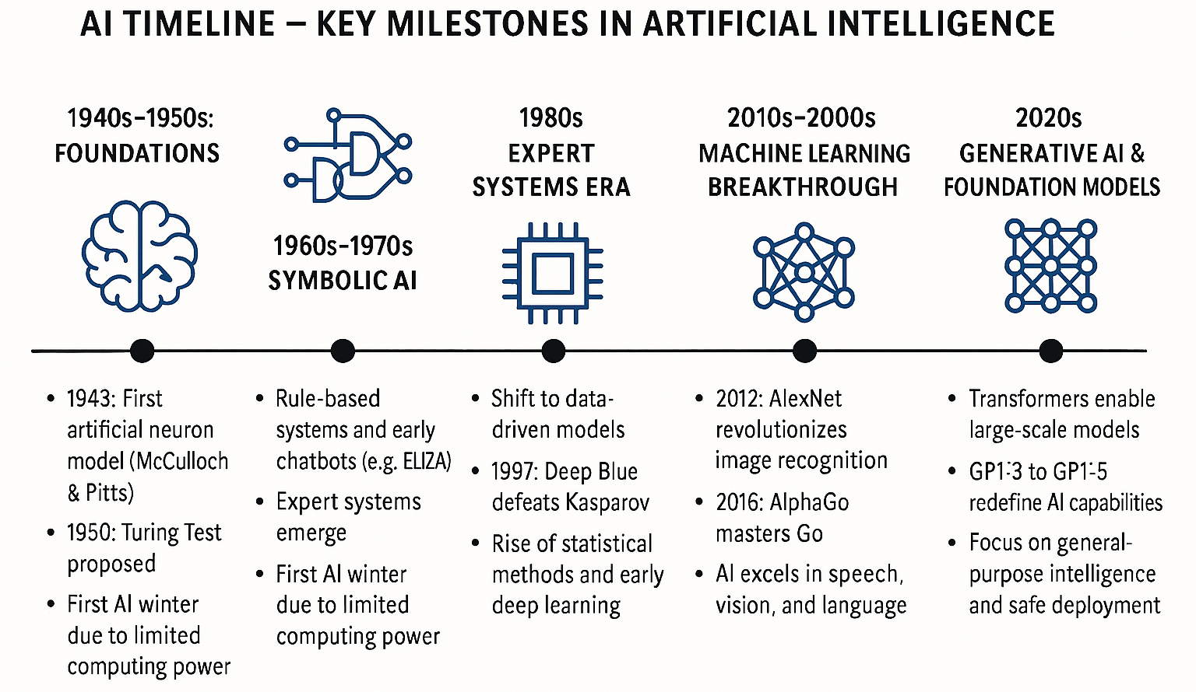
The history of AI, according to AI

Slide 12
The history of AI, according to AI

Slide 13
The history of AI, according to AI (and James)
Era | Key Moments | Why It Matters
1950s – 1970s | Turing poses the AI question (1950) Early problem-solving programs Term “Artificial Intelligence” coined (1956) | Establishes the foundation for machines performing human-like reasoning.
1980s – 1990s | Expert systems used in business and industry Early speech recognition Machine learning gains traction | AI shifts from research labs into commercial and industrial applications.
2000s | Rise of the internet and big data Graphics Processing Units (GPU) enable faster training | Data and computing power reach the scale needed for modern AI.
2010s | Deep learning breakthroughs in vision and speech AI powers everyday products: search, translations, recommendations | AI becomes embedded in global consumer and enterprise technology.
2020s – Today | Generative AI emerges Natural language interfaces Rapid acceleration in capability and accessibility | AI becomes a creative and collaborative tool that reshapes work, communication and innovation.
Notes:
Speaker Notes – AI Timeline
Intro:
“Let’s walk through how AI evolved — decade by decade — from theory to today’s generative models.”
1940s–1950s – The Birth of Thinking Machines
1943: First artificial neuron by McCulloch & Pitts.
1950: Alan Turing asks, ‘Can machines think?’ and proposes the Turing Test.
1956: Dartmouth Conference — the term ‘Artificial Intelligence’ is born.
AI begins as an academic idea — machines that might reason like humans.
1960s–1970s – Logic and Language
Symbolic AI tries to teach machines logic and language.
1966: ELIZA mimics conversation — impressive but shallow.
First AI winter hits as progress stalls.
AI can follow rules but can’t learn — enthusiasm cools.
1980s–1990s – Expert Systems to Data Learning
1980s: Businesses adopt expert systems like XCON.
1986: Backpropagation revives neural networks.
1997: IBM Deep Blue beats Garry Kasparov at chess — a global moment.
AI shifts from hand-coded rules to learning from data.
2000s–2010s – Deep Learning Revolution
Big data, GPUs, and neural networks change the game.
2012: AlexNet dominates image recognition — deep learning goes mainstream.
2016: AlphaGo beats world Go champion Lee Sedol, proving AI can master intuition and strategy.
Deep learning makes AI practical, powerful, and headline-worthy.
2020s – Generative Intelligence Era
2017: Transformers introduced — foundation of modern generative AI.
2020: GPT-3 explodes into public use.
2023: GPT-4 adds multimodal reasoning.
AI now creates, reasons, and interacts — shifting focus to safety and responsible use.
Wrap-up:
“Across 80 years, AI has evolved from simple neurons to creative intelligence — from thinking to learning to creating.”

Slide 14
The argument for financial advisers

Slide 15
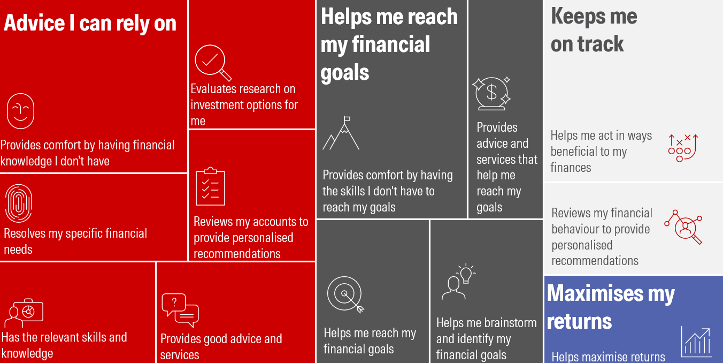
Advisors’ value proposition is changing
Notes:
But we also have data that validates this focus on human services.
This is a mind map we constructed by synthesizing the findings of four different studies we in Morningstar Behavioral Insights conducted on what clients value in working with a financial advisor. Across the studies, we found evidence for the four major value adds represented that are represented here: advice I can rely on, helps me reach my financial goals, keeps me on track, and maximizes my returns. You’ll see that each value has a different amount of real estate on the mind map, and that real estate reflects how much evidence we found for each value.
What is striking about this is that one value represents the more traditional role of financial planning, maximizes my returns, but it actually takes up the least amount of space compared to the other three values that dominate the map that reflect those human services advisors provide.
Let’s talk a little bit more about what they entail and why clients value them so much.

Slide 16
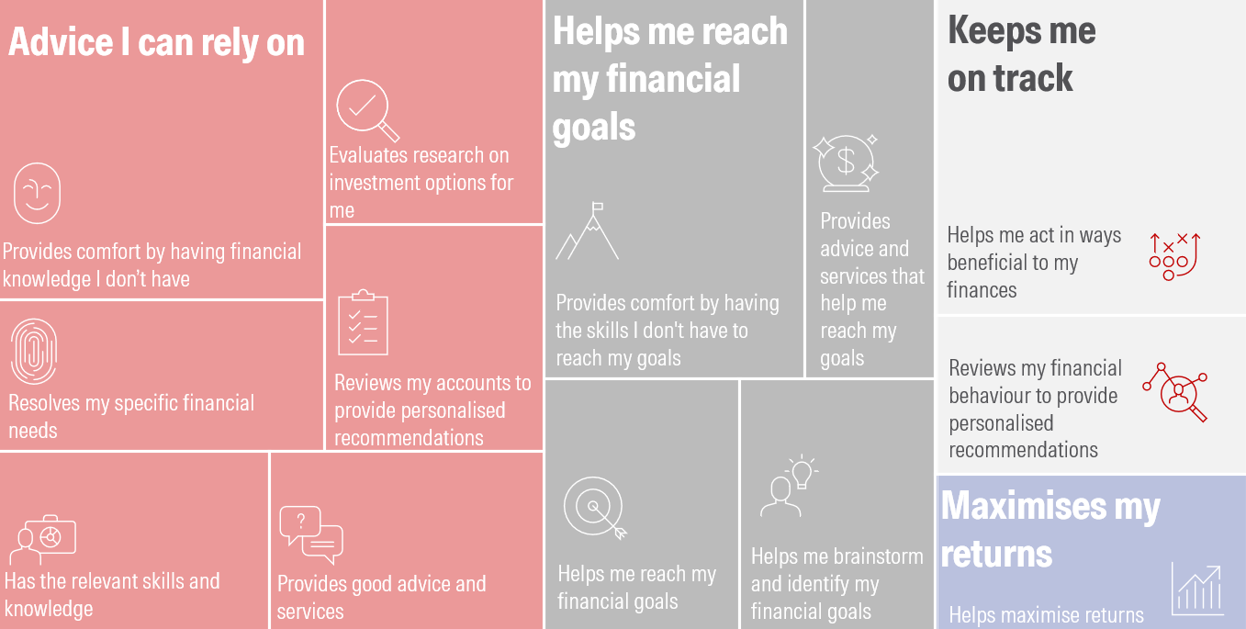
Notes:
Let’s start by talking about the value “keeps me on track”. This is a client-friendly gloss for behavioral coaching, which is that support advisors provide clients to help them make better decisions.
Other researchers have done work that shows that behavioral coaching is one of the most valuable services advisors provide their clients, and here we see that clients appreciate the support advisors give them with their behavior, even if they don’t call it “behavioral coaching” directly. In our studies, clients said things like appreciating having an advisor who could serve as a sounding board, who served as financial educator, who understood that humans are complex and can make mistakes and worked to provide their clients support accordingly—in short, behavioral coaching

Slide 17
Advisors’ value proposition is changing
Notes:
The next big value we found was “helps me reach my financial goals.” That is, that clients appreciate goals-based planning.
This is probably not news to the many advisors who already focus on goals-based planning. When you look at the constituents of this value, though, you’ll see that it wasn’t just that investors valued hitting their financial goals. They also valued the support advisors were able to give them along the way—from helping them identify their goals, to having the skills and expertise to respond reflexively to changing circumstances and goals.

Slide 18
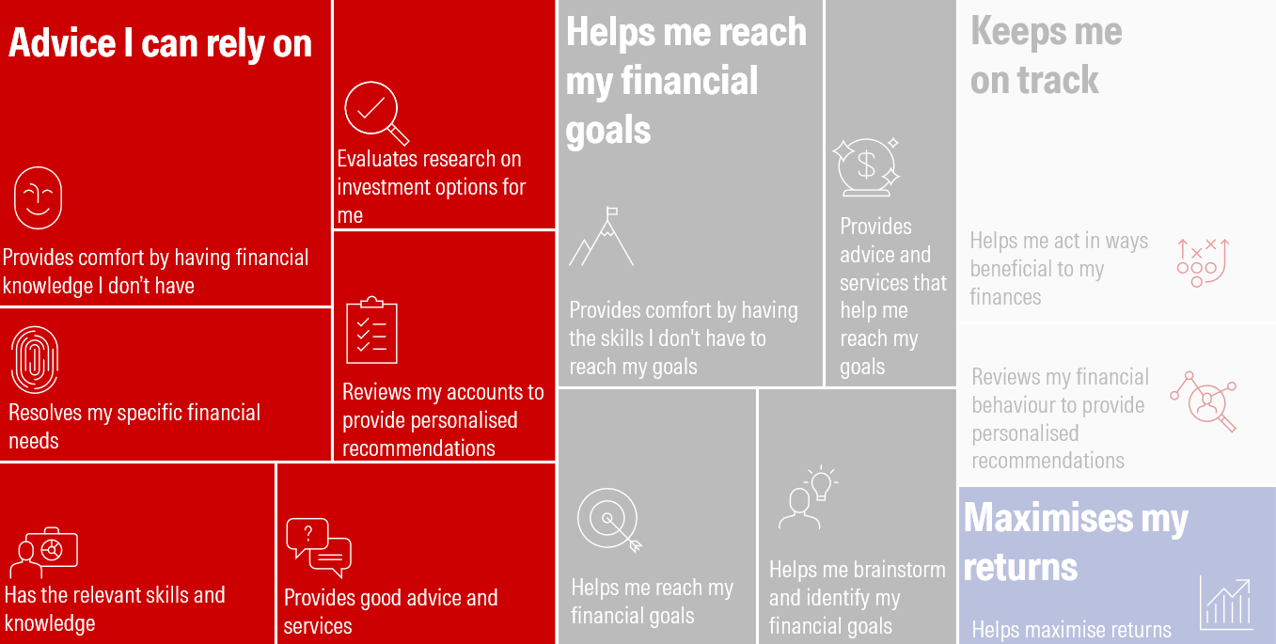
Notes:
Finally, the value we found the most evidence for was “provides advice I can rely on.” This is rooted in having a well-constructed and expertly-made financial plan, but it goes deeper than that.
When we dove into the responses people gave us in these studies, we saw that they wanted not just expert advice, but expert advice that saw them. This means providing advice that is specific to the client, that understands them, that helps them sleep better at night.
All these values may seem like things technology can do on the surface, but what we found by diving deeper is that clients value the human connection behind them—which technology can’t ever touch.
Now this information is largely good news for advisors. It shows how their clients are truly seeking out those human services from them even amid a time of fast-growing technology. But it also creates a problem in that these human-forwards services are time-consuming.

Slide 19
Morningstar’s research on generative AI and financial advisers

Slide 20
What AI is good at
What advisers want to offload to AI
Notes:
When it comes to using new technology, there is a tendency to fall into two camps. Either I’m going to use it for everything I can possibly think of or I’m going to use it for nothing at all. But as with Goldilocks, the extremes are probably not right, so let’s start by creating a framework for evaluating what falls into the “just right” category. On the screen, is the framework I often see people using when considering how to use AI in financial planning. It has two criteria: 1) use AI for things it’s good at and 2) use AI for things advisors want to offload.
Advisors will want to keep doing the most valuable services they provide clients themselves like giving them support for their goals, helping them make good decisions, helping them feel confident in their financial plan. So, you need to find activities that you may want to offload to AI. Maybe you don’t like writing emails or you struggle with creating marketing materials.
But then you must consider what AI is good at because we know it’s not good at everything. It’s very good at doing things like summarizing information, writing in different tones, and so on. But it doesn’t have critical thinking. It doesn’t have empathy. And on its own, it’s bad at math. So, if you don’t enjoy something like talking your clients off the edge when markets are bad, that doesn’t mean you can offload it to AI because it will struggle to convincingly provide what your clients need.
While this framework is a good start, it is missing something important…

Slide 21
What AI is good at
What advisers want to offload to AI
What clients are comfortable with
Notes:
Which is how clients feel about different use cases of AI in financial planning.
Behavioral science has long known that people are resistant to things like AI making decisions. Something we call algorithm aversion. For example, rideshare drivers often will miss out on known performance gains by rejecting algorithm generated recommendations in favor of less proven, human recommendations.
Algorithm aversion means the wrong uses of AI can erode trust and have a counterproductive effect on your relationship with them, which defeats the purpose of using it in the first place
But this means there will be more shades of gray. As we will discuss, there are some use cases that might fit neatly in the center but similar use cases similar use cases won’t. And, what fits into the center may change over time. So at the end of this presentation we’re not going to give you a neat little version of this Venn diagram with a list of things that do or don’t work. Instead, we’re going to give you’re a framework which can be applied as you go to help you make good decisions with AI in your practice.
And this is a good thing because the differentiator for advisors going forward will not be between who uses AI and who doesn’t but who thinks critically about their use of AI and who doesn’t because your thoughtless use of AI can harm your relationships with clients.
But I don’t just expect you to take my word for it. I’m drawing on our own research about clients’ comfort with AI in financial planning.
So, S, can you walk us through how we did this research?

Slide 22
 | “Your adviser uses Gen AI when…”
Providing personalised recommendations | ‘When reviewing your existing accounts and financial behavior to help them provide personalised recommendations to you.’
Conducting investment research | ‘To help them when evaluating research on investment options for you.’
Assisting in goal generation | ‘Helping you brainstorm and identify your financial goals.’
Drafting marketing communication | ‘Writing marketing content intended for your demographic.’
Creating an educational resource | ‘Summarising existing resources to create an educational PDF for you based on a topic you brought up in your last meeting.’
Generating a personalised email | ‘Writing a personalised email to you wishing you luck on an upcoming vacation.’
Notes:
Yes, we started by collecting potential use cases of Gen AI in financial advising.
We narrowed it down to the six uses cases here on the screen.
Not an exhaustive list, but you can see how we are touching on these key themes regarding the use of Gen AI in advising.
For example, everyone is worried about hallucinations, and our use case of conducting investment research incorporates that concern.
Another concern is Gen AI encroaching on an advisor’s role of providing a human touch, and the ‘Generating a personalized email’ starts to get at that idea.
Another common concern is privacy issues regarding client data, and we see that play out in the ‘providing personalized recommendations’ use case.

Slide 23


Adviser with AI
Adviser alone
N = 1218
N = 636
Comfort level
Relationship impact
Willingness to pay
Notes:
In our study, we asked on group of investors (N – 1218) to consider hypothetical scenarios where their advisor is using Gen AI while performing these behaviors.
Then we asked follow-up questions to gauge people’s reactions to these use cases. We asked how comfortable they were with their advisor using Gen AI in this way, how this would impact their relationship, and how much they would be willing to pay this advisor for this action. We also asked questions to understand why people reacting this way which can inform how we can manage these reactions.
Then we asked a completely separate group of investors (N – 636) to consider these same scenarios, but this time the advisor is completing these actions on their own. No mention of Gen AI. Then we ask the same follow up questions to gauge their reactions. This group is our baseline, they allow us to measure IF and to WHAT EXTENT the addition of Gen AI affected investors reactions.
With that, let’s talk about what we found. Danielle, can you walk us through our results?

Slide 24
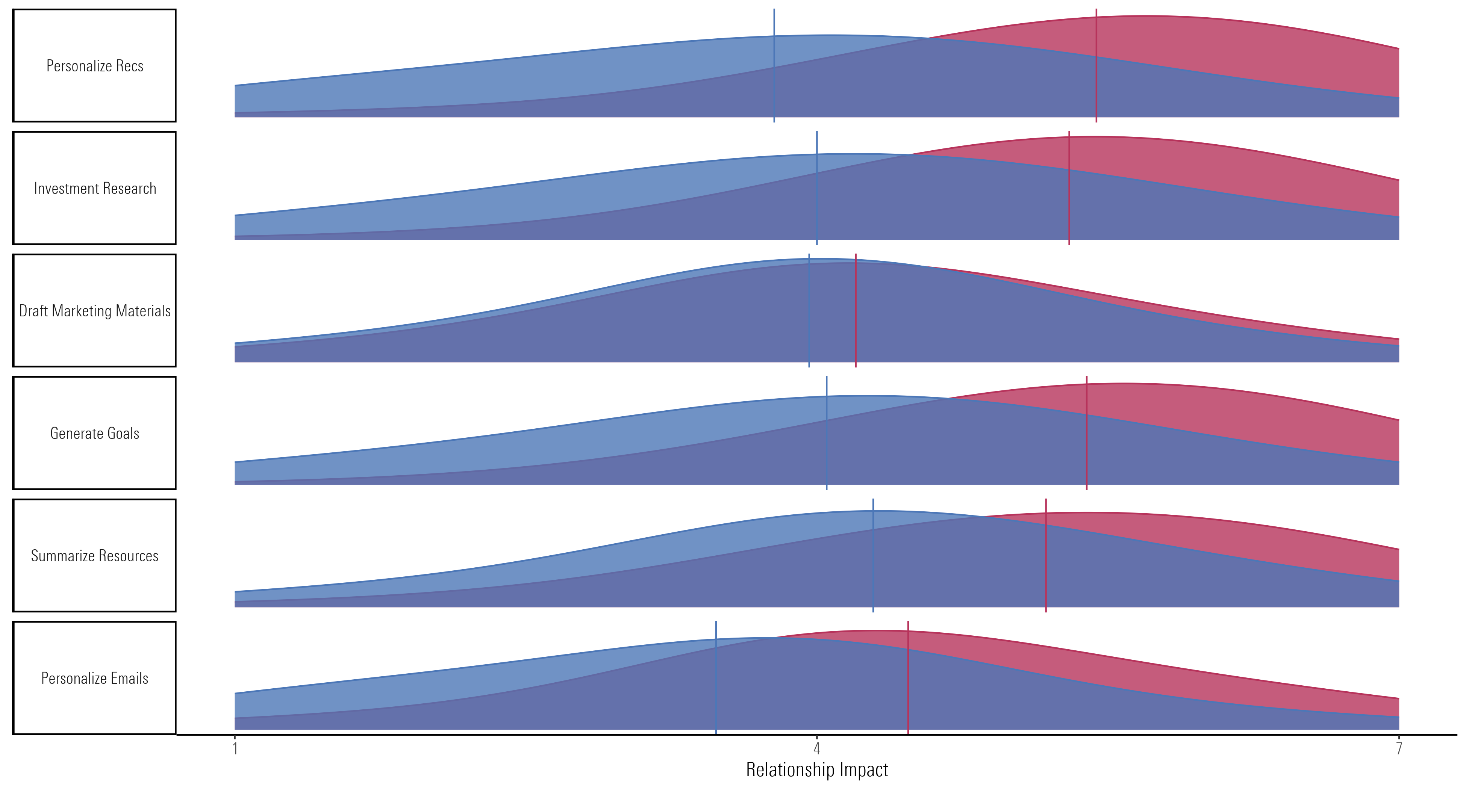
Adviser with AI
Adviser alone
Negative impact
Positive impact
Notes:
Here we are going to talk about the effect of different use cases of AI on the advisor-client relationship. People’s comfort with the use cases largely mirrored these findings, so we are going to focus on the relationship impact because it’s more tangible.
ORIENT TO GRAPH
There are a couple of ways that we can talk about these findings. We can talk about situations where using AI hurts the relationship (i.e., focus on which blue lines fall below the midpoint), or we can talk about activities that have a less positive impact when an advisor uses AI to do them than when advisors do it alone (i.e., focus on the space between the blue and pink lines).
Let’s start by taking the first approach. We see two activities where people tended to report that AI would hurt their relationship with their advisor: personalizing emails and personalizing recommendations. Right away, there is a clear theme here. People don’t like it when AI is being used for personalization. Remember, our previous research found people felt “advice I can rely on” was one of the most important value adds an advisor provides. This means providing advice that is specific to the client, that understands them, that helps them sleep better at night. Because of this, it’s understandable that people may not like AI getting involved. After all, an AI may “know” them but it doesn’t really know them at all.
Now, let’s talk about activities where AI doesn’t harm the relationship but still has a notably less positive impact than a human alone: doing investment research, summarizing resources, and generating goals. When it comes to activities like this, you will want to consider the trade-offs of using AI. For example, offloading goal generation to AI may save you some time but probably not enough to justify using it given how valuable clients find advisors’ support with their goals .So maybe you don’t use AI here, or if you do, it’s just a tool to kickstart the conversation that largely happens with you.
I would like to draw your attention to a clear win, though, which is using AI to help draft marketing materials, which many advisors have to do, eats up time, yet isn’t a big value add. Here we see no negative impact and no huge AI/human disparity in our ratings. So it sounds like a win all around to use AI.
So using AI can have a notable impact on your relationships with clients, which is important to know because that relationship is the bedrock of an advisor’s value to their client.

Slide 25
Adviser with AI
Adviser alone
Pay: -33%
Pay: -25%
Pay: -4%
Pay: -26%
Pay: -18%
Pay: -27%
Negative impact
Positive impact
Notes:
And this ding to the relationship is reflected in how much people are willing to pay an advisor who uses AI. We see people expect to pay up to 33% less for work done by an advisor with AI compared to an advisor alone.
I’m sure it has you all wondering whether AI may subtract—rather than add—value to your practice.
If so, then you’re right where we want you to be because, remember, the thoughtless use of AI is going to be what hurts your relationships with clients.
This is where behavioral science comes in. One of the benefits to behavioral science is that it helps us not only understand what people think, it also helps us understand why people think the way they do and how we can work with them, and this can help us develop an thoughtful approach to AI.

Slide 26
“Work smarter… outsource the dumb [stuff] to the robots.”
Notes:
To that end, we asked people why they felt the way they did about each of these use cases. We let people write whatever they wanted and gave them no prompting—so this is not us putting words in people’s mouths.
We found that people who mentioned efficiency in their responses tended to feel more positively about AI being used for all of the use cases we investigated. Like this guy.
This is where we begin to find an inroads for AI. We use AI to be efficient, and we can showcase that to clients!

Slide 27
Efficiency
“Work smarter… outsource the dumb [stuff] to the robots.”
“It seems to be a short cut to do less work but also lowers the quality. Why employ the adviser to do the work if they are not actually doing the work…”
Notes:
But clarity matter here because efficiency might be seen as laziness or cutting corners. So you have to communicate about why you’re using AI beyond freeing up some time for golfing—instead, efficiency buys back time so you can provide higher value services. This also helps solve that pay problem. Yes, maybe your client thinks your work that is AI-assisted is worth less BUT you’re providing more work that they value elsewhere thanks to gains in efficiency.

Slide 28
Why you use AI influences how investors respond to it.
Category | Example
Efficiency | “Work smarter… outsource the dumb [stuff] to the robots.” “It seems to be a short cut to do less work but also lowers the quality. Why employ the adviser to do the work if they are not actually doing the work…”
Personalisation | “The advisor made me feel like a number. I believe [the] advisor could have tried to get to know me personally.” “I would like the fact that they remember what we discussed and to take the time to use the information given to put something together to educate me.”
Expertise | “Now this concerns me because I question why a supposed expert has to use Gen AI to help with an individual case. It would cause me to question the qualifications for my advisor…” “Since marketing isn't their area of expertise, I wouldn't care. In fact, ChatGPT may be an improvement on what would otherwise be corporate drivel.”
Privacy | “It doesn’t require personal information, so I feel fine with generative content like this.” “I feel privacy could be breached.”
Accuracy | “I would be concerned that the information may be inaccurate. I would once again want reassurance from the financial advisor that the information is accurate.” “Using AI to make informational content is fine as long as he checks the accuracy…”
Trust | “I’m just not certain about the robust-ness of the technology yet, and whether I would trust it with my finances.” “I trust AI for research purposes.”
Human touch | “..The content may come across as generic or lack the human touch needed to build genuine connections.” “I think that people using AI is fine as long as they add a human-touch and proofread their responses.”
Notes:
Our final takeaway is that the value of AI in financial planning depends on “why advisors uses the AI”
How did we get here?
Well, we asked people to tell us in their own words why they reacted like they did to an advisor using AI.
We found that people often were tapping into the motivations listed here: efficiency, personalization, expertise, privacy, accuracy, and trust.
And most interestingly, what we found is that people who were focused on the efficiency of employing gen AI in financial advising were more likely to have a positive response to it.
This points to an important inroads to AI acceptance in financial planning: if clients understand that advisors are using gen AI not out of laziness or a lack of knowledge but because it will allow them to be more efficient—or outsource the dumb stuff—then they will be more like

Slide 29
Investors want their privacy protected. | Investors want disclosure on use. | Investors want human review. | Investors want agency. | Investors want unbiased advice.
“I think ensuring that AI is unbiased is the most important aspect. If they recommend specific investments etc. that are biased, then it could cause major damage.”
“It just needs to be disclosed: when they are using it, what they are using it for, how it will benefit me, the investor, and any impacts on my data”
“Only allow AI to invest in assets I am comfortable with and have approved. Do not let the AI make any moves without confirming with me”
“I would want to make sure that the AI being used is not sharing my information with third parties.”
“Can't make decisions, must be approved or finalised/checked over/read over by humans.”
License Gen AI with clear contractual protection of client data. | Develop disclosure statements. | Codify procedures for reviewing AI output in your firm. | Give clients the opportunity to opt out. | Clarify how the best interest standard is kept while working with AI.
Notes:
But you need to do more to implement AI in a client-friendly way than explain the benefits of making you more efficient.
We also asked people what kind of safeguards they wanted in place to feel comfortable with AI in financial planning. Again, this was unprompted open text.
So along the top we see the issues clients were concerned with, in the middle we have examples of what people told us, and at the bottom we’ve provided good starting points to help alleviate these concerns.
Walk through table (these are some good starting points for how to address these concerns)
Remember that these are just a starting point and is by no means meant to be the comprehensive list of guardrails. 35% - don’t want to alienate a third of your clients; no demo differences – don’t assume your clients will be okay with these concerns
Now that we’ve discussed our results, let’s discuss the framework we’ve developed from them to help you use AI intelligently in your practice. S, can you help us out here?

Slide 30
How to apply these insights to your practice.
Notes:
High level findings and how we got there,
Gen AI can be a powerful tool but
but proceed with caution with these insights in mind.
To help make that advice more actionable

Slide 31
Why are you using Gen AI in this manner?
What tasks are you using Gen AI for?
How are you implementing the use of Gen AI in your practice?
Notes:
Yes, and our framework here revolves around the fact that these decisions are not clear cut.
To help you muddle through this, our results suggest that it’s important to consider three overarching questions when incorporating Gen AI, those are: why you are using Gen AI in this instance, what tasks you’re using AI for, how you are implementing these uses in your practice.
As you can see from the screen, we see it as a hierarchy of considerations.
Let’s talk about each of these in more detail.

Slide 32
Why are you using Gen AI in this manner?
What tasks are you using Gen AI for?
How are you implementing the use of Gen AI in your practice?
Is your goal to be more efficient? To improve creativity?
Have you communicated this to clients?
Notes:
Starting with Why, at the top of our hierarchy. Why are you using Gen AI in this manner. Our results point to the fact that, no matter what you are doing with AI, the why matters for clients.
For many, advisors using Gen AI can be seen as a way of just cutting corners. We know that’s not the case, but it’s worth clarifying this to clients.
To do this question justice, first you have to clarify with yourself why you are using Gen AI here. Some level of humility and honesty. Where you check in with yourself on what the purpose of this task is and what the purpose of offloading this task is.
If it’s to be more efficient in back-office or admin tasks, then that might be okay. If it’s to be more efficient by improving the quality of your work, helping you be more creative and engaging as you create a great educational resource for clients, then again that might be okay. As D mentioned, efficiency is well-regarded by investors.
But if its to cut corners on building a stronger relationship with a client or fill in the gaps of your own expertise, then it might be worth double-checking that AI is necessary.
Once you have a clear picture of your purpose, then it’s about communicating this to clients. Explaining how using AI in this manner, allows you to have more time to do things only humans can do for their clients. That the time saved, is spent on them.
Now, if a Gen AI use passes the ‘Why’ question. Then we can move on to our two other questions here.

Slide 33
What tasks are you using Gen AI for?
What tasks are you using Gen AI for?
How are you implementing the use of Gen AI in your practice?
Are you automating a human interaction?
Is client data involved?
Notes:
Starting with What
We learned that certain use cases may backfire. In particular, activities that had to do with personalization had a negative effect on the client advisor relationship.
But even here there is some nuance. For example, investors may not feel comfortable with advisors automating an email wishing them luck on their next vacation, but they may be okay with an email with some recommendations for their upcoming trip which you wrote after brainstorming with the assistance of Gen AI.
Thus the question is, how can we define that nuance. You can start by asking yourself does this automate a human interaction. That’s at the core of our findings, investors have a negative visceral reaction to an advisor trying to hand-off personal connection to AI.
Another key detail you can consider here is whether client data is involved. We saw this come up in the safeguards conversations. Investors want to be sure their data is being protected.
If either of these questions are a ‘yes,’ then one needs to proceed with caution. It doesn’t mean ‘absolutely don’t proceed’ instead, it may just mean asking yourself if AI is needed in this case and to what extent.

Slide 34
How are you implementing the use of Gen AI in your practice?
What tasks are you using Gen AI for?
How are you implementing the use of Gen AI in your practice?
Disclosed your use of Gen AI to clients?
Taken precautions with client data?
Developed a process for reviewing AI responses?
Notes:
Moving on to the How question, our findings point to the need for advisors to be cognizant of and address investors’ concerns as they incorporate Gen AI.
Privacy: When an investor is in your office, they are talking about very private topics. Money is still taboo in a lot of circles. And, if you engage in the softer side of financial planning, some of those conversations can dig into a person emotions, goals, values. So, when we say privacy here, it’s not only a person's account information or social security number, its their conversations, their aspirations, the hopes and dreams they entrust to you.
Bias: We’ve all know of Gen AI hallucinations. Making up data, findings, even sources.
Lastly in the pay data, we saw that investors are also concerned about this idea of fairness. That they are getting their money’s worth. That you’re not doing less work for the same amount of money.
All these are legitimate concerns and not addressing them could let them fester.
So, address them. Ask yourself, have you developed disclosure statements explaining to clients how you use Gen AI, given them the option to opt out? Have you taken the necessary precautions to protect your client’s data, including with any Gen AI enabled tools you’re using. Have you developed a process for reviewing Gen AI responses for accuracy. After you’ve done all this, have you communicated this to your clients, reassuring them.

Slide 35
Why are you using Gen AI in this manner?
What tasks are you using Gen AI for?
How are you implementing the use of Gen AI in your practice?
Notes:
This framework helps you think critically about your implementation of Gen AI, so that it doesn’t backfire and hurt your relationship with clients.
We want to give you a few more examples of seeing this framework in action.
One where you are evaluating a Gen AI enabled tool, trying to decide if it’s right for your practice.
And one where you are using a Gen AI powered assistant directly.
Starting with using Gen AI enabled tools.
Pass off: Danielle can you walk us through an example here?

Slide 36

Yellow flags for evaluating AI tools
New AI Tool
Why am I interested in this tool?
What is it doing?
Personalising content for clients
How is it doing it?
Making recommendations to clients
Using client data
Proceeding without human review
Notes:
The number one question we get from advisors on this topic is “What software do you recommend?” We don’t ever answer this question because tools are changing so rapidly that what we think works well one week may not work well the next and vice versa. Furthermore, there may be parts of tools that we think work well and other parts don’t.
So again, it’s key for advisors to be able to critically evaluate these tools on your own, and this is where the framework comes in.
Now, remember, when it comes to AI, clients want to understand why you are doing so. So you’re first step in evaluating a tool is clarifying the reason you want to use the tool (beyond, hey, that’s pretty neat). Maybe efficiency, brainstorming, creativity, etc. – should be something the complements you not replaces you or your human value.
Next, we want to consider what AI is being asked to do here and how it is doing so. Based on our research, we’ve put together some yellow flags for advisors to look for when evaluating a new AI tool. These aren’t red flags, so we’re not saying it’s a no go if you encounter them. But they are yellow, so you want to make sure you slow down and figure out whether these concerns can be adequately addressed or worked around.
What:
Personalization – investors reported that personalizing with AI—such as through recommendations or communications—would have a negative impact on their relationship with their advisor. Be careful when it comes to personalization–the closer it gets to a client, the more likely they are to dislike it.
Recommendations – investors were also worried about the quality of the output they received from AI and the biases it may have. If a tool provides recommendations, how do you ensure that they provide quality information to your clients? do you understand how the AI comes to its conclusion? If not..
How:
Use of client data – the most common concern people talked about was whether their data was protected when AI is used. This means when a tool uses client data, you want to ensure you not only understand the protections in place but also limit how much information is being shared (parsimony)
Lack of human review – investors also expressed concern about material being created by AI and not reviewed by human experts; with AI, ask whether the outputs being given to your clients have a checkpoint for human review, and what you can do if there isn’t.

Slide 37
How do you feel about using AI in your advice workflow?
1-3 - Still not very confident about using Gen AI in my workflow
4-7 Moderately confident, I would consider using Gen AI in my workflow
7-10 - I am very confident/ I am using Gen AI in my workflow

Slide 38
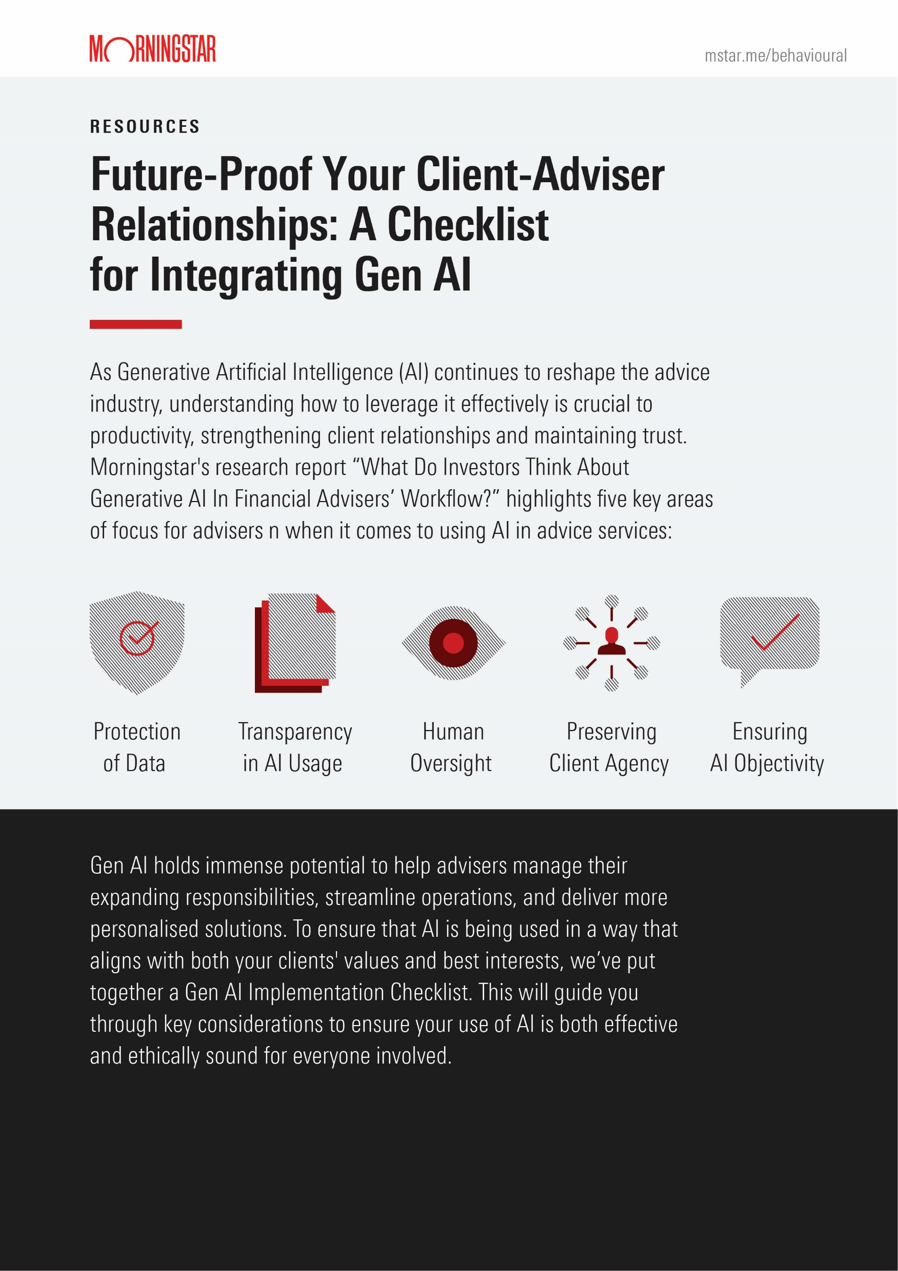
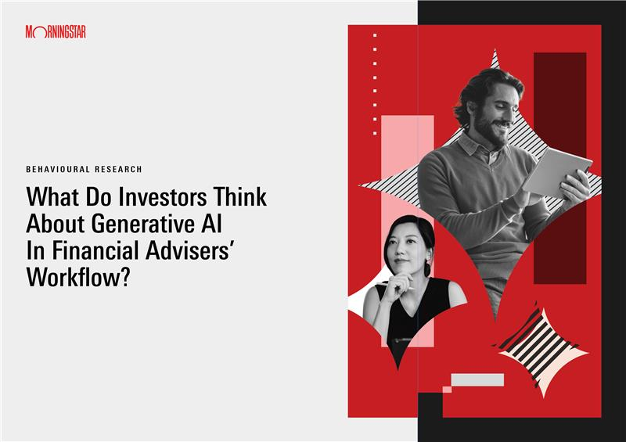
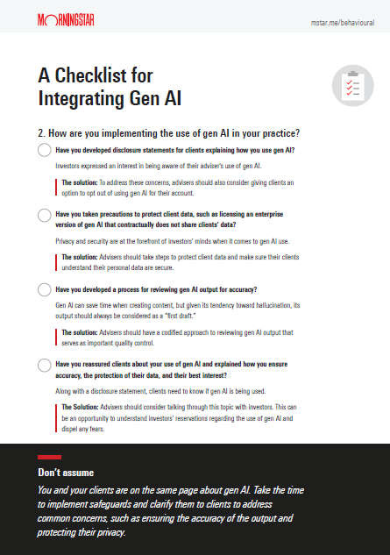
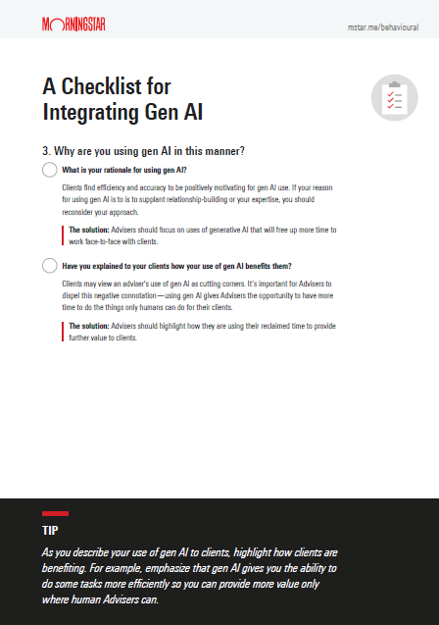
Resources
Notes:
Here’s what you can expect to receive this week! (report and the takeaway)

Slide 39
Learning Outcomes
Understand the most common challenges and misconceptions around AI adoption in smaller advice businesses, especially around client trust and privacy.
Explore the practical Gen AI use cases that can be implemented without specialist support.
Learn how to organise and use client data responsibly to maximise the benefits of AI while maintaining trust and compliance.

Slide 40



Adviser solutions united to support financial advisers empower investor success
Professionally managed investments
Platform
We take care of the heavy lifting of administering investments.
Award winning service means you can focus on providing great service to your clients.
Bringing together global Morningstar expertise across asset allocation, capital markets research, multi-asset portfolio construction, security selection and manager research.
Enabling Technologies
Advice practice technologies that enable a transformative client experience, handling complex data and processes; scaling your business.
Research, data, uniquely Morningstar insights
Wealth Platform | UK and International
Managed Portfolios | Multi Asset Funds
Wealthcraft | Finametrica
Notes:
SO THAT'S THE IMPORTANT BUT FLUFFY STUFF
WHAT DOES M* UK GIVE YOU
2 PLATFORMS
MANAGED INVESTMENTS – MPS AND MULTI ASSET
TECHNOLOGIES TO HELP RUN YOUR ADVICE PROCESS AND BACK OFFICE – BACK OFFICE SYSTEM, RISK PROFILER
Products
An adviser service proposition that gives you practical support in whatever area you need.
Access to firsthand data, research and analytics – independent resources from our global analysts provides additional insight for you and your clients.
Access to senior experts across many disciplines: advice, strategy, technology (AI, machine learning, practice optimisation etc.) – we are well placed to help you grow your business, incorporating across current themes, challenges and opportunities for advisers
Cutting edge research in behavioural finance – academics produce research to help advisers to understand more about their clients and the value they can add.
Our global reach provides you with a wide network of advice professionals – utilise expertise across the globe to help business growth and innovation
Wealthcraft
Back office and CRM system
Adviser Workstation
Data, tooling, reporting
Finametrica
Risk profiling

Slide 41
Morningstar Wealth Solutions
Investments and Research
Operations and Marketing
Risk Profiling and Client Management
A B2B consultation function that:
Enables you to make the most of Morningstar
Works with you to create an end-to-end solution that is fit for purpose
Provides technical expertise on the ‘frontline’ and through regular interactions
Support advisers to meet both business and client goals
Maps out a path to reach business outcomes whilst generating investment alpha.
CIP & CRP

Slide 42


Stay in touch
Join our research circle
Read more about how Morningstar Wealth supports financial advisers below
Or come chat to us on Stand 9 and try our coffee ...

Slide 43
Disclosures
©2025 Morningstar. All Rights Reserved. The Morningstar name and logo are registered trademarks of Morningstar, Inc. This presentation includes proprietary materials of Morningstar. Reproduction, transcription, or other use, by any means, in whole or in part, without the prior written consent of Morningstar is prohibited. Morningstar Investment Management Europe Ltd. is a member of Morningstar’s Investment Management group, a leading provider of discretionary investment management and advisory services. Guided by seven investment principles, the group is committed to focusing on its mission to design portfolios that help investors reach their financial goals. The group’s global investment management team works as one to apply a disciplined investment process to its strategies and portfolios, bringing together core capabilities in asset allocation, investment selection, and portfolio construction. This robust process integrates proprietary research and leading investment techniques. As of 30 June, 2025, Morningstar, Inc.’s investment advisory subsidiaries were responsible for approximately US $352 billion* in assets under advisement and management across North America, EMEA, and Asia-Pacific. In the UK, Morningstar Investment Management Europe Ltd is authorised and regulated by the Financial Conduct Authority to provide these services to Professional clients Registered Office: 1 Oliver’s Yard, 55-71 City Road, EC1Y 1HQ.
Morningstar Managed Portfolios can only be made available through the use of Financial Advisers and other relevant intermediaries appropriately authorised and regulated by the Financial Conduct Authority or equivalent financial regulatory authorities.
This presentation does not constitute investment, legal, tax or other advice and is supplied for information purposes only. Past performance is not a guide to future returns. The value of investments may go down as well as up and an investor may not get back the amount invested. Reference to any specific security is not a recommendation to buy or sell that security. The information, data, analyses, and opinions presented herein are provided as of the date written and are subject to change without notice. Every effort has been made to ensure the accuracy of the information provided, but Morningstar Investment Management Europe Ltd makes no warranty, express or implied regarding such information. It is the responsibility of the adviser to assess the suitability of an investor and select the correct model, appropriate to the investor’s objectives and needs. Morningstar Managed Portfolios are not suitable for clients who cannot bear any capital loss. The information presented herein will be deemed to be superseded by any subsequent versions of this presentation. Except as otherwise required by law, Morningstar Investment Management Europe Ltd shall not be responsible for any trading decisions, damages or losses resulting from, or related to, the information, data, analyses or opinions or their use. To learn more about Morningstar Wealth regulated entities and products in EMEA, please visit Morningstar Wealth EMEA Disclaimers.

Slide 45






























































































































































































































































Icon sticker sheet– (copy icon and paste INto an image box) – additional icons can be downloaded from the Morningstar design site – delete before use
Notes:
These icons can be copied from this 'sticker sheet' then on an 'icon' slide, select the border of the icon placeholder and paste it. (clicking the center of the icon placeholder box will call up an 'import from file' window)

Slide 46
Color sticker sheet– delete before use
Core colors
Neutral colors
Presentation theme and chart colors
Supporting colors
Notes:
‘Core colors’ and ‘Presentation theme and chart colors’ are already included in the default MorningstarChartlab color set. Neutrals and Supporting colors are added here and can be sampled with an eyedropper from the 'More Colors' fill or stroke panes.

