Slide 2
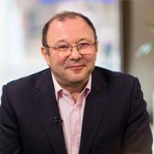
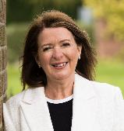
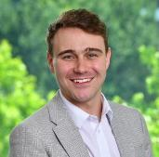
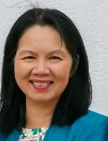
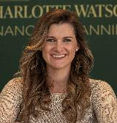
Bridging the talent gap: Fresh perspectives on entering the profession
Edward Grant
PFS Board Director
Jane Gow
Clear Cut FP
Ollie Hynd
Bowcliffe Wealth Management
Dr Lien Luu
Coventry University
Charlotte Watson
Charlotte Watson Financial Planning

Slide 3
Bridging The Talent Gap
Fresh perspectives on entering the profession

Slide 4
Learning Objectives
Understand the current challenges contributing to the talent gap within financial planning.
Explore a range of career pathways into the profession, including academic routes, career changes, and graduate schemes.
Gain insights into how firms can support and retain new entrants, including practical strategies shared by experienced professionals.
Reflect on how diversity of background and experience can strengthen the profession.
Identify actions they can take to contribute to a more inclusive and accessible profession.

Slide 5
Bridging The Talent Gap
Fresh perspectives on entering the profession

Slide 6


10 Years of Graduates Video
https://www.youtube.com/watch?v=I_JszSq9xvU

Slide 7


Slide 8
Bridging The Talent Gap
Fresh perspectives on entering the profession

Slide 9

Coventry University Scholarships
Insert Lien’s video

Slide 10
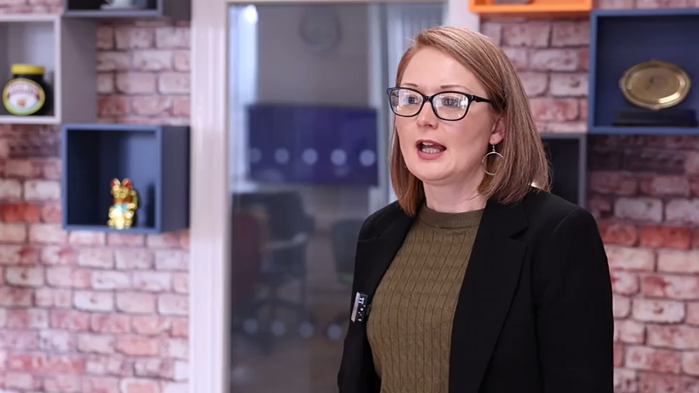

Slide 11
Bridging The Talent Gap
Fresh perspectives on entering the profession

Slide 12

Transferable Skills

Slide 13
Bridging The Talent Gap
Fresh perspectives on entering the profession

Slide 14
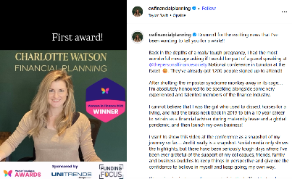
10 Years of Graduates Video
Insert Charlotte’s Instagram video

Slide 15


Slide 16
Bridging The Talent Gap
Fresh perspectives on entering the profession

Slide 17

Pathway To The Profession
Our ‘Pathway to the Profession’ is for anybody looking to develop a career in financial planning profession.
It comprises a series of initiatives to help individuals take their first step into a new career, for those looking for new purpose, or those ready to return the profession after a period away.
Our mission is to invest, inspire, involve and inform to help create a route that anybody can find and follow.

Slide 18

invest.
We’re investing in early careers to equip aspiring professionals with the knowledge, skills, and behaviours to launch thriving careers in financial planning.
R05 Qualification &
free PFS student membership
500 students
first step towards Level 4 Diploma in Regulated Financial Planning
CPD, networking and mentoring opportunities
UpReach support
award-winning social mobility charity
identify students from disadvantaged backgrounds to fill some of the 500 R05 spaces
Notes:
R05 Qualification & free PFS student membership
We’re supporting 500 students to complete a recognised financial planning qualification focused on financial protection – a key first step into the profession and a pathway towards achieving the Level 4 Diploma in Regulated Financial Planning. We are also providing them with free PFS membership, giving them access to a wide range of member benefits, including CPD events and networking opportunities.
UpReach support
We are working with an award-winning social mobility charity, to identify students from disadvantaged backgrounds to fill some of the 500 R05 spaces.

Slide 19
invest.
Internship support
promoting paid placements
expand access to early careers experiences within financial services
build confidence, practical skills and career readiness
Coventry University Scholarships
new scholarship programme
promotes structured pathways into the financial planning profession
supporting five students with scholarships worth £6k over their three-year courses
Notes:
Internship support
We’re promoting meaningful internship opportunities by encouraging firms to offer paid placements. Through good practice guidance, promotion and outreach, we will help expand access to early careers experiences within financial services – building confidence, practical skills and career readiness for aspiring professionals.
Coventry University Scholarships
We're supporting a new scholarship programme with Coventry University that promotes structured pathways into the financial planning profession. We’ll initially be supporting five students with scholarships worth £6k over their three-year courses.

Slide 20

inspire.
UCAS collaboration
raise awareness of careers in financial services
UCAS attracts over 1.5 million annual visitors
promote early career opportunities, feature a live jobs board and will be supported by targeted marketing
Career returners programme
supporting individuals to return to work
support the provision of tailored guidance, resources and training
Notes:
UCAS collaboration
We are collaborating with UCAS to raise awareness of careers in financial services amongst students exploring their next steps. UCAS attracts over 1.5 million annual visitors to its website to research their future career path. Our professional body pages will promote early career opportunities, feature a live jobs board and will be supported by targeted marketing campaigns throughout the year, helping young people discover rewarding roles within the sector.
Career returners programme
We are looking to support individuals returning to work after a career break, whether that is due to parental leave, health leave or post redundancy. We will support the provision of tailored guidance, resources and training to help them re-enter the profession with confidence. We will be hosting an interactive webinar with Everywoman at the end of September.

Slide 21
inspire.
We're supporting our members to attract bold, diverse talent into the profession.
Tomorrow’s Finance Professional Symposium
dedicated student focused symposium
part of the PFS Festival of Financial Planning in 2026
TED style talks, employer insights and guidance on sector entry points
2025 PFS National Conference will pilot some new ideas and invite aspiring professionals
Notes:
Tomorrow’s Finance Professional Symposium
We will be launching a dedicated student focused symposium as part of the PFS Festival of Financial Planning in 2026, to showcase the profession at its best. With TED style talks, employer insights and guidance on the various entry points into the sector including apprenticeships, the event will connect aspiring students with the inspiration, information and networks to take their first step into financial planning and advisory roles.

Slide 22

involve.
We're encouraging our members to become active PFS volunteers & mentors, to support aspiring professionals.
Outreach collateral
equipping volunteers and outreach network with new, engaging materials
Notes:
Outreach collateral
We’re equipping our volunteers and outreach network with new, engaging materials to support impactful careers events in schools, colleges, and communities across the UK.

Slide 23

involve.
We're leading the profession to deliver practical, engaging financial education to secondary school-age children across the UK.
My Personal Finance Skills & Duke of Edinburgh Workshops
expanding our financial education programme to reach even more young people
updated workshops, enhanced partnerships
new sessions for volunteers
Careers Website & resource hub
revamping all of our career's pages and online tools
Notes:
My Personal Finance Skills & Duke of Edinburgh Workshops
We’re expanding our financial education programme to reach even more young people. This will include updated workshops, enhanced partnerships - such as with the Duke of Edinburgh Award - and new sessions for volunteers, which will not only educate but also promote financial planning as a career of choice.
Careers Website & resource hub
We’re revamping all of our careers pages and online tools to better support students, educators, and career changers exploring the world of financial planning.
We will begin this development work at the beginning of 2026.

Slide 24
Bridging The Talent Gap
Fresh perspectives on entering the profession

Slide 25
Professional Development Pathway

Slide 26
Thank You

