Slide 1
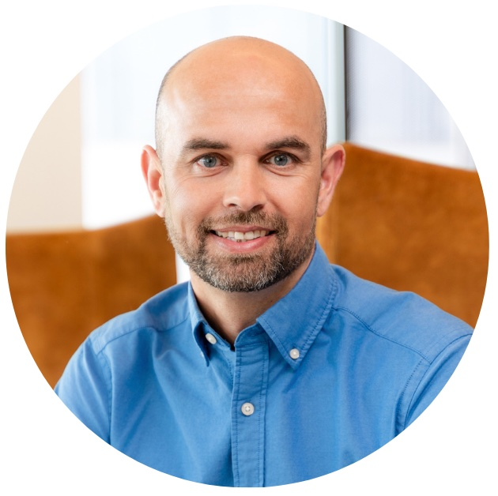
From pressure to purpose - the shift every ambitious financial planner must make to win at work and at home
Tony Fields
pH7 Performance

Slide 2
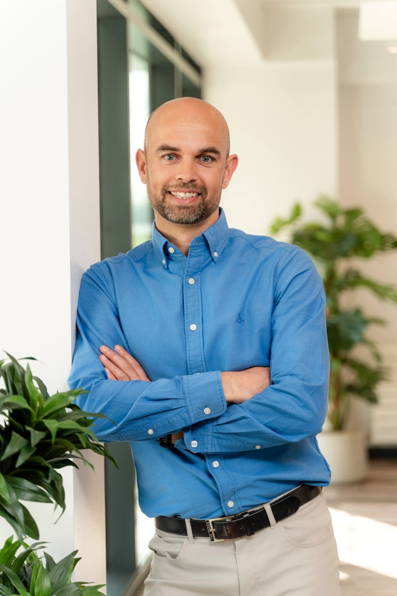

From Pressure to Purpose
The Shift to Win at Work and at Home
Tony Fields
Performance Coach | Former Chartered
Financial Planner
Notes:
Big entrance, lots of energy

Slide 3
Learning Objectives
Cut through external noise to reconnect with the personal values and internal drivers that sustain high performance and long-term fulfilment
Recognise the hidden habits and mindset patterns that silently drain energy, focus, and capacity, even in high achievers
Strengthen their internal compass to lead with clarity, purpose, and presence (both in business and at home

Slide 4
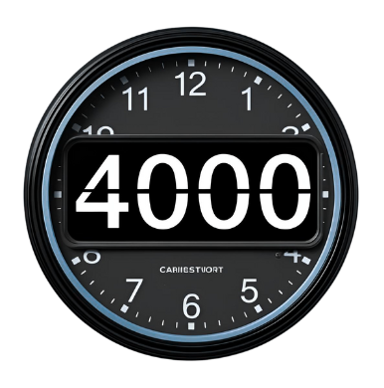
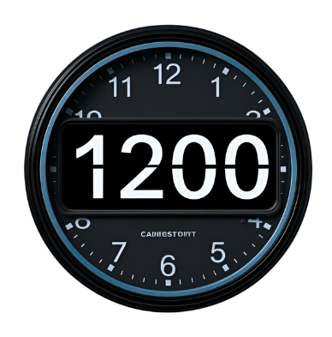

Slide 5

What more could you do?

Slide 6

Success does not equal fulfilment

Slide 7

Sad Reality
  Attention span has dropped to 8.25 sec
  We check our phones 144 times a day
  Extra 10 hours online per week
  Blurred boundaries
  Treat every task as urgent

Slide 8

The Real Cost
​
What your partner feels
​
What your kids see
  Never enough
​
What you
feel
Notes:
Reduced productivity
Increased baseline stress
Increased workload
Distracted
Partner feels emotionally alone

Slide 9

From Pressure to purpose
Feel calm, focused, and energised
Be present with the people who matter
Live a life that feels as good as it looks
“Success is not just what you achieve, it’s how it feels to live it.”

Slide 10
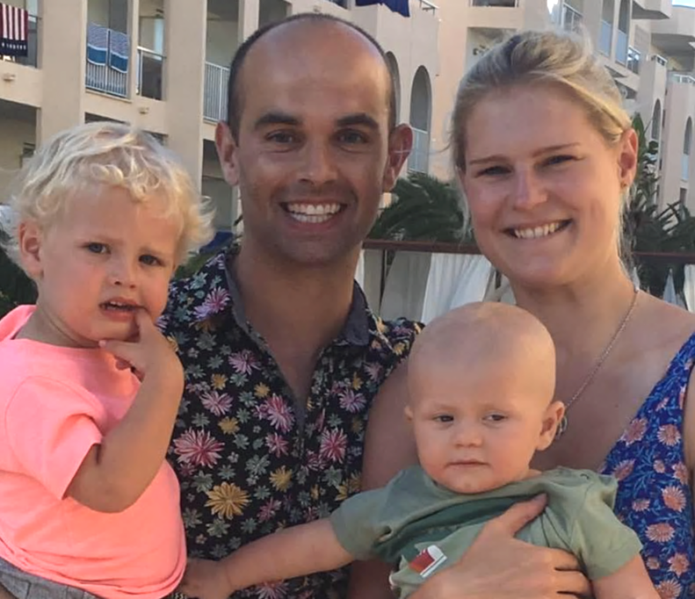
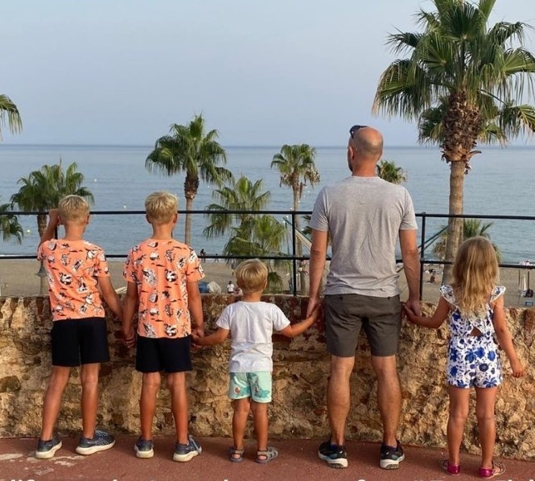
Success - But at What Cost?
What the world saw…
What matters most today...

Slide 11
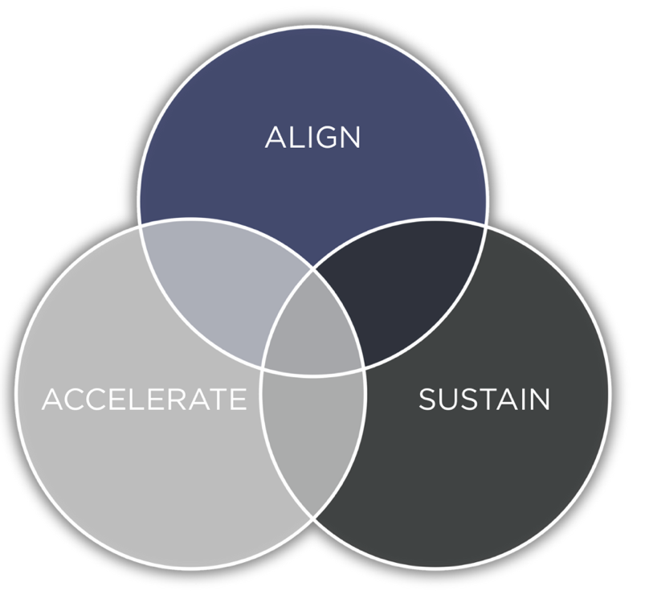
Performance without compromise

Slide 12
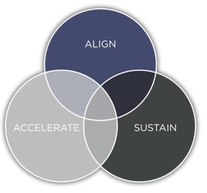
Reconnect with the best version of you
"Success without fulfilment is the ultimate failure"
Tony Robins
Notes:
Today, not strategy, not about greater knowledge
Reality check, and line in the sand
What are you waiting for

Slide 13






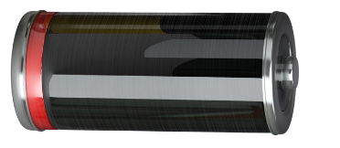


Typical day ​

Slide 14

Who Are You?
How would your clients describe you?
How would your partner or kids describe you?
How would you describe yourself (when no one’s watching)?
Awareness isn’t judgement, it’s the start of change
Notes:
Follow around camera 4 weeks

Slide 15
The Best Version Of You?
When you’re at your best what’s different
At work
At home
Being your best self isn’t about doing more
It’s about showing up with purpose
Now ask yourself, where’s the gap between that version of you… and how you’re showing up today?
Notes:
Feel fulfilled, energised

Slide 16
Reclaim your genius
"True performance isn’t about doing more. It’s about doing more of what only you can do"
Tony Fields

Slide 17

What you've normalised
Always switched on ​
Chasing next milestone
Always saying
yes
Guilt not working
Filling every gap in calendar
Busy = Productive ​
Need to stay in control
Responding clients immediately
Rest is for holidays
You’re achieving more than ever, but are you actually fulfilled​

Slide 18
How much time are you spending
doing tasks you LOVE?
A All the time
B Most of the time​
C Some of the time
D None of the time
Notes:
Feel fulfilled, energised

Slide 19
Introducing your ZONE of genius
Zone of GENIUS
You are doing things uniquely suited to you​
Zone of excellence
You are playing to more of your strengths​
Zone of competence
Others can do things just as well as you​
Time
Zone of incompetence
Others can do things better than you​
Best use of
Talent

Slide 20
Remember your real purpose
Q1: What could you do all day without getting bored?
Q2: What is a unique ability of yours?
Notes:
Feel fulfilled, energised

Slide 21
Create the life you actually want
"You get to define what success looks like (and feels like)"
Tony Fields

Slide 22

You help clients
plan for the future...
But what about
your life today?
What does freedom and fulfilment look like for you (not 10 yrs), but now?

Slide 23


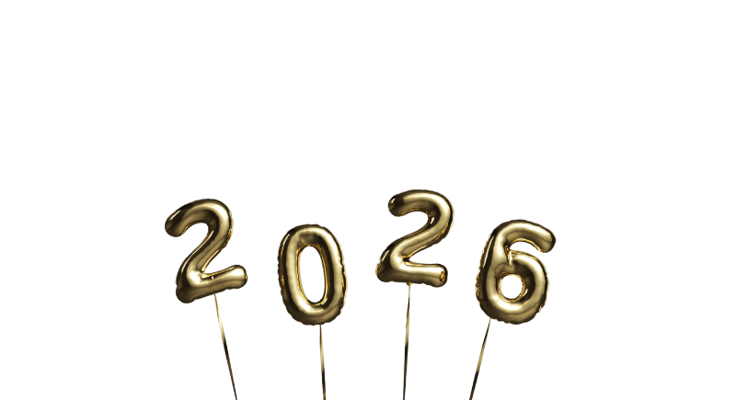


Future Self
You’ve just had the most aligned year of your life
What’s changed?
How are you spending your time?
What do others notice about you?
How do you feel?

Slide 24
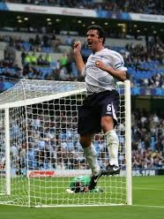
Act as if
Notes:
Commit to an ACTION during this session. I.e. before we finish. I will stay as long as we need.

Slide 25

STOP Waiting
Tomorrow, next week, next month, next year
Start TODAY

Slide 26
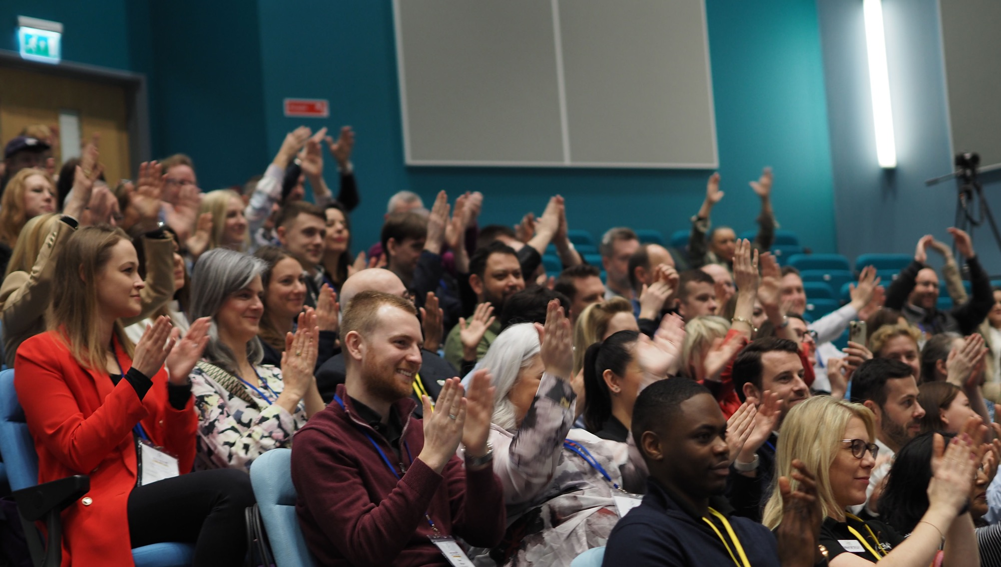

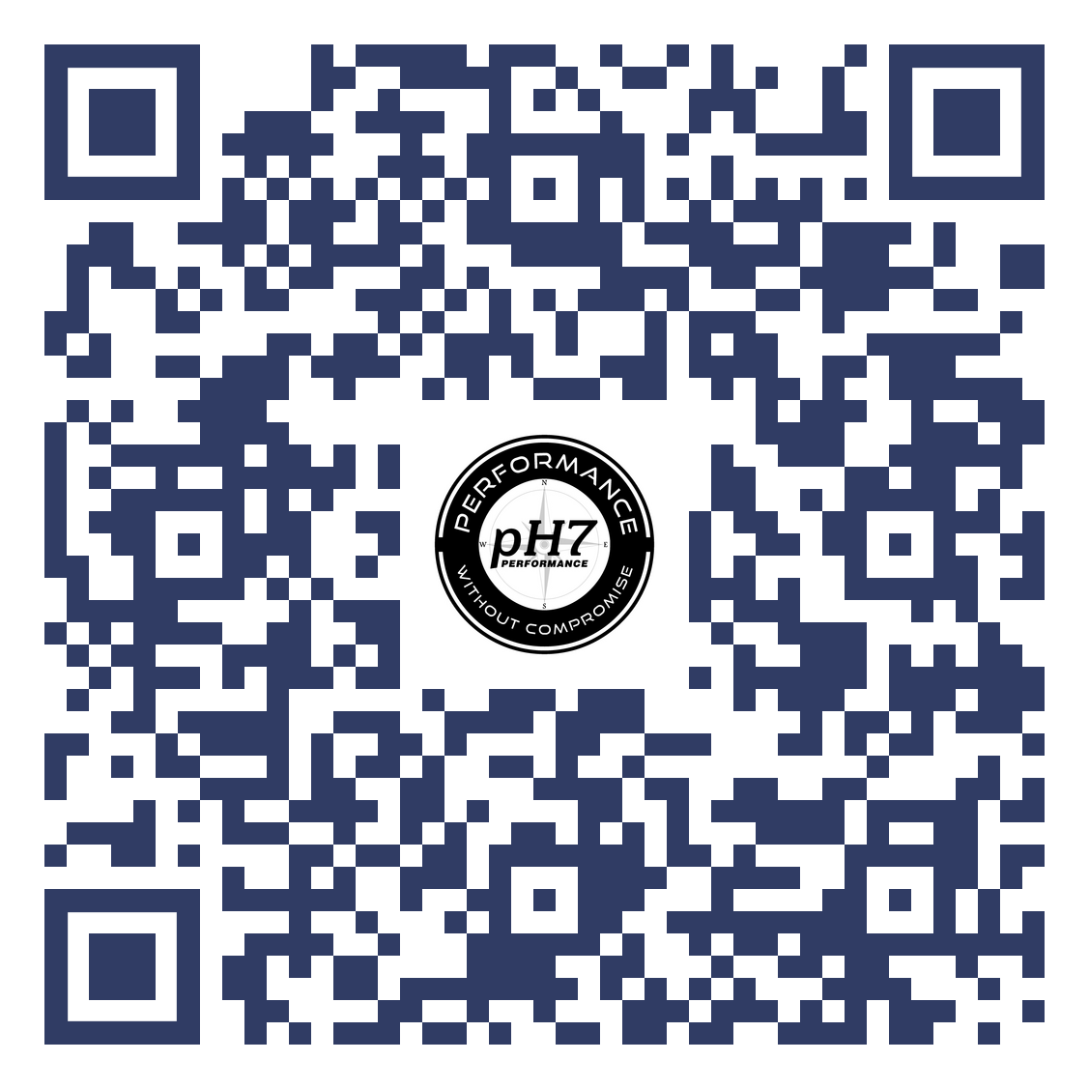
Lead with purpose not pressure
5 days
5 powerful shifts
Just 30 minutes a day to realign how you think, work, and live
Start showing up as the best version of you (at work and at home)​
​
You invest for your clients. Now its time to invest in YOU

Slide 27
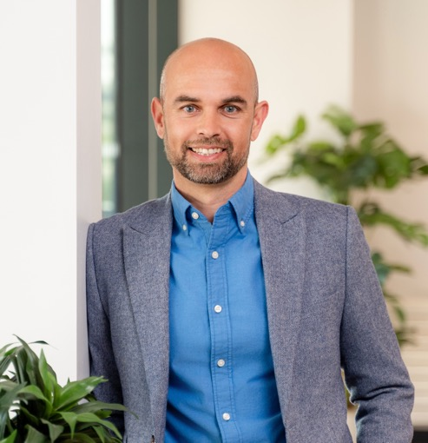


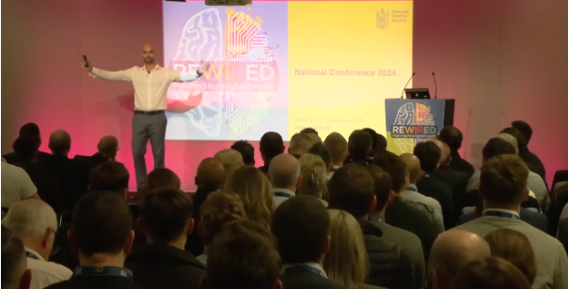
Tony Fields
www.pH7Performance.com
Tony@pH7Performance.com

