Slide 1
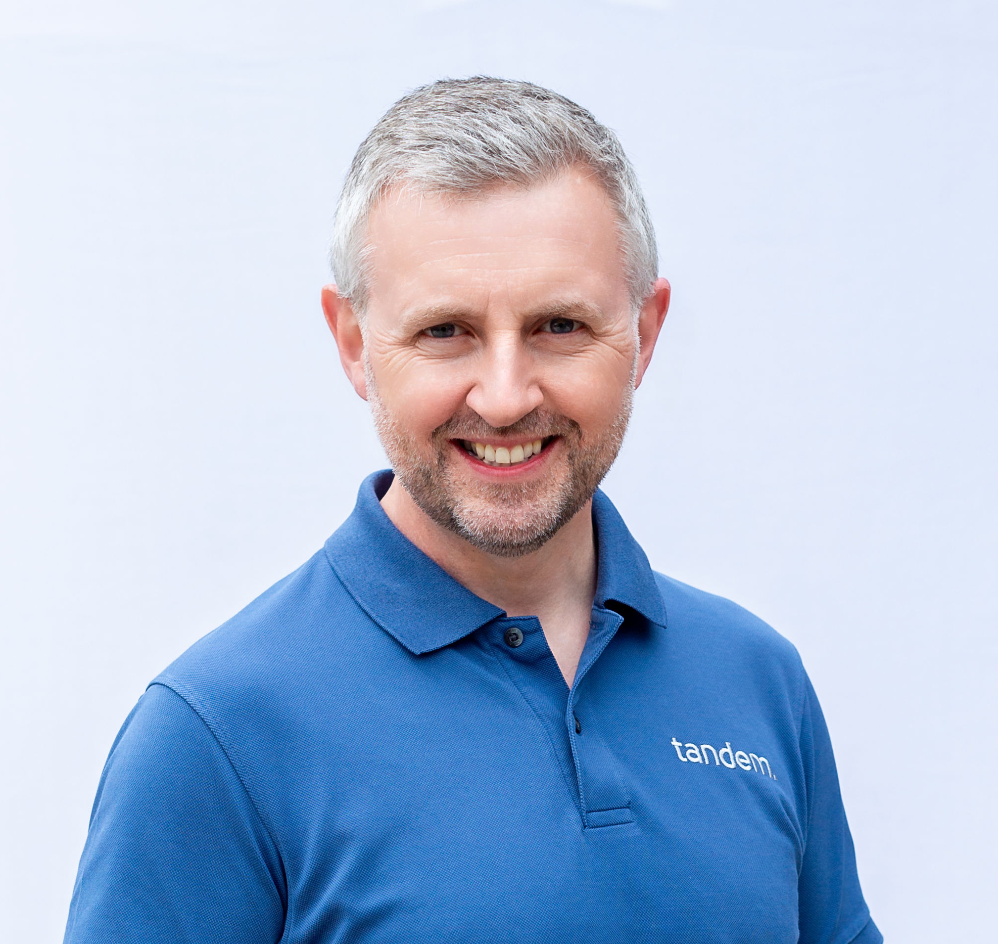

Beyond £1m: Building a business that truly matters – the Finance Geeks share their journey
Paul Cleworth
Tandem Financial Ltd
Warren Shute
Lexington Wealth Management

Slide 2


Slide 3


Slide 4


Slide 5


Slide 6


Slide 7


