Slide 1

Making intangible value visible in financial planning
Ilana Miller
Royal London

Slide 2
PFS – Making intangible value visible
Ilana Miller, Investment Development Director

Slide 3

`
Learning objectives
Understand the importance of evidencing both tangible and intangible value.
Explore how behavioural insights and client behaviour tracking can enhance financial decision-making and wellbeing.
Learn how to build and apply a Value Index, including defining value, scorecards, data segmentation, client surveys, and analysis.
Use insights to support Consumer Duty compliance, build client trust, and differentiate
your firm.
Reflect on how measuring intangible value strengthens your service models, client relationships, and adviser development.

Slide 4
`
Define value
?

Slide 5


Defining value
Insights
“Not everything that can be counted counts and not everything that counts can be counted!”*
What gets measured, gets done.
*Source: William Bruce Cameron Quote

Slide 6
How important is investment performance when you consider overall value for money?
24% of advisers say it has a big impact on consumer perception of value, however ...
Aspects of consideration | Total | Gender
 |  | Male | Female
It is the most important factor | 45% | 50% | 38%
It is important, but not the most important factor | 31% | 29% | 34%
It is a consideration, but not hugely important | 17% | 16% | 18%
Investment performance can’t be predicted, so it is not important to me at all | 7% | 5% | 10%
Source: The meaning of value report 2024 – Adviser research conducted by the Lang Cat. Sept/Oct 2024

Slide 7
Defining value
Insights
“Not everything that can be counted counts and not everything that counts can be counted!”*
What gets measured, gets done.
How is it going?
*Source: William Bruce Cameron Quote

Slide 8

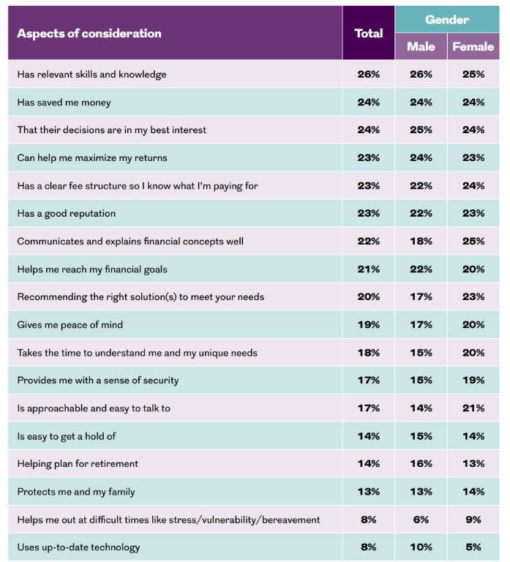
What people value from an adviser
Communicates and explains financial concepts well
Male 18% v Female 25%
Recommending the right solution to meet your needs
Male 17% v Female 23%
Takes the time to understand me and my unique needs
Male 15% v Female 20%
Is approachable and easy to talk to Male 14% v Female 21%
Source: The meaning of value report 2024 – Adviser research conducted by the Lang Cat.
Sept / Oct 2024

Slide 9

Demographics matter
Insights
39% of UK adults have confidence in the FS industry. 28% disagree.
36% believe most firms are honest and transparent. 27% disagree.
Banks are the most trusted financial institutions, but trust is still limited.
Positively, trust is higher about own provider/adviser.
Demographics matter - low financial capability, age and gender identity significantly impacting level of trust.
Trust and value, same problem, same solution?
Source: FCA Financial Lives survey, 2024

Slide 10
Define it. Measure it. Evidence it.

Slide 11
Building resilient investors
Financial resilience
Products and services

Slide 12


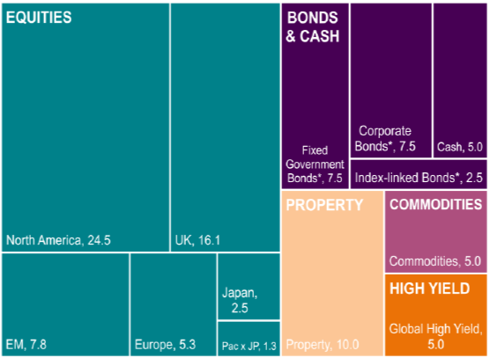
Creating resilient investments and resilient investors
Insights
Portfolio for example only

Slide 13


Building resilience
Insights
Foreseeable harm
The investor gap
Behavioural bias
Wellbeing
Vulnerable circumstances

Slide 14

Building resilient investors
Measure it and demonstrate value.
“It’s simple, but it’s not easy”.
Financial coaching and education.
Make complex concepts simple.
Use familiar context.

Slide 15
Define it. Measure it. Evidence it.

Slide 16


How do we measure it now?
Client retention data
Complaints data
INSUFFICIENT
FCA Financial Lives survey 2024: 23% consumer investment product holders report experiencing a problem.
Only 4% of all holders complained. Why?

Slide 17
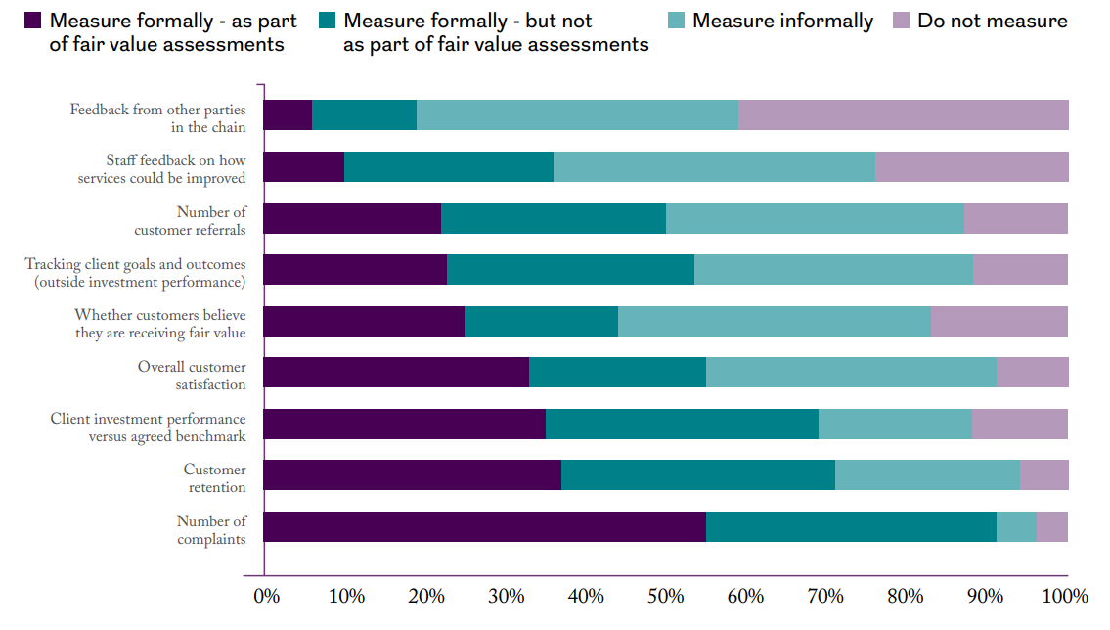
Measuring fair value
Which of the following do you measure?
Source: The meaning of value report 2024 – Adviser research conducted by the Lang Cat. Sept/Oct 2024, 170 responses (page 41)

Slide 18
Define it. Measure it. Evidence it.

Slide 19
The value index

Slide 20

A client value index
Tracking perceptions of value
 | 0 | 1 | 2 | 3 | 4 | 5 | 6 | 7 | 8 | 9 | 10 | Don’t know | Average
Their advice / recommendations are in my interest | 3% | 1% | 2% | 5% | 5% | 9% | 11% | 17% | 17% | 9% | 16% | 6% | 6.9
Has relevant skills and knowledge | 2% | 1% | 1% | 4% | 7% | 10% | 8% | 16% | 17% | 11% | 19% | 5% | 7.1
Can help me maximise my returns | 3% | 1% | 1% | 4% | 5% | 9% | 12% | 16% | 16% | 7% | 15% | 11% | 6.8
Has a clear fee structure so I know what I’m paying for | 3% | 2% | 2% | 5% | 4% | 10% | 10% | 17% | 14% | 8% | 16% | 8% | 6.7
Communicates and explains financial concepts well | 2% | 1% | 2% | 3% | 5% | 8% | 13% | 17% | 15% | 9% | 18% | 6% | 6.9
Takes the time to understand me and my unique needs | 2% | 1% | 2% | 4% | 6% | 11% | 11% | 16% | 16% | 8% | 17% | 6% | 6.9
Has a good reputation | 2% | 1% | 2% | 3% | 4% | 12% | 11% | 13% | 16% | 9% | 17% | 10% | 7
Is approachable and easy to talk to | 1% | 1% | 1% | 4% | 5% | 8% | 11% | 16% | 18% | 9% | 20% | 6% | 7.2
Source: Opinium Research for meaning of value, conducted between 21st to 24th November 2023. 776 responses (page 3)

Slide 21
A client confidence index
Tracking behaviour and wellbeing changes
 | 0 | 1 | 2 | 3 | 4 | 5 | 6 | 7 | 8 | 9 | 10 | Don’t know | Average
I feel secure in my current financial situation
I am confident about my financial future
I am prepared for unexpected financial changes
I am confident I won’t run out of money in retirement
I feel in control of my financial decisions
I feel my financial goals are aligned to my values and aspirations
I’m confident I understand key financial concepts
I don’t panic during market volatility as I take a long-term view
I feel informed about how behavioural biases can impact my goals.
Questions on:
Client confidence
Financial wellbeing
Financial resilience
Financial literacy
Fear / emotional drivers
Source: Opinium Research for meaning of value, conducted between 21st to 24th November 2023. 776 responses (page 3)

Slide 22
Points to consider
Approach: what survey tool will you use?
Pilot with small group of clients first to refine.
Training your team on positioning with clients.
Segment: what identifying data will you gather to allow you to drill down to segments
and demographics.
Automate: easy for clients to complete and you to analyse.
Communicate: how will you share / promote key findings and outcomes with clients?
Ongoing services: how you will use data in outcomes monitoring.
Differentiation: how you’ll use findings to stand out.
Brand it: use this name or choose something meaningful to you and your clients.

Slide 23


The good stuff
Measures what matters
Invisible is visible
Behavioural insight
Builds client trust
Relevant data for Consumer Duty
Enhance outcomes with precision
Competitive edge
Engaging marketing
Develop ongoing services
Individual excellence

Slide 24
Good practice tips
Focus on outcomes not just process – how is the client better off?
Be great at making the intangibles, tangible and visible.
Ensure sufficient data to make assessment.
Clear action plans - evidencing proactive action.
Sufficiently consider demographics and vulnerability.
Promote and differentiate.
Build resilient investors.

Slide 25

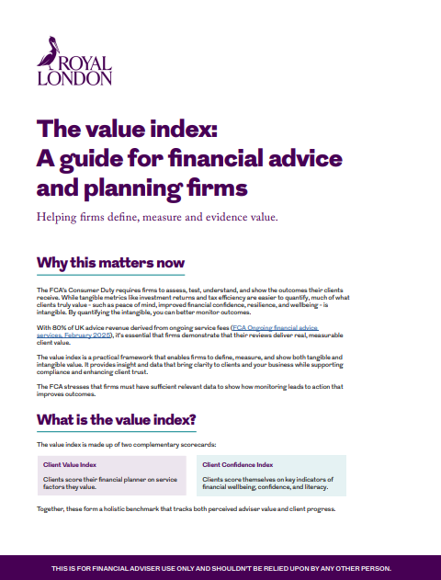



Ideas
Available to download …
2023
2024
2025
Coming soon
The meaning of value 2024 - Royal London for advisers

Slide 26

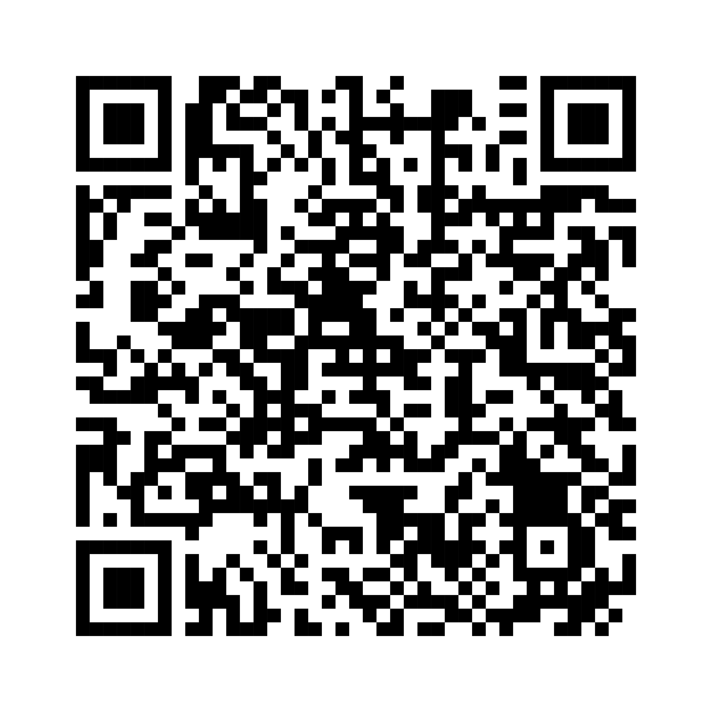
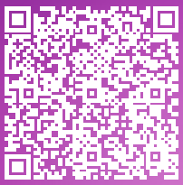
Ideas
Available to download …
2024

Slide 27
`
Learning outcomes
Articulate the role of tangible and intangible value in financial advice and its relevance to FCA Consumer Duty.
Apply behavioural insights to assess client behaviour and support better financial decision-making
and wellbeing.
Design and implement a value index within their firm, including client value definition, scorecard creation,
data segmentation, and survey analysis.
Leverage client insights to demonstrate Consumer Duty compliance, build trust, and enhance
market differentiation.
Evaluate how intangible value measurement can improve service models, deepen client relationships,
and support adviser growth.

Slide 28

Important Information
Thanks
The Royal London Mutual Insurance Society Limited is authorised by the Prudential Regulation Authority and regulated by the Financial Conduct Authority and the Prudential Regulation Authority. The firm is on the Financial Services Register, registration number 117672. It provides life assurance and pensions. Registered in England and Wales, company number 99064.
Registered office: 80 Fenchurch Street, London, EC3M 4BY.
October 2025

