Slide 2
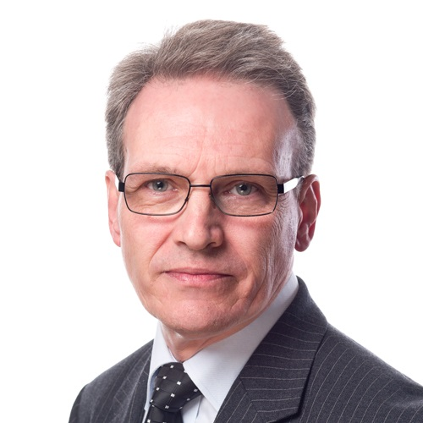
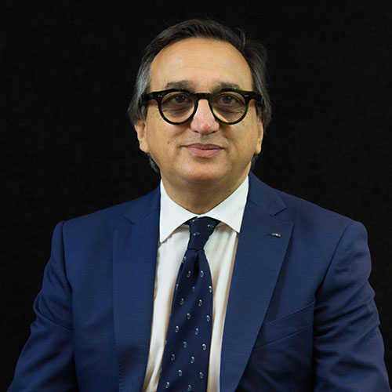
Beyond borders: Navigating financial wellbeing across cultures
Dean Mullaly
Mark Dean Wealth Management
Emanuele Carluccio
EFPA

Slide 3
Dangers of providing financial advice outside the UK

Slide 4
Learning Objectives
Know & understand your limitations.
Dangers of relying on the reverse solicitation rules.
Interaction with Consumer Duty rules.
Possible solutions to deliver good client outcomes.

Slide 5
Know Your Limitations
You are authorised to provide financial advice to anyone in the UK only, unless you hold specific passporting rights granted by the FCA.
What does your PI cover you for, are there exclusions?
Beware of accidental breach of cross border marketing.
  Social Media post
  Website
  Webinar
  Phone/Zoom (blind ignorance is no excuse)

Slide 6
Dangers of relying on ‘Reverse Solicitation’ rules
Definition of reverse solicitation: It refers to a client initiating contact with a financial adviser or firm, rather than the adviser marketing or soliciting the client.
Many jurisdictions require financial advisers to be licensed or authorised if they’re providing services to it’s residents —regardless of how the relationship started.
Risk: Regulators might not accept the reverse solicitation claim if they believe there was any indirect solicitation (e.g., websites, webinars, social media posts, etc.).

Slide 7
Inconsistent Interpretations Across Jurisdictions
Different countries and regulators interpret reverse solicitation differently.
Advisers might be compliant in one jurisdiction but in breach in another.
Several firms have faced enforcement actions for misusing reverse solicitation as a loophole to bypass licensing.
For instance, EU regulators have fined firms for:
    Actively maintaining websites targeting EU clients.
    Sending newsletters, or allowing easy onboarding that seems to imply solicitation.
Advisers must be able to prove that the client initiated the relationship.
If challenged by a regulator or in court, weak or missing documentation (e.g., logs, email trails, disclaimers) could invalidate the reverse solicitation claim.
Take a look at Article 42 MIFID II
https://dwfgroup.com/en/news-and-insights/insights/2021/1/brexit-and-mifid-ii-rules-on-reverse-solicitation

Slide 8
Legal Grey Areas & Ambiguity
The line between passive acceptance of clients and indirect solicitation is often blurry.
  Example: A website available in multiple languages might be interpreted as targeting foreign clients.
Even well-meaning efforts can fall foul of regulators due to technical non-compliance.
Best Practice if relying on Reverse Solicitation
  Clear disclaimers on websites and materials.
  Avoid targeted advertising or SEO strategies in foreign markets.
  Keep detailed records of how the client initiated contact.
  Regularly review local regulations or consult legal counsel.
  Consider licensing or passporting where possible if clients are consistently from a specific jurisdiction.

Slide 9
Consumer Duty
If charging for an ongoing service then you must be able to provide an ongoing service, not just annual reviews but adhoc communication which might involve providing advice.
How can you confirm annual suitability of a product or service unless you also understand the tax rules in the jurisdiction where they live and are taxed?

Slide 10
Solutions to deliver good client outcomes
Partner with an adviser in the jurisdiction that the client resides.
Join a ‘not for profit’ trade association like Federation of European Independent Advisers (FEIFA) so as to broaden your net work of professional contacts across the EU.
Ensure your website contains disclaimers.

Slide 11
Learning Outcomes
What you can & can’t do.
The minefield of relying on reverse solicitation.
The burden of proof required.
Possible solutions to being able to continue a client relationship compliantly if they move abroad.
Build a good network around you.

Slide 12
Beyond borders: Navigating financial wellbeing across cultures
Dean Mullaly
Mark Dean Wealth Management
Emanuele Carluccio
EFPA

Slide 13
Financial Health of Europeans
Quantitative Research Report
Based on EFPA’s 2025 study amongst 14300 European citizens
Emanuele Carluccio
Chair, European Financial Planning Association

Slide 14
Improving the competences of financial advisors and planners in benefit of the customer, the professional itself, the financial institution they work for, the industry
25 yrs experience establishing
common European certification standards
25° Anniversary
in 2025

Slide 15
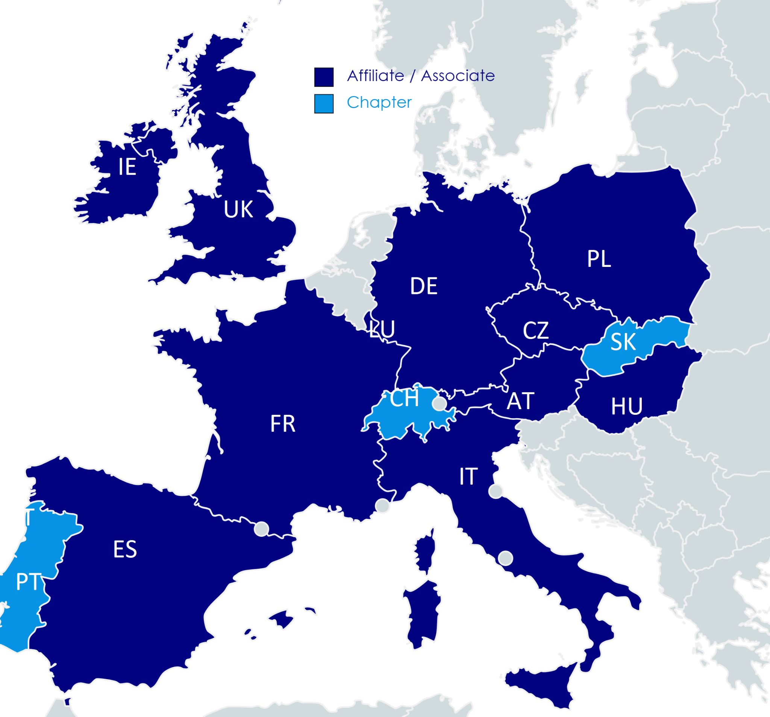











EFPA Map

Slide 16




+100.000
+10.000
ESG CERTIFICATES
+9.000
CERTIFICATE HOLDERS
EFP CERTIFICATES = APFS / FPFS
11
+63.000
MEMBER COUNTRIES
EFA CERTIFICATES = DipPFS
+100
+18.000
CORPORATE PARTNERS
EIP CERTIFICATES
+170
+500
ACCREDITED UNIVERSITIES & TRAINING CENTERS
EIA CERTIFICATES

Slide 17


FINANCIAL HEALTH OF EUROPEANS
01
Notes:
We knew that we were undertaking a new initiative not in a vacuum. And we do not like to reinvent the wheel, so we did our homework on where financial health stands globally today. Briefly:
Financial well-being as a key policy objective: There has been a growing global recognition of financial well-being (also referred to as financial health) as a core outcome for individuals and a guiding principle for financial inclusion, financial education, and financial consumer protection policies.OECD. (2024, November 21). G20 policy note on financial well‑being.
Bank for International Settlements,2024: in their bulletin they recommend multi-pronged approaches aimed to improve both the availability and the effective, responsible use of financial services, ultimately fostering more inclusive and sustainable financial health. There is a pressing need to move beyond access and usage to focus on the true impact of financial services on people's lives and their ability to use these services judiciously. Financial health, therefore, emerges as a critical area focusing on these outcomes.
UN, 2023,This policy note, highlights the need for adopting financial health as a critical policy area across developing countries. It provides a set of good practices and recommendations for stakeholders to advance the financial health agenda
United Nations Environment Programme Finance Initiative (2024). Driving impact on Financial Health and Inclusion of Individuals and Businesses: From setting targets to implementation. Geneva.The core purpose of the guidance is to provide a strategic framework and practical tools for banks to address the growing strain on families and businesses due to economic, political, and environmental shifts. It emphasises that financial institutions have a unique responsibility to promote the financial health and inclusion of their customers. It outlines Outcomes: The effects a "Pathway to Impact", indicating among others outputs: primarily increasing financial inclusion, healthier financial behaviour, and strengthened financial literacy.
• Impacts: The ultimate positive changes achieved, specifically improving the four components of financial health (day-to-day financial management, financial resilience, financial planning and execution, and financial confidence). The guidance recommends a continuous focus on vulnerability and equality throughout this pathway

Slide 18
FINANCIAL HEALTH OF EUROPEANS
THE BIGGER PICTURE
FINANCIAL HEALTH on the agenda of the UN, OECD/G20, BIS:
  Policy recommendations
  Driving stakeholder engagement
  Call for action
There has been a growing global recognition of financial well-being, also referred to as financial health, as a core outcome for individuals and a guiding principle for financial inclusion, financial education, and financial consumer protection policies. OECD/G20, 2024
There is a pressing need to move beyond access and usage to focus on the true impact of financial services on people's lives and their ability to use these services judiciously. Financial institutions have a unique responsibility to promote the financial health and inclusion of their customers. UN EPFI, 2024
The ultimate measure of success for financial literacy efforts should be improvement in individual financial well-being. To improve financial literacy means moving beyond simply increasing factual knowledge to helping consumers develop the skills, experience, familiarity, and self-confidence to engage in behaviours that increase financial well-being, CPFB, 2015, 2017.
01
Notes:
We knew that we were undertaking a new initiative not in a vacuum. And we do not like to reinvent the wheel, so we did our homework on where financial health stands globally today. Briefly:
Financial well-being as a key policy objective: There has been a growing global recognition of financial well-being (also referred to as financial health) as a core outcome for individuals and a guiding principle for financial inclusion, financial education, and financial consumer protection policies.OECD. (2024, November 21). G20 policy note on financial well‑being.
Bank for International Settlements,2024: in their bulletin they recommend multi-pronged approaches aimed to improve both the availability and the effective, responsible use of financial services, ultimately fostering more inclusive and sustainable financial health. There is a pressing need to move beyond access and usage to focus on the true impact of financial services on people's lives and their ability to use these services judiciously. Financial health, therefore, emerges as a critical area focusing on these outcomes.
UN, 2023,This policy note, highlights the need for adopting financial health as a critical policy area across developing countries. It provides a set of good practices and recommendations for stakeholders to advance the financial health agenda
United Nations Environment Programme Finance Initiative (2024). Driving impact on Financial Health and Inclusion of Individuals and Businesses: From setting targets to implementation. Geneva.The core purpose of the guidance is to provide a strategic framework and practical tools for banks to address the growing strain on families and businesses due to economic, political, and environmental shifts. It emphasises that financial institutions have a unique responsibility to promote the financial health and inclusion of their customers. It outlines Outcomes: The effects a "Pathway to Impact", indicating among others outputs: primarily increasing financial inclusion, healthier financial behaviour, and strengthened financial literacy.
• Impacts: The ultimate positive changes achieved, specifically improving the four components of financial health (day-to-day financial management, financial resilience, financial planning and execution, and financial confidence). The guidance recommends a continuous focus on vulnerability and equality throughout this pathway

Slide 19


Participants
In the Study
A total of 14,318 adult Europeans participated in the study:
1,650 Britons,
1,200 Czechs,
1,675 French,
1,500 Germans,
1,000 Hungarians,
1,625 Italians,
1,068 Poles,
1,000 Slovaks,
2,600 Spaniards, and
1,000 Swedes.
Sample representative of each country in terms of gender and age, and diverse in terms of education and place of residence.
Methodology: CAWI survey between 06.2024 and 07.2025.

Slide 20

Research
OBJECTIVES
In the context of financial health, the study specifically examined:
• The financial situation of the surveyed sample
• A sense of financial security and stability
• Planning and achieving financial goals
• Self-assessed financial knowledge and skills
• The state of financial liabilities
• The level and type of financial safeguards
• Financial preparedness for retirement
• The degree of financial control
• Europeans’ attitudes toward money
Notes:
Adjust the proportions of graphics and the text, so that the objectives are more visibel

Slide 21
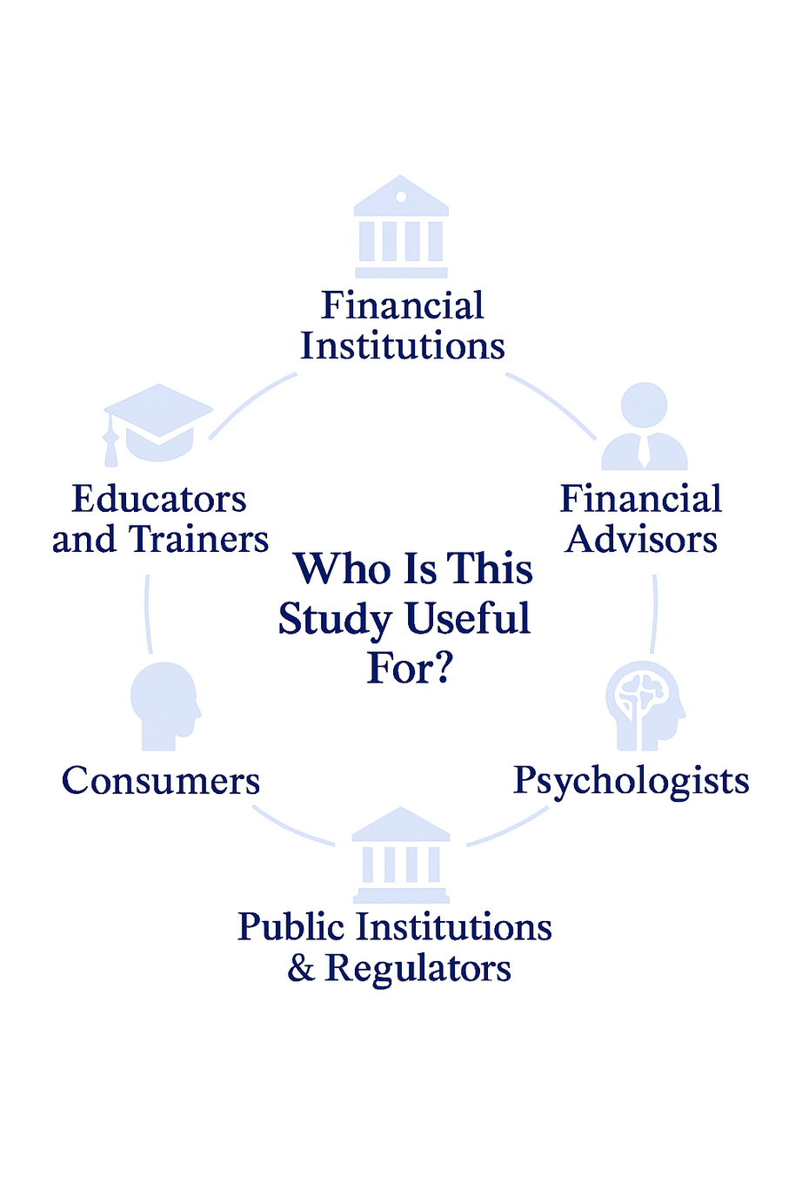
Report
RECIPIENTS
Notes:
The groups is enough. Put psychologists after Advisors

Slide 22
Definition of
FINANCIAL HEALTH
The study adopted a definition of financial health as a state in which:
- You feel you are in control of your current finances and your monthly and annual budget,
- You are able to cope with unexpected major expenses,
- You meet your financial goals according to plan,
- You have the financial freedom to make decisions that allow you to enjoy life.

Slide 23

Financial Health of Europeans:
SELF-EVALUATION
4.3
from 1- very bad to 7- very good
Notes:
The main message should be the avarage evaluation of health. Out of reach can be a subinsight

Slide 24
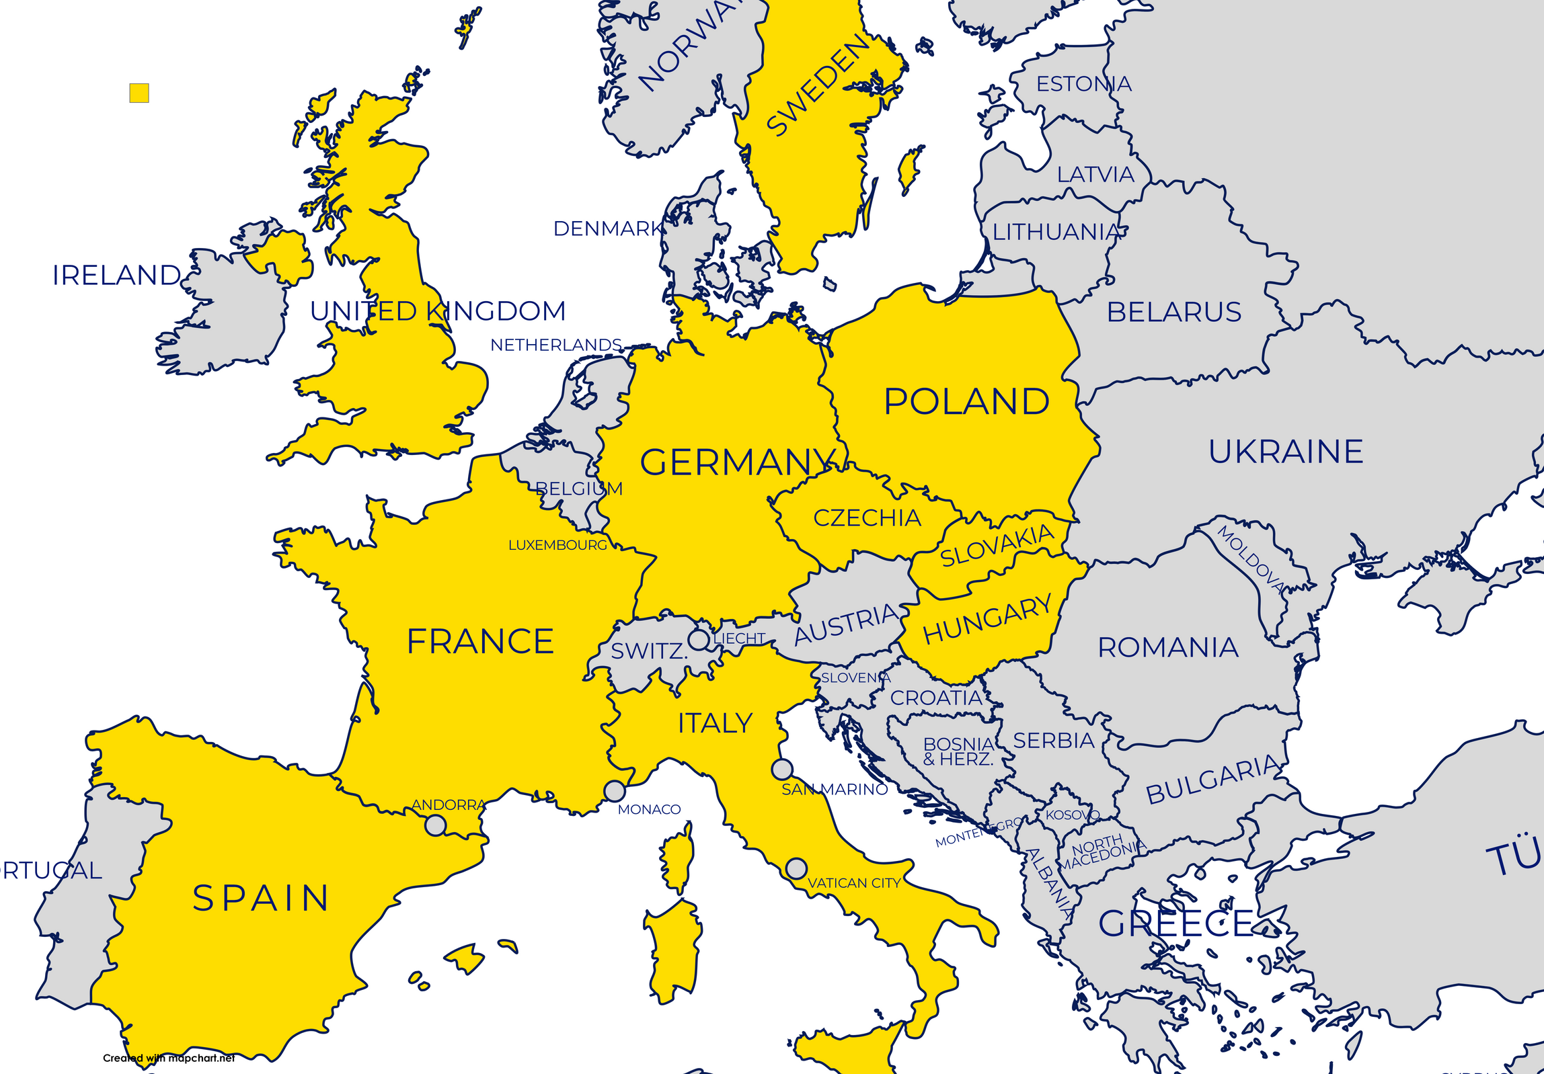
THE MAP
4.25
OF EUROPEANS’ FINANCIAL HEALTH
4.51
How would you rate the state of your financial health?
4.61
4.41
4.39
4.33
3.92
4.2
4.14
4.26
Notes:
Perhaps we should call it MAIN OUTCOME or THE MAP OF FINANCIAL HEALTH IN EU

Slide 25


KEY FINDINGS
Financial Health Is Highly Valued, Yet Feels Out of Reach
Strong Connection Between Financial Health and Mental, Physical and Social Well-Being
Financial security as the foundation for financial health
Perceived Security Varies Across Europe
Most Europeans Meet Only Basic Financial Needs
Limited Financial Control & Budgeting Practices
Major Gaps in Investment & Retirement Knowledge and Behaviour
Major Gaps between Goal Setting and Implementation
High Motivation to Learn
Notes:
Plenty to do, but how. Before passing it over to Alexandra I want to share the very fresh insights of how we want to go forward, with the motivation that if we want to improve we need to measure. Premier disclousure of the financial health index

Slide 26


EUROPEANS’ PERCEPTION OF
FINANCIAL HEALTH
  High Value, Low Fulfillment: Although 86% of Europeans consider financial health important, only 15% feel financially free. Most (83%) meet only basic financial needs.
  Aspirations vs. Reality: While 78% believe financial health is achievable, only 48% find it easy to attain. One-third think it's reserved for the wealthy or financially educated.
  Confidence & Disparities: Less than half feel financially secure short or long term. Confidence varies by country—higher in Germany, Spain, and Sweden; lower in Hungary and Slovakia.

Slide 27

Advisor
BEST PRACTICES
Notes:
I would put the key findings hers before recommendations

Slide 28
How Can Advisors Help?
BEST PRACTICES
💡 Encourage Clients to Get Holistic Advice- No matter if they come for insurance or mutual funds, have them fill out a questionnaire at home and advocate for the importance of holistic planning.
🎯 Advocate for Financial Health – which can and should be pursued by every individual. Start by helping the client define their objectives, then build a plan, then follow it.
📊 Emphasize Retirement Planning – Every young person in Europe needs to worry about the future of Pillar 1 pensions. Help build this consciousness and provide advice.
.

Slide 29
How Can Advisors Help?
BEST PRACTICES
💳 Recommend Financial Literacy Tools & Platforms – Encourage your clients to do some self-learning and come back with questions.
❤️ Address Emotional Triggers - Recognize that money evokes strong emotions. Include stress management and communication strategies in your advisory work.
💳 Remember the Code of Ethics – The CII Code of Ethics (as well as the EFPA one) will guide you in your professional decisions. Ethical decision-making can be trained. Look out for tools and trainings to learn to identify and handle ethical dilemmas in your practice

Slide 30
From the Advisor’s Handbook
10 QUESTIONS
What is the time horizon for your investments and/or for this investment?
When will you need to dispose of your money?
What approximate amount do you have available to save and invest?
What purpose do you have for your money? What do you save/invest for?
Experience: either personally or through an advisory/portfolio management contract, how many years have you been operating in the financial markets (stocks, investment funds, ETFs, bonds)?

Slide 31
From the Advisor’s Handbook
10 QUESTIONS
What training and experience do you have in the investment world? Do you have any positive or negative experience to highlight?
What negative return can you bear, that doesn’t keep you awake at night and result in you selling?
Are you saving for retirement?
Is owning a home a priority? Are you considering property investment?
What percentage would you allocate to ESG investment?

Slide 32

FINANCIAL HEALTH
IS OUR COMMON GOOD
LET’S WORK TOGETHER
TO IMPROVE FINANCIAL HEALTH IN EUROPE
Notes:
Let’s put it on the agenda of public institutions, financial instituions, NGOs and of individuals.

Slide 33

THANK
YOU
  info@efpa-eu.org
  Sq de Meeus 35, Brussels
  www.efpa-eu.org

