Slide 1

Celebrity service (discover the gap in your client service you never knew existed)
Geoff Ramm

Slide 2

PFS
@GEOFFRAMM

Slide 3


Slide 4


Slide 5
@GEOFFRAMM

Slide 6
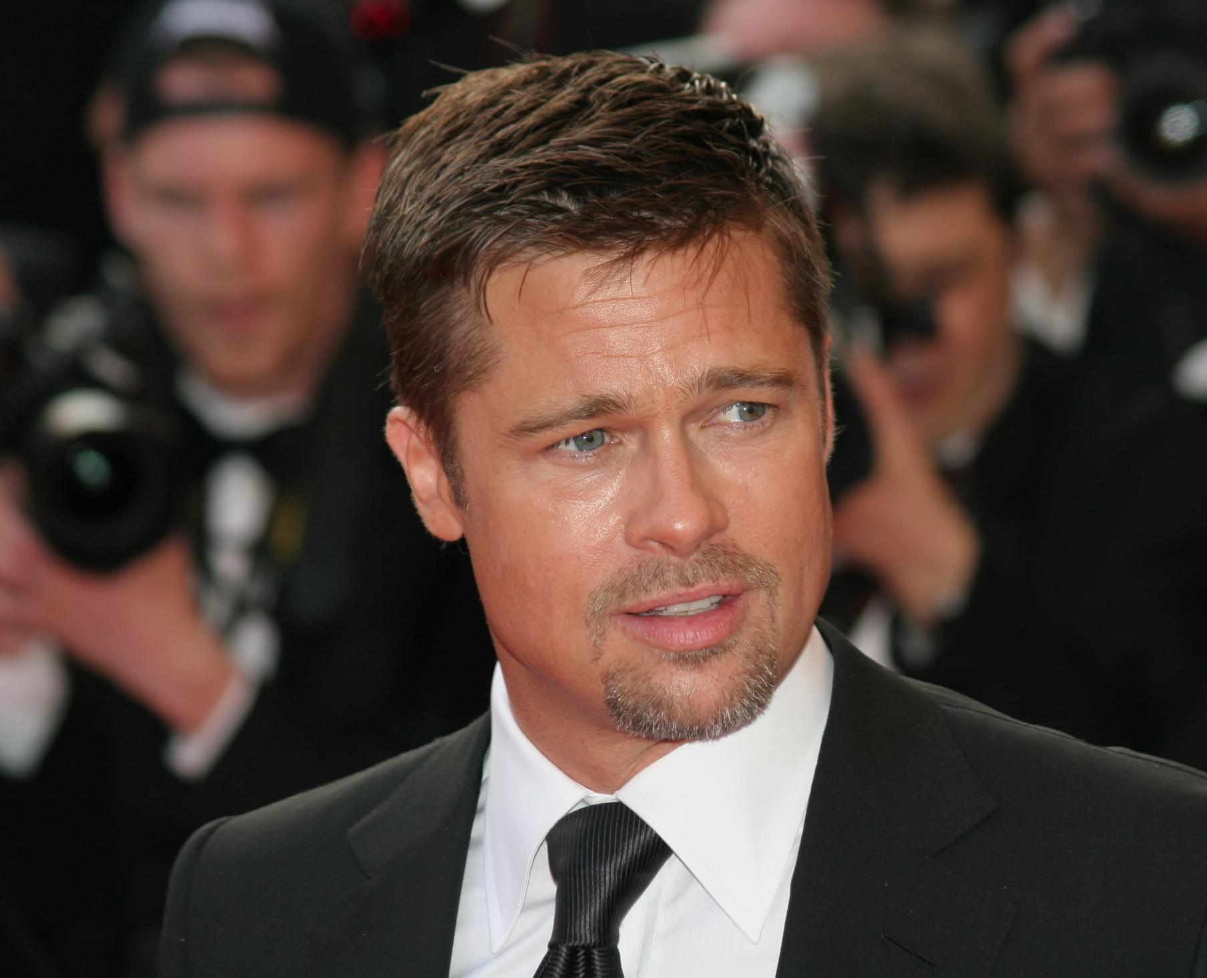


Slide 7


Slide 8
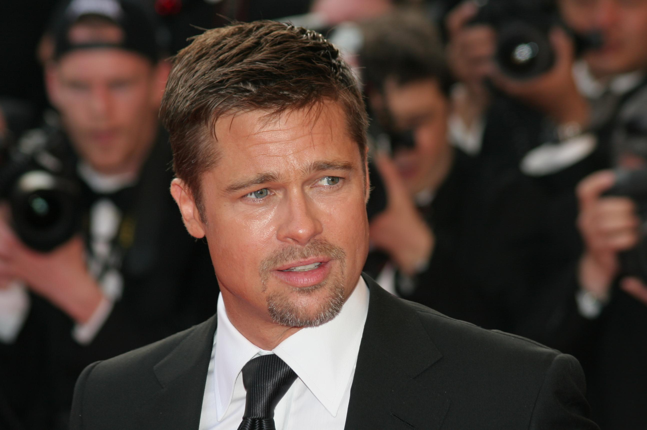

Slide 9


Slide 10
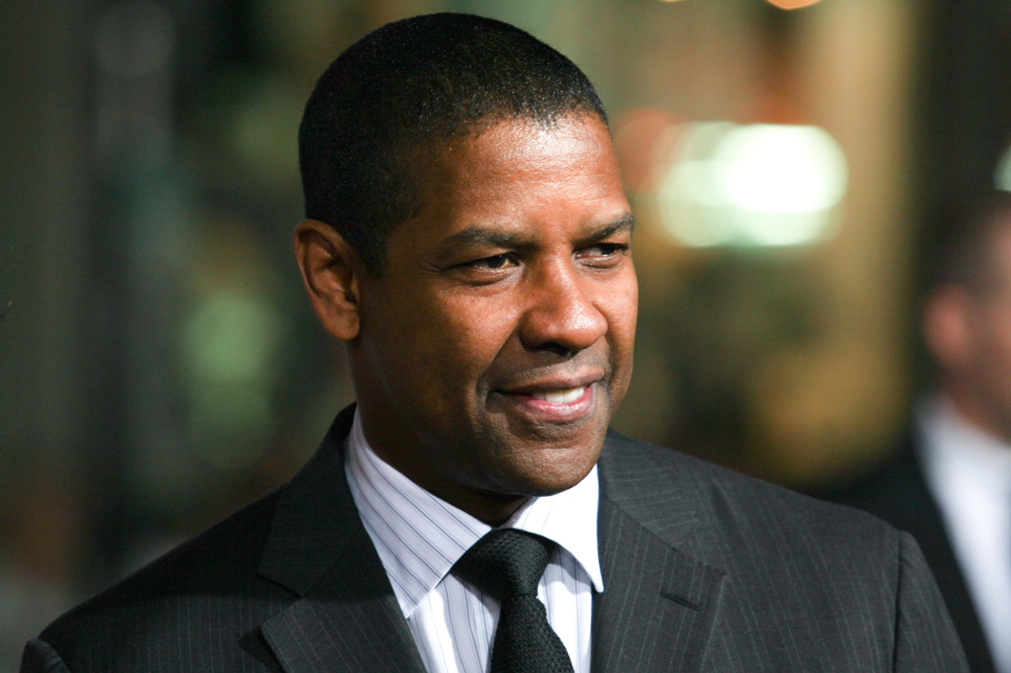

Slide 11


Slide 12


Slide 13


Slide 14


Slide 15
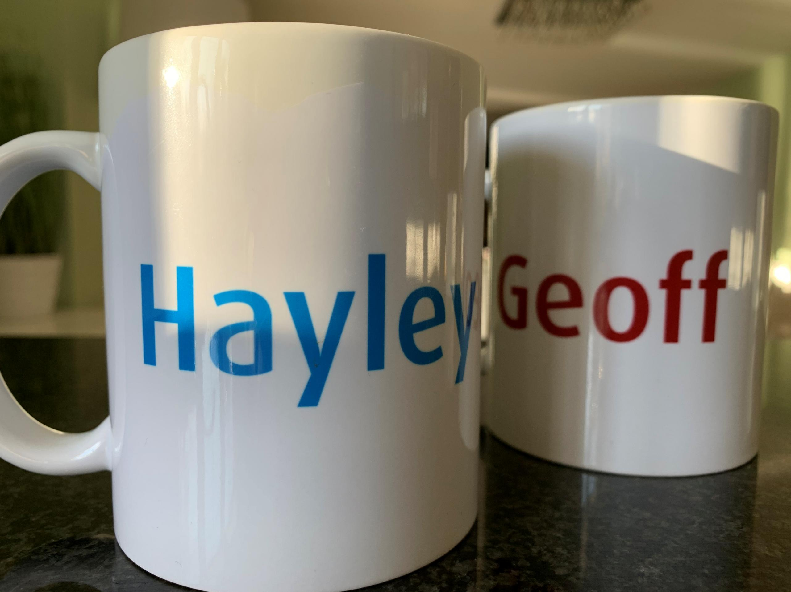

Slide 16


Slide 17


Slide 18


Slide 19


Slide 20


Slide 21


Slide 22


Slide 23


Slide 24
