Slide 2

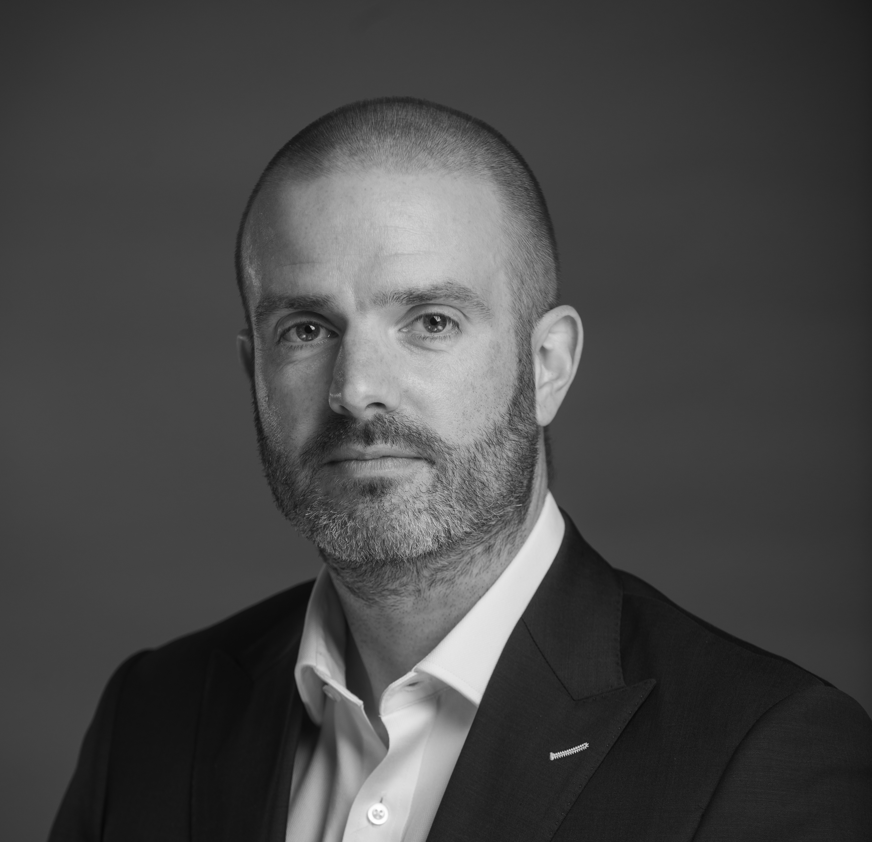
Breaking the Mould: The Human Edge in a Tech-Driven Era
Abraham Okusanya
Timeline
Matt Pitcher
Altor Wealth

Slide 3
Breaking the mould:
The human edge in a tech-driven era
Abraham Okusanya & Matt Pitcher

Slide 4
Learning Objectives
See how technology can transform advice delivery and client value.
Explore what clients really pay for in a tech-enabled world.
Learn strategies for scaling your firm and attracting diverse talent in the AI era.
HARNESS TECH & AI
RETHINK FEES & MODELS
GROW SMARTER

Slide 5
Thank you!

Slide 6
TIMELINE
50 Liverpool Street,
London, EC2M 7PY
0203 427 5467
Timeline Planning is a product of Timelineapp Tech Limited. Registered in England. RC: 11405676. Timeline Portfolios is part of Timeline Holdings Limited (Company number 13266210) incorporated under the laws of England and Wales, and operates under the wholly owned regulated subsidiary Timeline Portfolios (Company number 11557205), which is authorised and regulated by the Financial Conduct Authority (firm reference number 840807).
This document has been created for information purposes only and has been compiled from sources believed to be reliable. None of Timeline, its directors, officers or employees accepts liability for any loss arising from the use hereof or reliance hereon or for any act or omission by any such person, or makes any representations as to its accuracy and completeness. This document does not constitute an offer or solicitation to invest, it is not advice or a personal recommendation nor does it take into account the particular investment objectives, financial situation or needs of individual clients and it is recommended that you seek advice concerning suitability from your investment adviser.
Investors are warned that past performance is not necessarily a guide to future performance, income is not guaranteed, share prices may go up or down and you may not get back the original capital invested. The value of your investment may also rise or fall due to changes in tax rates and rates of exchange if different to the currency in which you measure your wealth.

